Slide 1
Early Childhood Education and Care Department
Cabinet Secretary Elizabeth Groginsky
SFSP Meals Counts and Claims
Notes:
Acknowledge: Governor, Dr. Scrase, Sec. Stewart
Thank you, Secretary Stewart – and thank you, Governor, for the chance to share an update on child care and other early childhood programs in New Mexico.
NEXT SLIDE

Slide 2
MEAL COUNTS AND CLAIMS

Slide 3
ORGANIZATION OF MEAL COUNT RECORDS
Meal count forms must be completed for every meal service at every site and maintained for review.
Keep meal count records organized
By the meal type
By the day, from newest to oldest
By the month
Notes:
During current COVID-19 operations it is common to combine two meals at one meal service to limit contact with participants. If so, meal count forms must be completed for both meal types (2 forms).

Slide 4
MEAL COUNT BASICS
Meal count form 6.4
The official record of meals served – serves as an invoice for payment
When serving multiple types of meals keep separate meal counts for breakfast, lunch and supper
Closely review daily meal count forms before they are entered in EPICS
Most discrepancies result from 6.4 forms not being properly reviewed prior to inputting to EPICS
Notes:
count meals at the point of service, On March 25,2020 USDA announced a nationwide waiver to allow parents/guardians to pick up meals for children. Have a plan and maintain accountability and program integrity. Provide a plan to the state agency for the parent pick up. Example: ask the parent(s) how many children live in the house

Slide 5
MEAL COUNT BASICS
Prior to input into EPICS look for:
Incomplete forms
No day or date indicated
Meal type not indicated
No Site Supervisor signature
Evidence of meals not being counted at the point of service (POS) – examples given
Questionable claiming patterns – example given
Evidence of block claiming – definition and example given
Use the slash or tick marks as your guide for the correct number of meals to input into EPICS
The presence or absence of a slash or tick marks on form 6.4 determines the number of meals allowed for reimbursement
Notes:
count meals at the point of service, On March 25,2020 USDA announced a nationwide waiver to allow parents/guardians to pick up meals for children. Have a plan and maintain accountability and program integrity. Provide a plan to the state agency for the parent pick up. Example: ask the parent(s) how many children live in the house

Slide 6
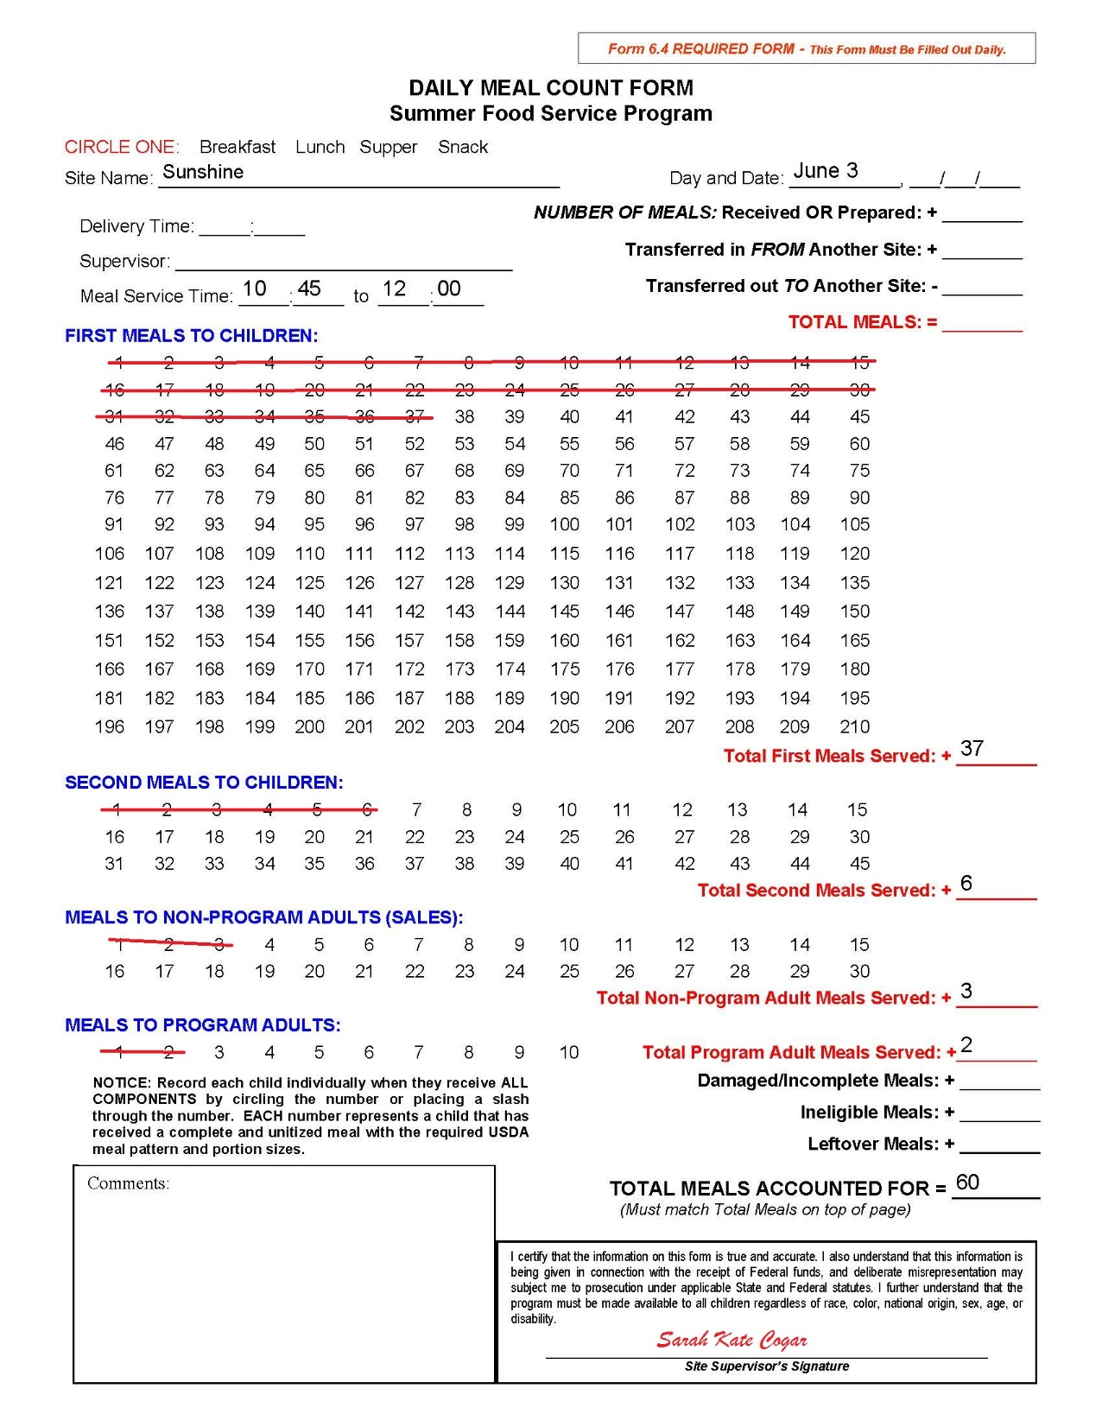

Slide 7
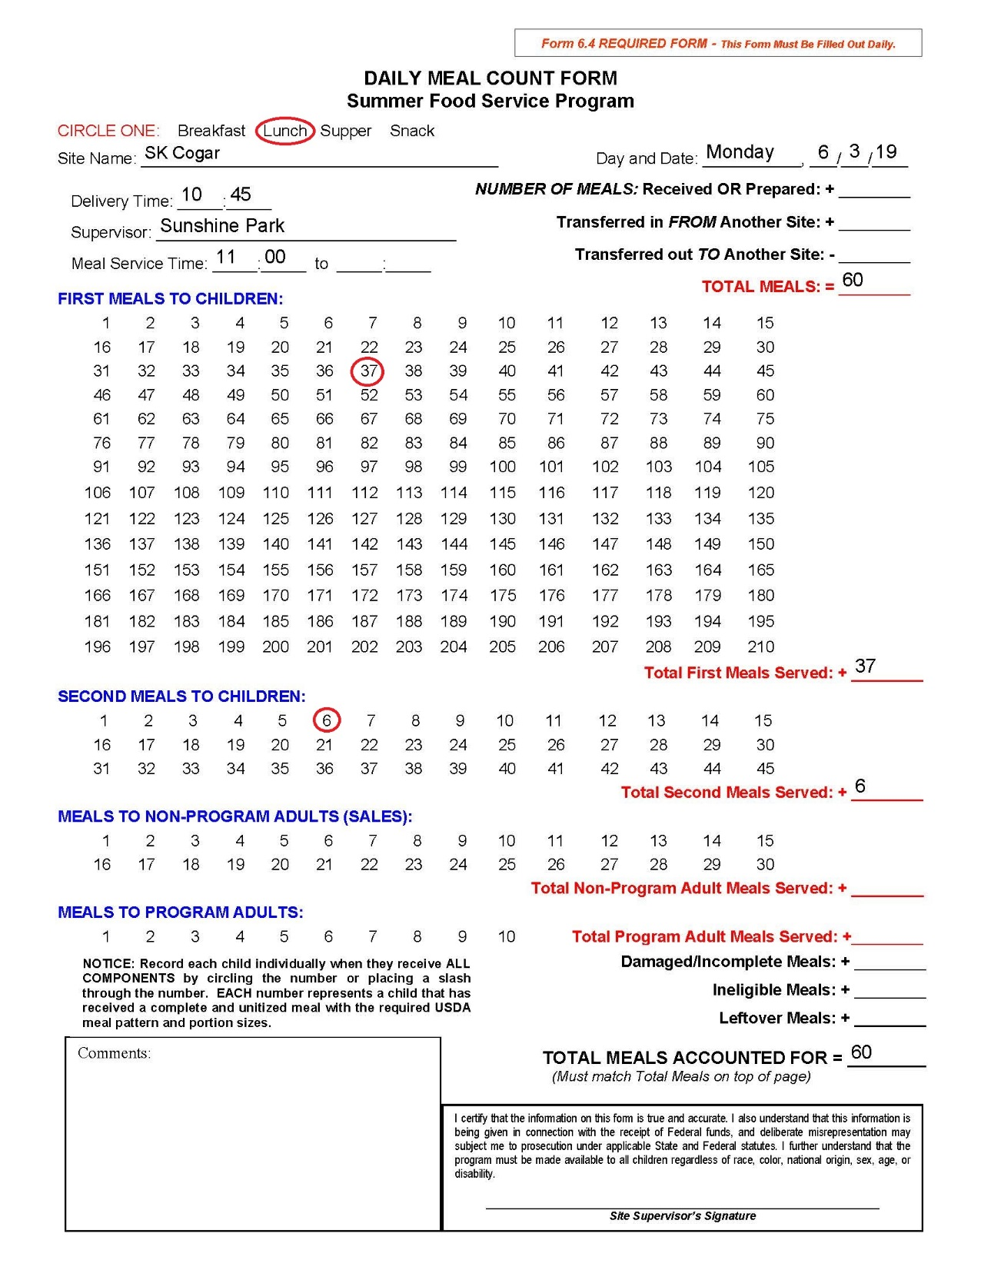

Slide 8
QUESTIONABLE CLAIMING PATTERNS
Meal counts for each day end in a “5”
Meal counts for each day end in a “0”
Notes:
USDA encountered 5’s and 0’s on their review and requested corrective action

Slide 9
BLOCK REPORTING/CLAIMING
Block reporting or claiming is defined as reporting the same number of meals served each day
Example listed on the next page
Notes:
OIG and the federal agents consider this fraud

Slide 10
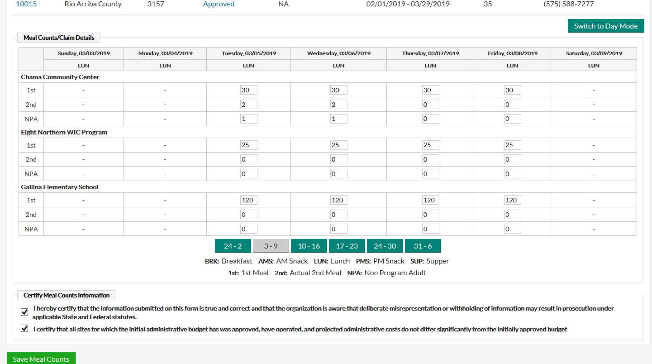

Slide 11
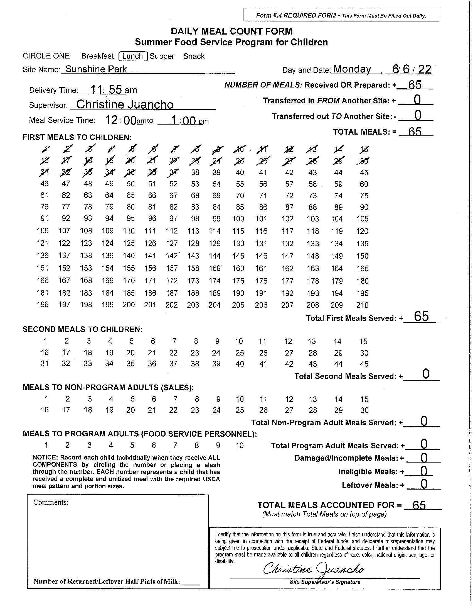
TICK MARKS TELL THE STORY, NOT THE NUMBERS!

Slide 12
SITE CAPACITY ADJUSTMENTS
Each meal site has an approved capacity that reflects the approved level of meal service
Insufficient site capacities will prevent you from entering correct meal counts
CAPs cannot be adjusted upward, once claim is submitted

Slide 13
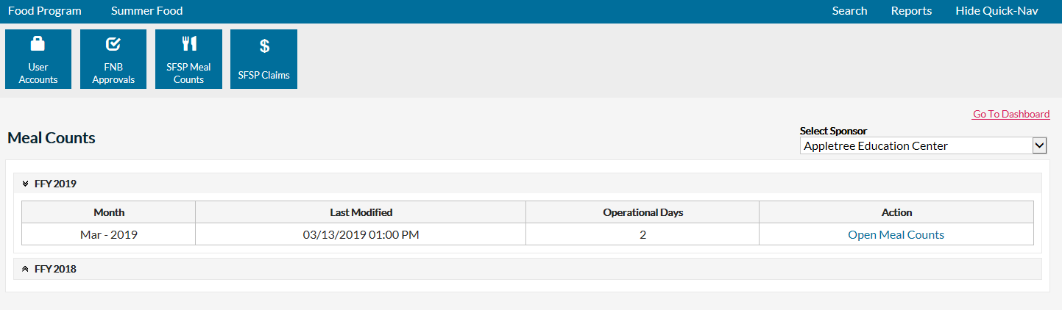
ADJUSTING MEAL COUNTS IN EPICS
Example: After claim submission
75 1st eligible breakfast meals was entered in EPICS
The correct number of 1st eligible breakfast served was 78
The correct adjustment is a positive 3

Slide 14
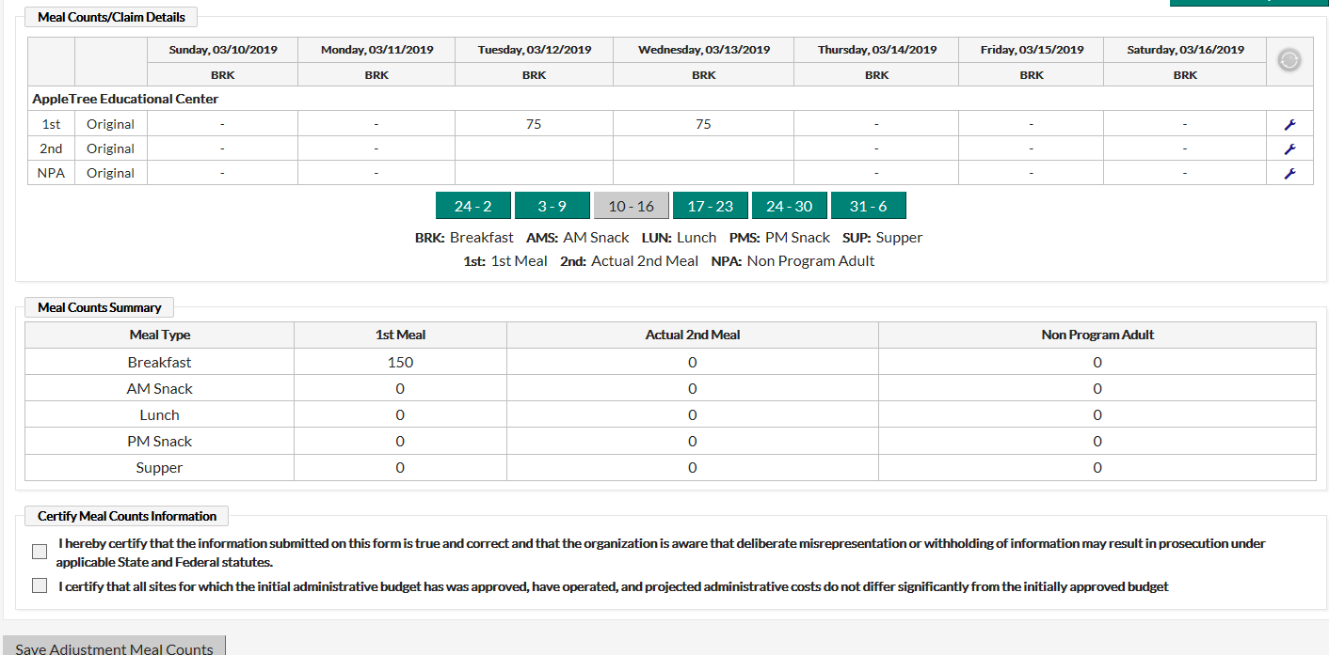

Slide 15
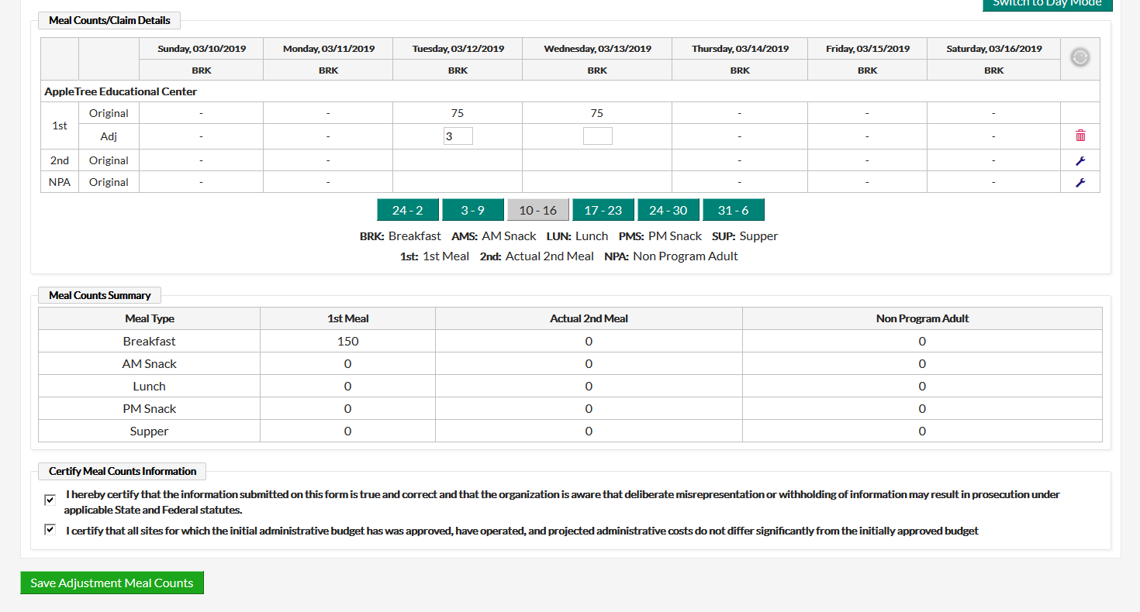

Slide 16
CLAIMS IN EPICS
Reminders
Claims are being completed as meal counts are being entered
Claim submission is a separate process

Slide 17
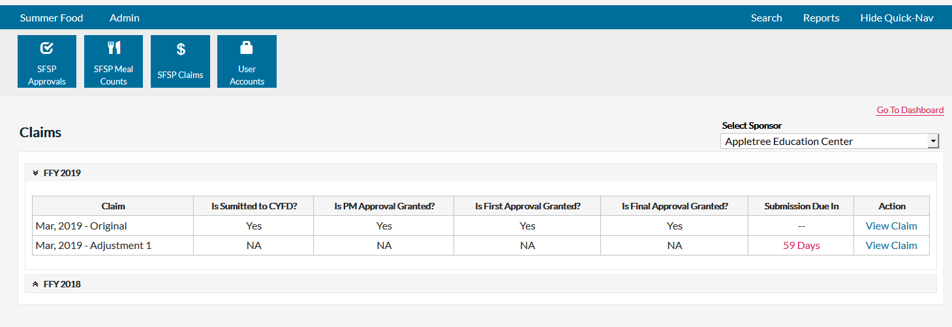

Slide 18
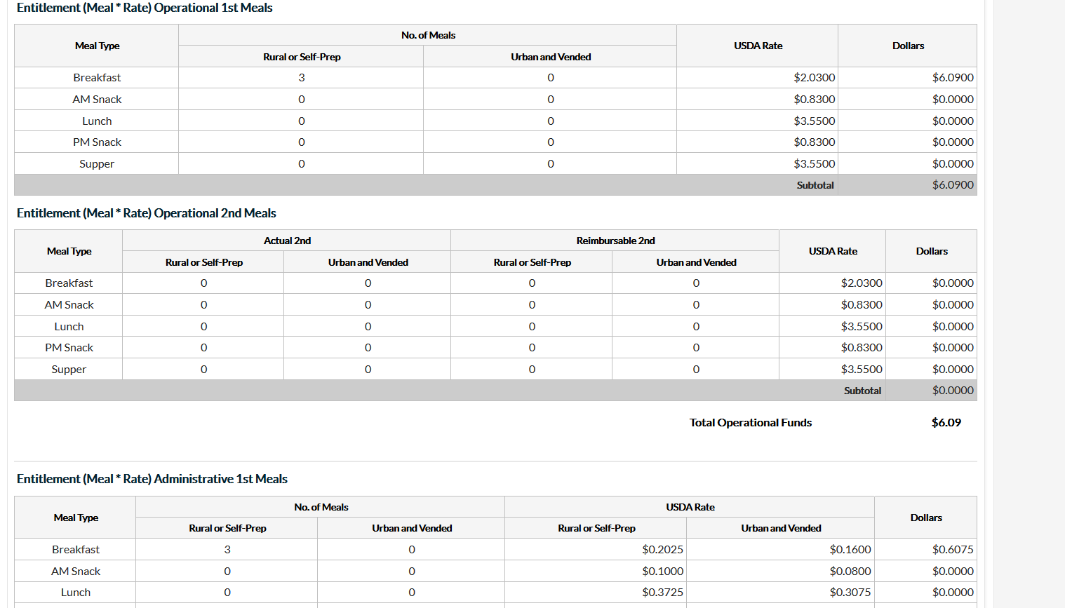
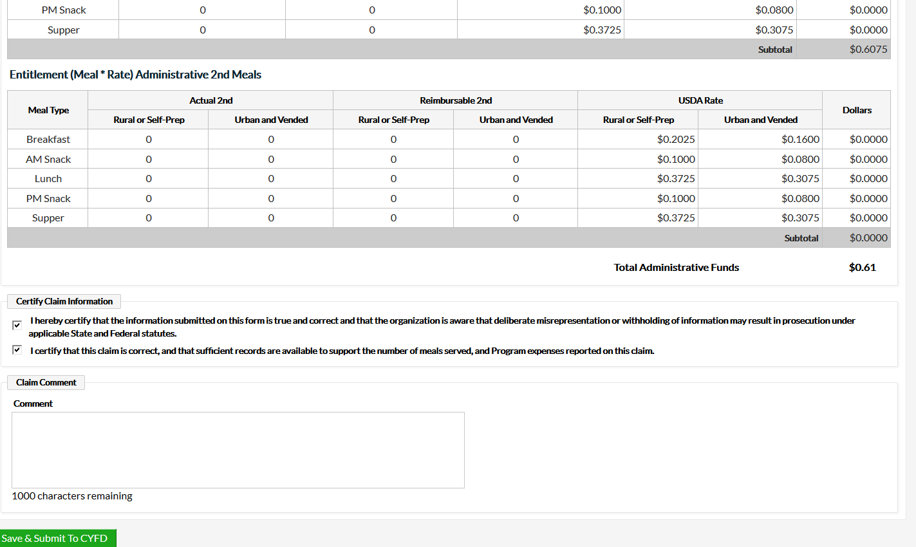

Slide 19
More information about the New Mexico Early Childhood Education and Care Department— Programs for Parents and Professionals: nmececd.org
Program Resources for SFSP Sponsors–
summerfoodnm.org/sponsors/program-resources

