Slide 1


Early Childhood Education and Care Department
Cabinet Secretary Elizabeth Groginsky
Meal Pattern
Notes:
Acknowledge: Governor, Dr. Scrase, Sec. Stewart
Thank you, Secretary Stewart – and thank you, Governor, for the chance to share an update on child care and other early childhood programs in New Mexico.
NEXT SLIDE

Slide 2

SFSP Meal Pattern Requirements

Slide 3

Training Agenda
Meal Pattern Requirements
Menu Planning
Nutrition Resources
Notes:
Founding Department/Meeting New Mexicans’ Needs During Pandemic
As many of you know, the Early Childhood Education and Care Department was created last year and officially launched on July 1, 2020. This was a strange time to launch a new Cabinet agency, but throughout this pandemic, our staff has worked doubly hard to stand up the new department and meet the needs of children, families, and communities across our state.
NEXT SLIDE

Slide 4

2020-2025 Dietary
Guidelines for Americans
Aligns with
SFSP meal
pattern
“Make Every Bite Count” by:
Limiting added sugars to less than 10% of calories/day for ages 2 and up; avoid added sugars for infants and toddlers;
Limiting saturated fat to less than 10% of calories/day starting age 2;
Limiting sodium intake to less than 2,300 mg per day (one tsp. or less);
Develop healthy eating habits by:
  controlling portion size,
  eating a variety of foods from all the Food Groups (whole fruits and vegetables, variety of whole grains, lean proteins, dairy products, small amount of healthy fats)

Slide 5
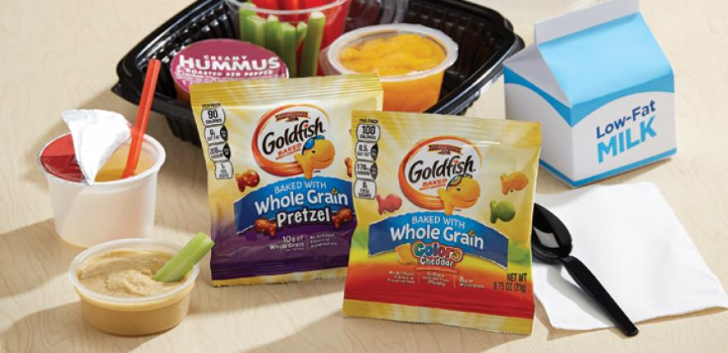
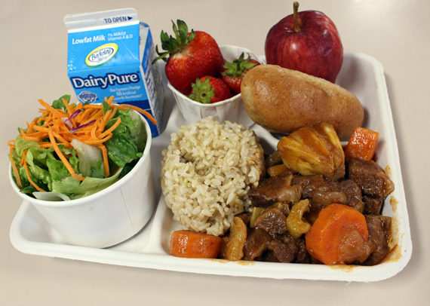
SFSP Meal Pattern

Slide 6

Meal Pattern
Options
Non-School Sponsors will follow:
  Summer Food Service Program meal pattern
School sponsors may choose to follow one of the following meal patterns:
  National School Lunch Program (NSLP) and School Breakfast Program (SBP)
  -or-
  Summer Food Service Program

Slide 7
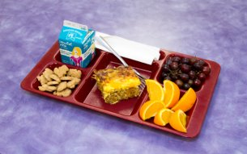
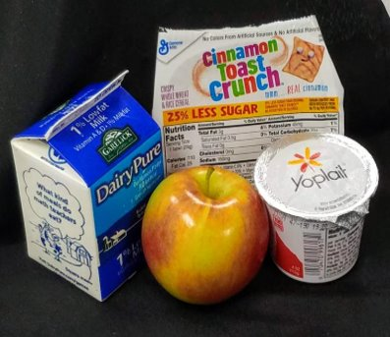
Breakfast
  Milk (fluid, pasteurized)
    1 cup or ½ pint
      All fat content, flavored or unflavored milk reimbursable
      1% or Non-Fat Unflavored (recommended)
      No substitutes for fluid milk such as cheese, yogurt, or other dairy products
  Vegetable and/or Fruit
    ½ cup
  Grains
    1 serving/1 oz equivalent
    Whole Grain-Rich/Enriched
  Meat/Meat Alternate (Optional)

Slide 8

Low-Sugar Cereals (Recommended)

Slide 9
Low-Sugar Cereals (Recommended)

Slide 10
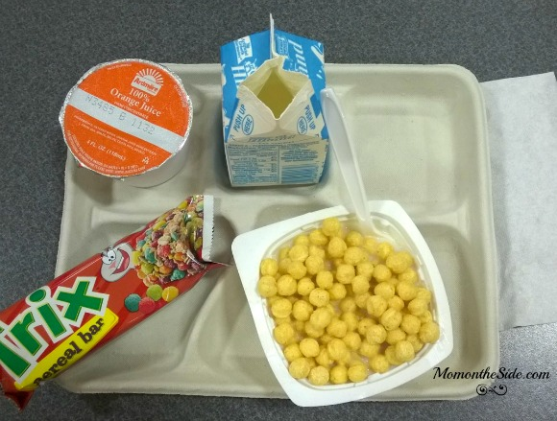
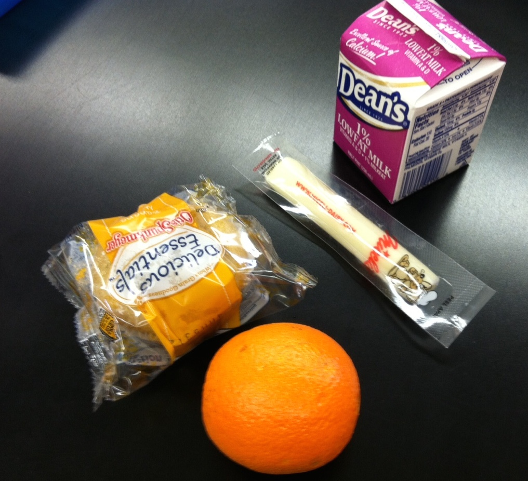
Breakfast
Total milk waste increased 12% when juice offered
High Sugar/Milk Consumption Decreased
Lower Sugar/Milk Consumption Increased
Notes:
Total milk waste increased 12% when juice was offered

Slide 11
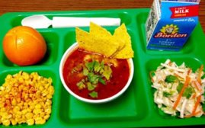
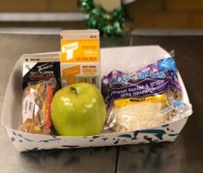
Lunch/Supper
  Milk (required)
    1 cup (8 oz.) or ½ Pint
  Meat/Meat Alternate
    2 ounces
  Vegetable and/or Fruit
    ¾ cup total (½ cup + ¼ cup)
      ½ cup fruit + ¼ cup vegetable
      ½ cup vegetable + ¼ cup fruit
      2 or more different vegetables
      2 or more different fruits
  Grains
    1 serving/1 ounce equivalent
      Whole grain or Whole grain-rich (recommended)

Slide 12

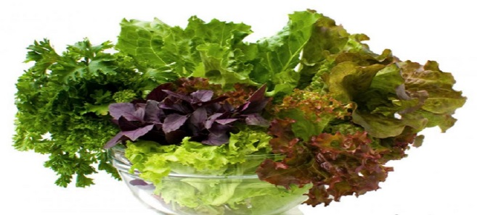
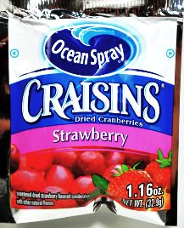
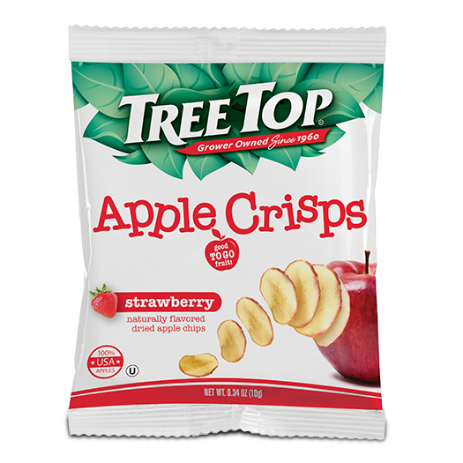
Dried Fruits/Leafy Vegetables
SFSP Meal Pattern Crediting Only
¼ cup dried fruit
= ¼ cup fruit
½ cup raw leafy greens
= ½ cup vegetable
Notes:
1) Make sure there is enough supervision to monitor site to regulate food item taken off site
2) Can only take 1 food item from the meal site
3) Combination items should not be taken offsite = food safety issues (burrito) – not a single food item
4) Sponsors may allow a child to take offsite from his own meal or the “share table” if in compliance with local environmental health regulations and has adequate staffing to monitor

Slide 13
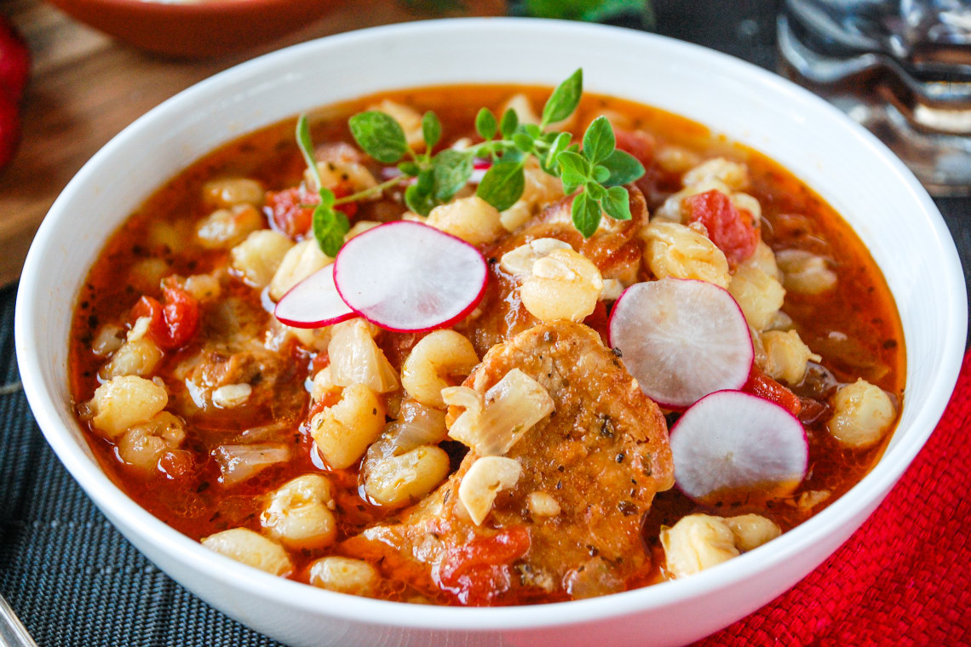
Hominy
  Vegetable (Posole)
  ¼ cup canned, drained hominy =
  ¼ cup vegetable

Slide 14
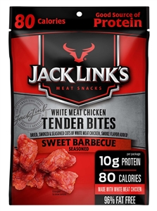
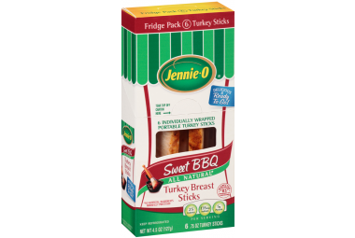
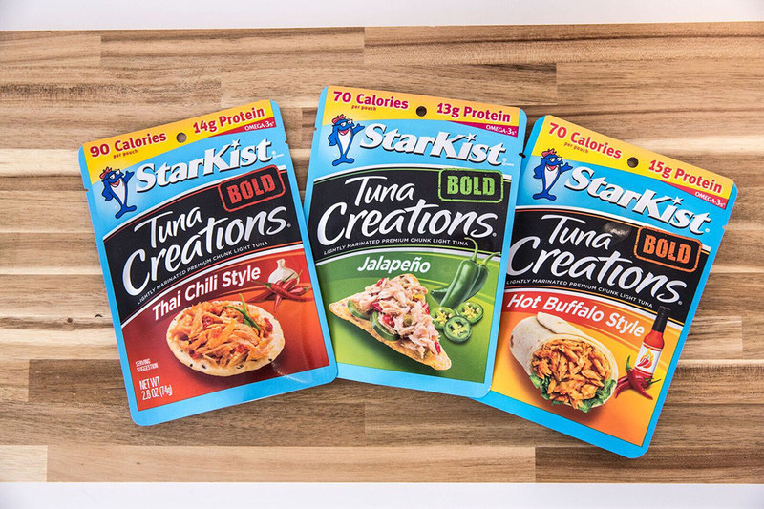
Creditable Meat Products
Dried Meat, Poultry, Seafood
Meals
  Off-Site for Field Trips
  Recommended for Snacks
Nutrition
  High in sodium and saturated fat
Required Documentation
  CN Label
  Product Formulation Statement

Slide 15

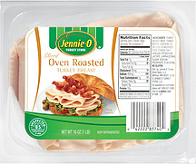
Packaged Luncheon Meats
Documentation required
  CN Label
  USDA Foods Fact Sheet
  Product Formulation Statement (PFS)
Notes:
To be in absolute compliance with USDA SFSP regulations, you should only serve deli meats (preferably lean) that are listed in the FBG or have a CN label. A list of CN packaged deli-luncheon meats is available. Please come see us to get a list if you are in need of recommendations.
Deli meats are not in the FBG because they have no Standard of Identity -
Standards of Identity set specific (and optional) ingredients a food must contain when a product is to be labeled or identified by a common product name.
Deli meats must not contain binders, extenders or by-products. Only turkey, turkey ham, and bologna without binders, extenders, or by-products in FBG.

Slide 16
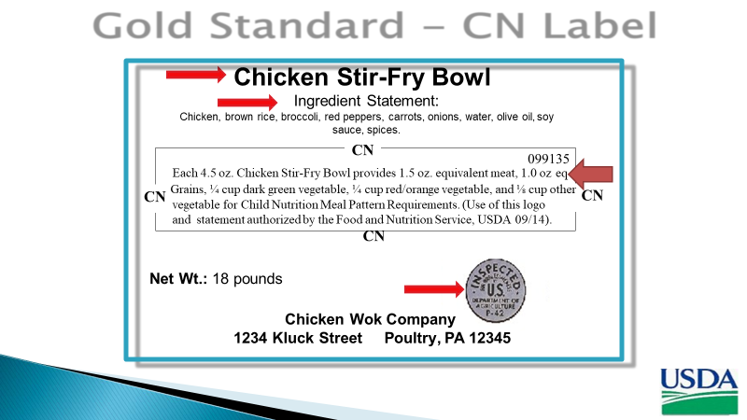

Slide 17
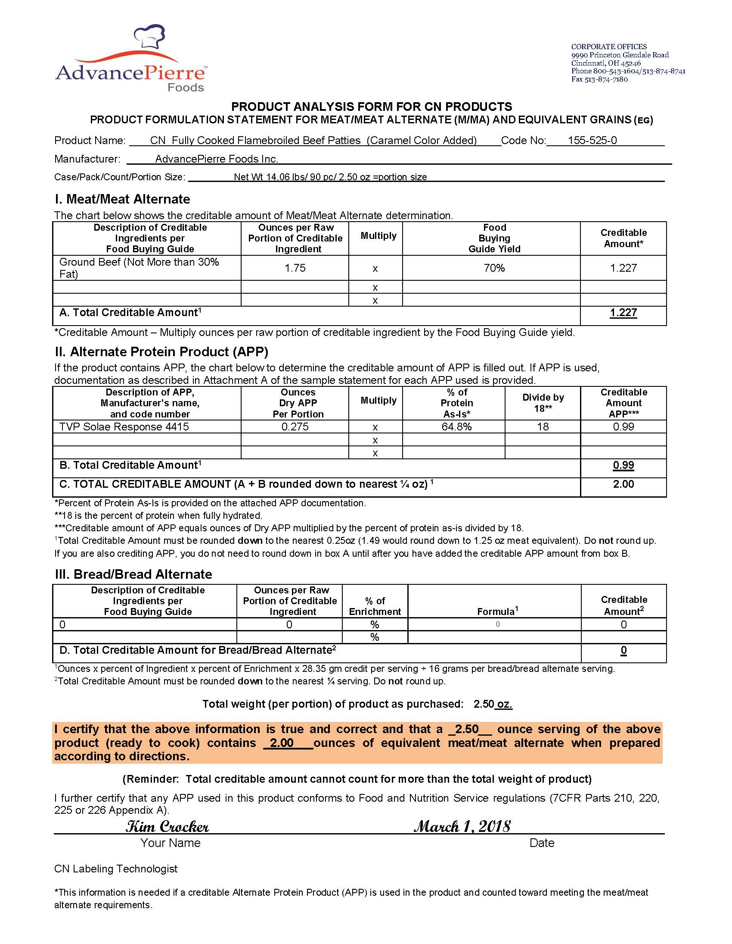
Product Formulation Statement (PFS)

Slide 18
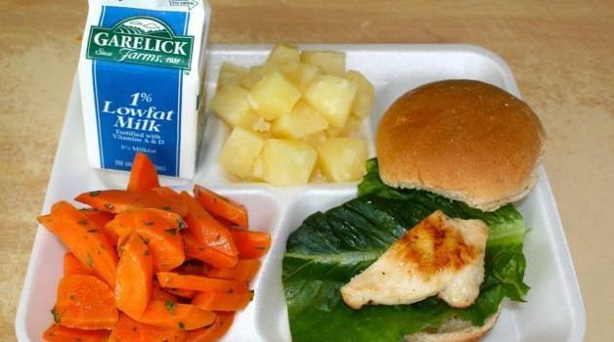
Lunch/Supper
Is this meal reimbursable?
Notes:
This meal is short on the meat/meat alternate food component.

Slide 19
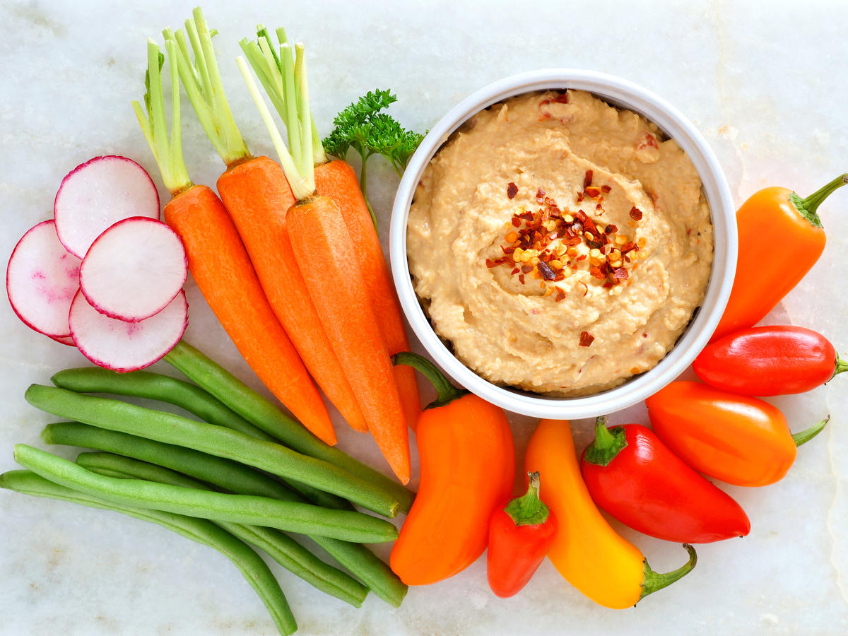
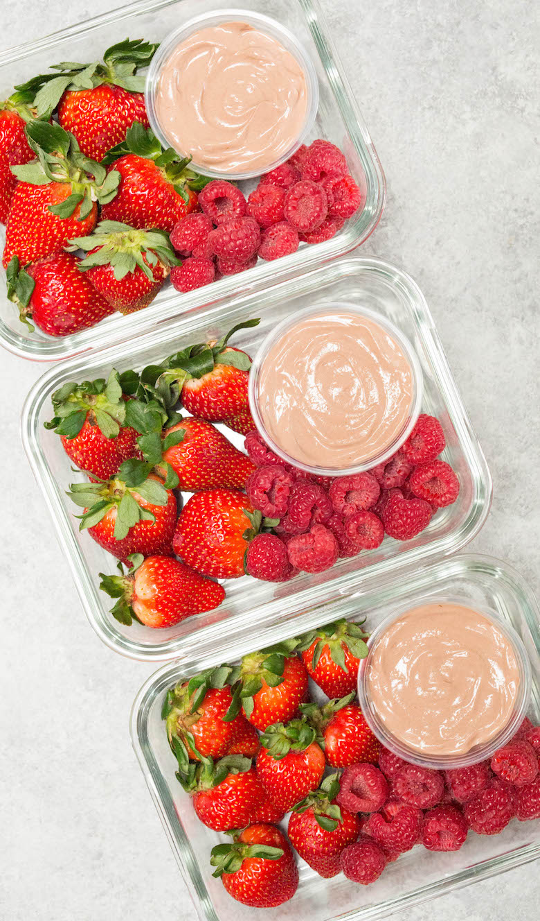
Snack
Serve two or more components:
  1. Milk – 1 cup or ½ pint
  2. Meat/Meat Alternates – 1 ounce
  3. Vegetables/Fruits – ¾ cup
  4. Grains – 1 serving or ounce equivalent
    Whole grain-rich/ enriched
  Example:
    Yogurt (4 ounces) + Strawberries
    Hummus (1/4 cup) + Fresh vegetables (3/4 cup)

Slide 20


Planning for the
Meal Service

Slide 21
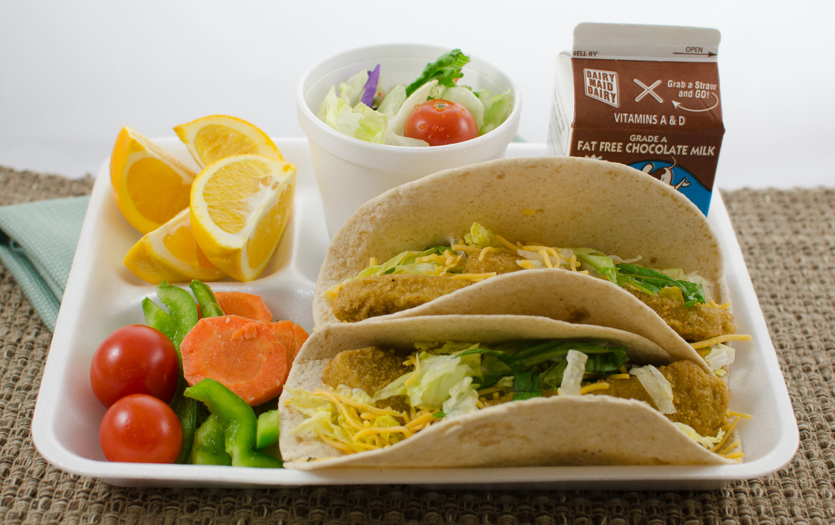
Cycle Menus
Menu Cycle
  2 week (requirement)
  Unitized
  All components packaged together
Food Service Preparation
  Hot or Cold Meals or Both
    Food Safety for preparation & transportation
  Standardized Recipes
    Scratch cooking (best practice)
  CN Label Foods (Keep in binder)
  Shelf-Stable Foods

Slide 22


What Foods Should Be Served?
Creditable/Reimbursable Foods
  Most foods that are basic foods, plain, and without additives
  Foods in the Food Buying Guide for Child Nutrition Programs
  Foods in the USDA’s Food Buying Guide Calculator (and new mobile app) https://foodbuyingguide.fns.usda.gov
  Foods in the New Mexico CACFP Program Food Purchasing & Production Guide
Non-Creditable/Not Reimbursable Foods
  May not be served to meet any part of the CACFP meal pattern requirements
  Are listed as “Other Foods” in Section 5 of the USDA’s Food Buying Guide for Child Nutrition Programs
Notes:
Refer to Handout 2.

Slide 23
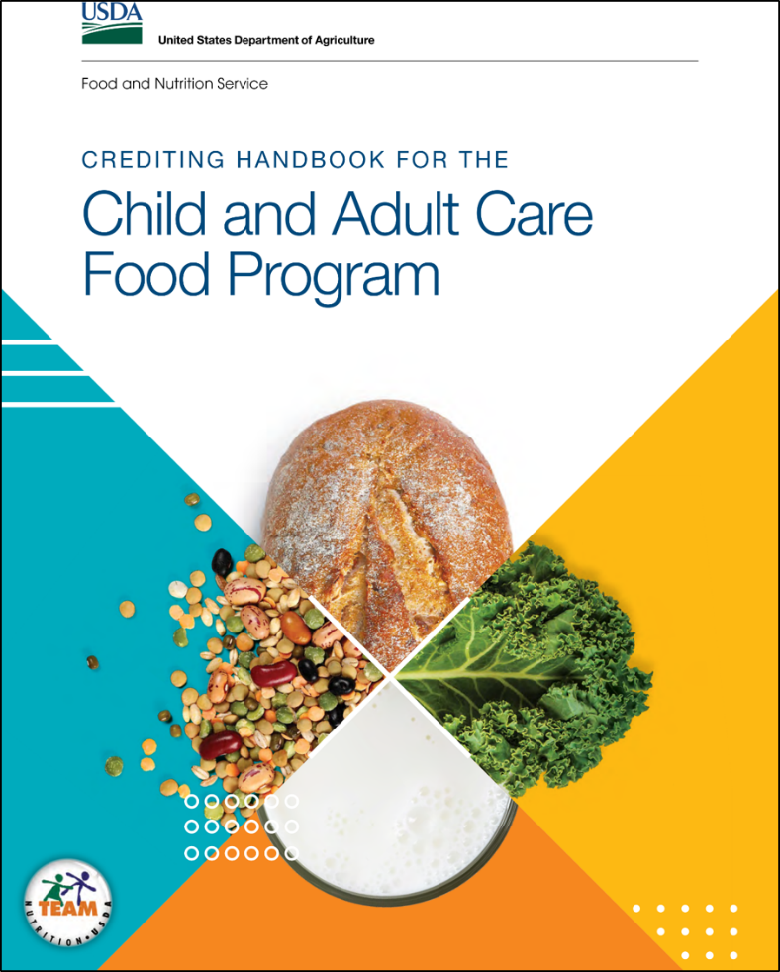

Great Resource – Creditable Foods
CACFP & SFSP
https://www.fns.usda.gov/tn/crediting-handbook-child-and-adult-care-food-program

Slide 24
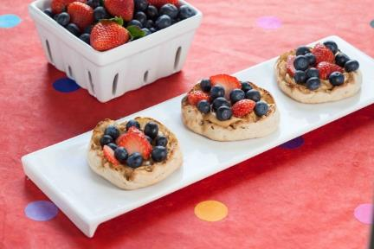
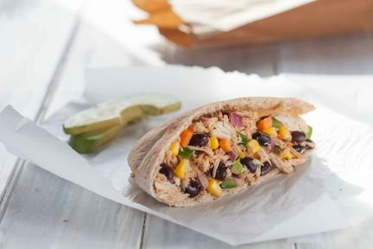
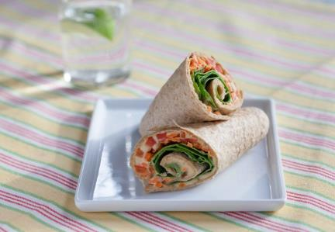
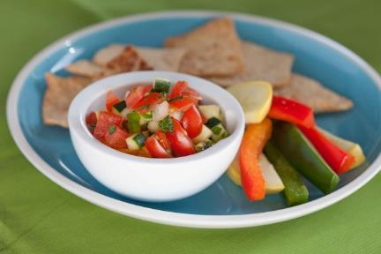
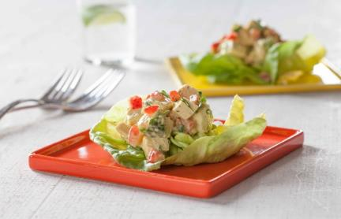
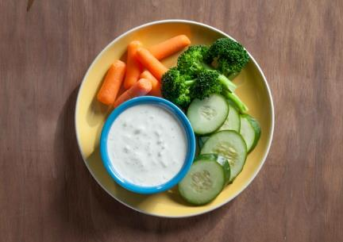
Summer Food, Summer Moves Recipes
Garden Fiesta
Tuna Pockets
Berry Jams Party Bites
Home Run Hummus Wrap
Summer
Vegetable Salsa
Fun Fruity Chicken Salad Cups
Cool Cucumber
Yogurt Dip
Notes:
The Operator’s Activity Guide includes the six chef-developed and kid-approved recipes that are shown on this slide.
These recipes can be prepared as part of a food demonstration. Each recipe also provides tips on how children can help prepare the recipe. The Activity Guide also includes a tasting activity for each theme that encourages children to try new flavors and foods.

Slide 25
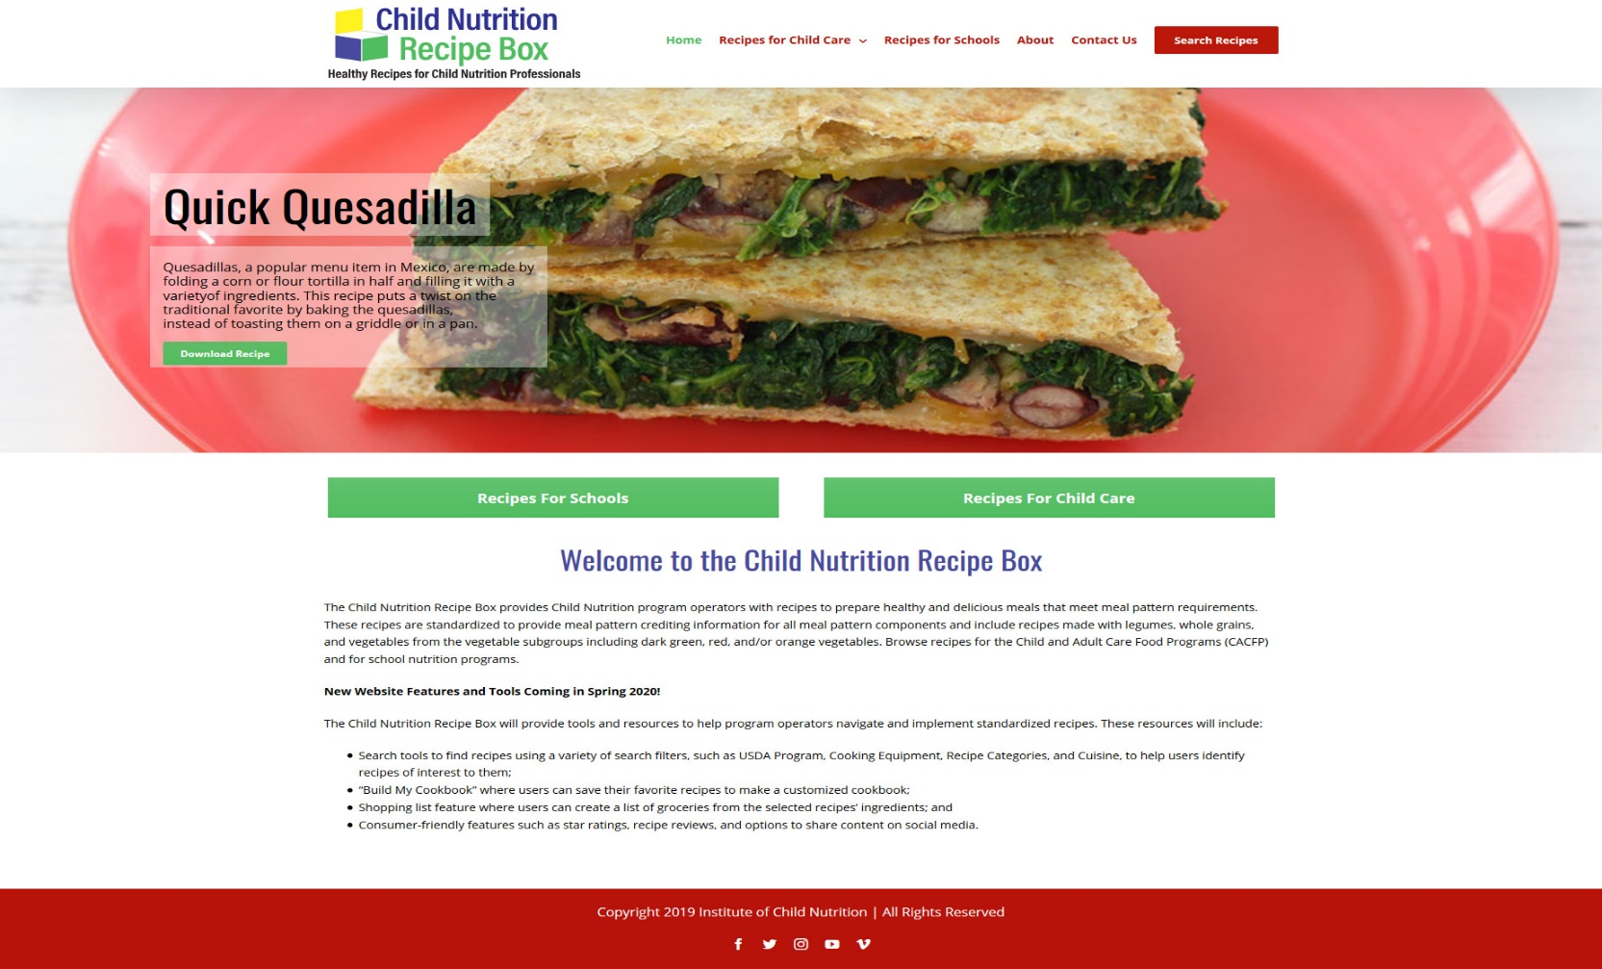
Standardized Recipes
theicn.org/recipes

Slide 26


USDA Memo Updates

Slide 27
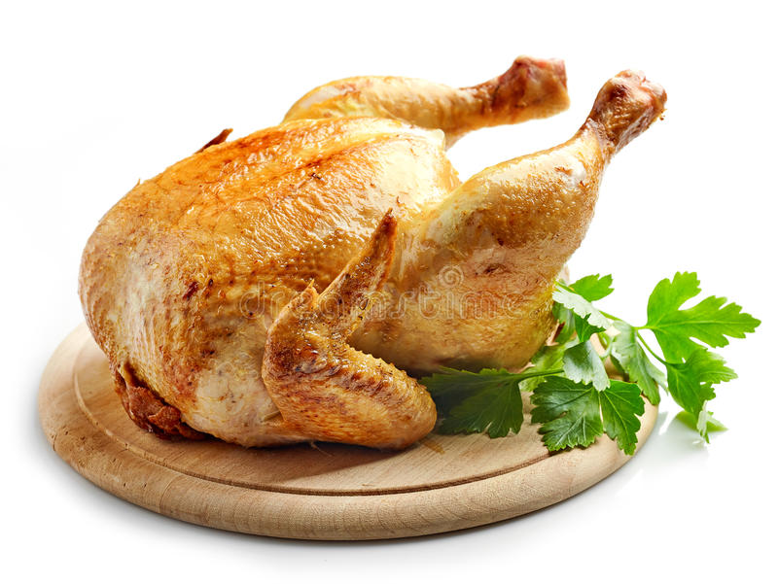
Consolidated Appropriations Act, 2021:
Child Nutrition Programs - SFSP 06-2021
SFSP funds cannot be used to buy raw or processed poultry products from the People’s Republic of China.

Slide 28
Offer Versus Serve
SFSP 01-2019 - Schools Only
Breakfast
  Offer 4 food items, one from each component:
    Milk, fruit & vegetable, grains, meat/meat alternate or fruit/vegetable or grains
    Example: 1% milk, apple slices, whole-wheat toast, sunbutter (nut free)
  Child must take 3 different foods out of the 4 offered
    Milk, fruit & vegetable, grains, meat/meat alternate or fruit/vegetable or grains
    Example: 1% milk, whole-wheat bread, sunbutter (nut free)
Lunch/Supper
  Offer 5 foods from the four food components:
    Milk, fruits & vegetables, fruits & vegetables, grains, meat/meat alternate
    Example: Fat-free milk + green beans + orange slices + whole wheat roll + grilled chicken
  Child must take 3 food components out of the food items offered
    Example: orange slices + whole wheat roll + grilled chicken

Slide 29
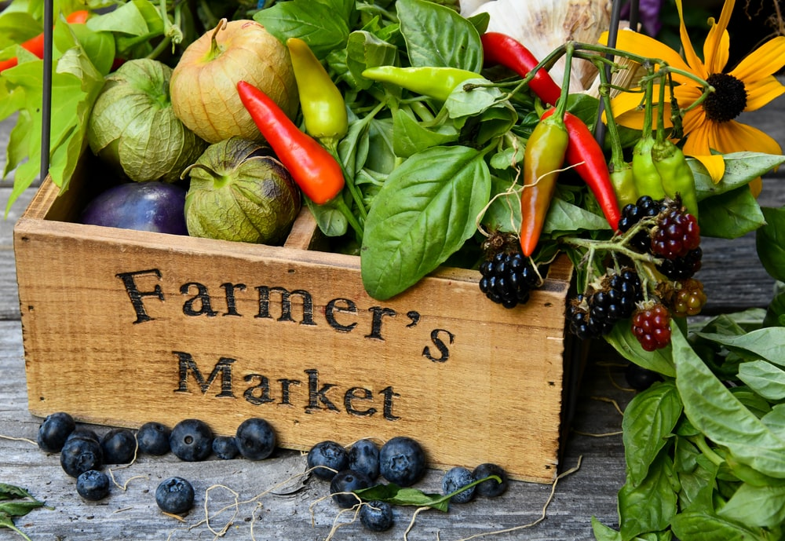
Local Foods/Farm to Summer
SFSP 06-2017
Incorporate local foods and seasonal produce in menu cycle
  DOD Fruits and Vegetables
  Food Vendor/Distributor
    NM Grown Approved Supplier List
  School Garden
  Community Supported Agriculture (CSA) program
    Agri-Cultura Coop
Notes:
Local foods – improve quality and appeal of meals using local products
can improve participation
FSMC and Catering contracts can be amended to include more fresh/local products in meals

Slide 30

Modifications to Accommodate Disabilities
SFSP 10-2017
Required to purchase and supply food substitutions when child has a medical statement
  Foods that cannot be eaten
  Substitutions
  Contact State Agency Nutritionists for Guidance
Notes:
USDA regulations require sponsors to purchase and supply food substitutions or make modifications to the standard meal patterns for meals and snacks served to children whose disabilities restrict their diets. Parent gives copy of med statement to site supervisor who hands it over to sponsor rep.
Sponsors are not expected to make accommodations that are so expensive or difficult that it would cause the sponsor undue hardship.
Meal or food substitutions may be made at a sponsor’s discretion for a child with non-disability medical or other special dietary need. Determinations usually are on a case-by-case basis.
An example is a vegan diet – meal substitutions should be within the meal pattern – cheese stick/PB&J instead of chicken nuggets.

Slide 31
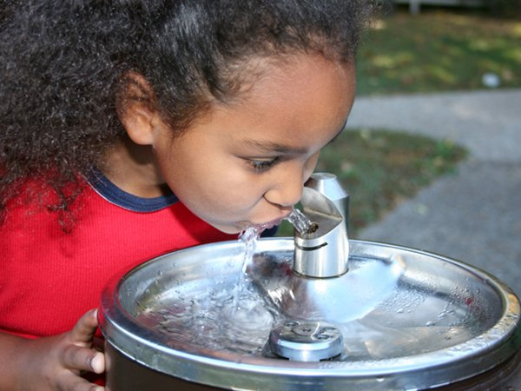
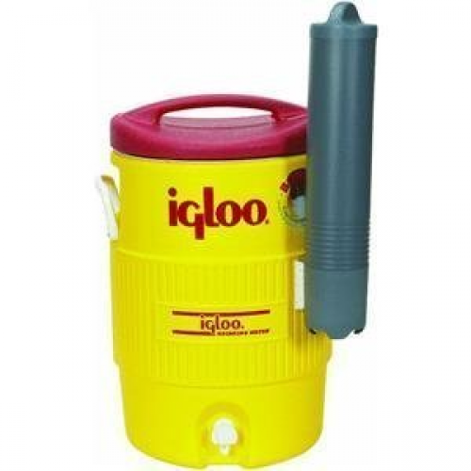

Hot Summer, More Water!
Notes:
1) Not a SFSP requirement but highly recommended if a sponsor has extra funds
2) Plain water is best source.
3) Avoid serving children too much water before and during mealtimes which could decrease food/milk consumption.
4) Make available during meal time especially for snack when either component is not a fluid.
5) Water is not a component

Slide 32


USDA Foods 2022

Slide 33
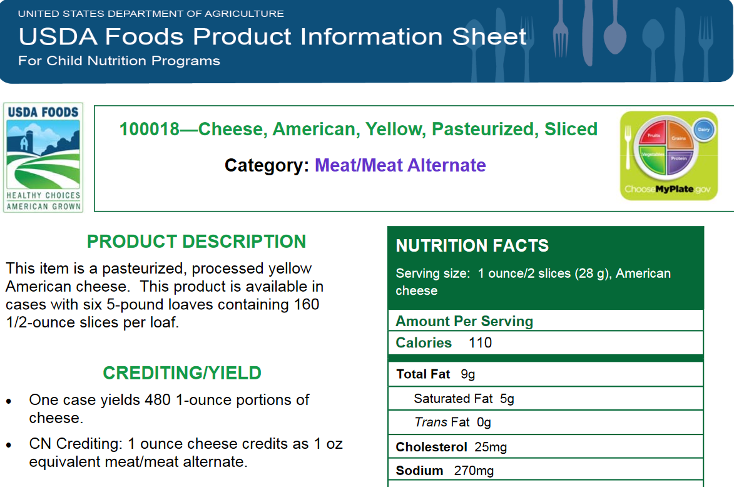
USDA Foods - American Cheese
100018-American, Yellow, Sliced
Crediting Yield
**2 slices cheese (28 grams)
= 1 ounce meat alternate

Slide 34
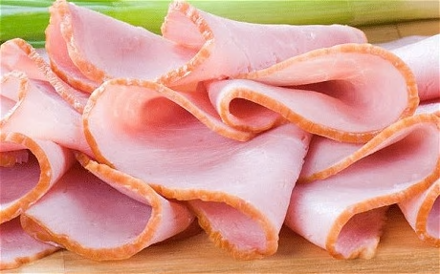
USDA Foods- Ham, 97% Fat Free
100187—Cooked, Sliced
Crediting Yield:
1 slice ham (1.22 oz.)
= 1 oz. meat

Slide 35
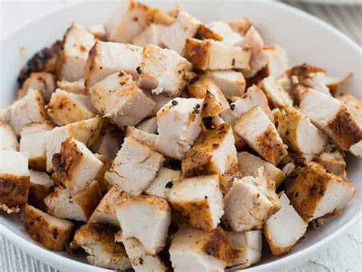
USDA Foods- Chicken
100101—Cooked, Diced, Frozen
Crediting Yield:
1 ounce diced chicken
= 1 ounce meat

Slide 36
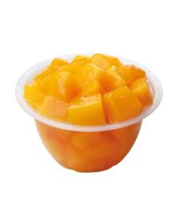
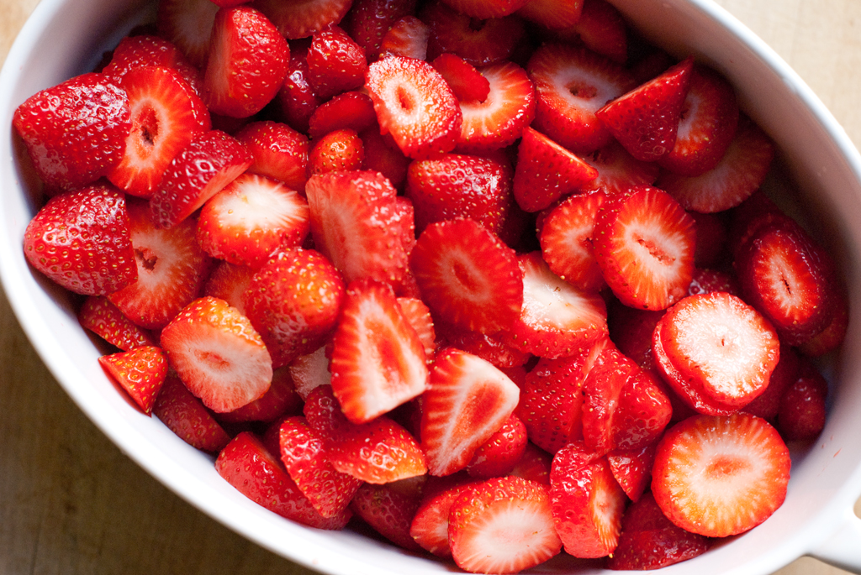

USDA Foods- Fruits
100241 - Peaches, diced, cups, frozen
  one 4.4-oz. cup of peaches = ½ cup fruit
110651 – Orange juice, cups, frozen
  One 4-oz. cup of orange juice = ½ cup fruit
100256 – Strawberries, diced, cups, frozen
  one 4.5-ounce cup of strawberries = ½ cup fruit

Slide 37

Food Safety Resources
Notes:
Team Nutrition has developed several resources to help support different meal service options available during the coronavirus (COVID-19) pandemic. These resources are available on Team Nutrition’s COVID-19 Resources webpage (fns.usda.gov/tn/covid19-resources).

Slide 38

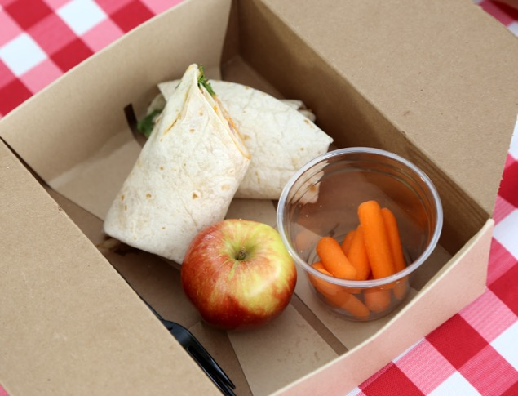

Foodborne Illness
and Outbreak
The Numbers:
1
48 million illnesses
128,000 hospitalizations
3,000 deaths
Foodborne illness (FBI) – illness transmitted from food to people
Outbreak – An incident in which two or more people experience the same symptoms/illness after eating the same food
  local Environmental Health Department
  confirmed by lab analysis
Major Risk Factors
Purchasing unsafe/unapproved items Failing to cook food adequately
Time and temperature abuse
Poor personal hygiene
2
Highly Susceptible Populations
Young Children,
elderly and weakened
immune systems.
3

Slide 39
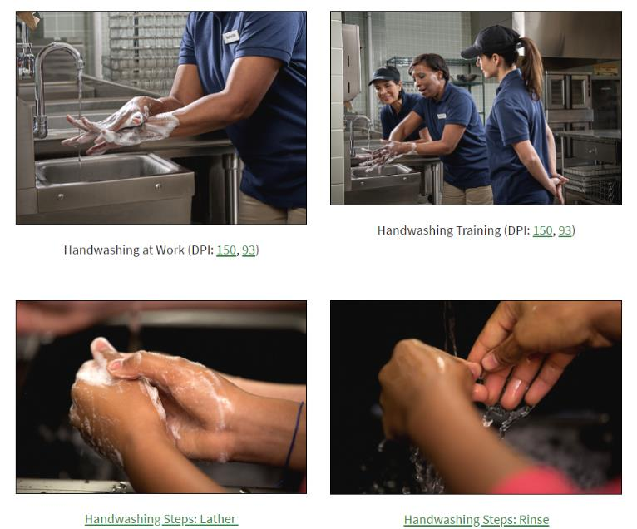
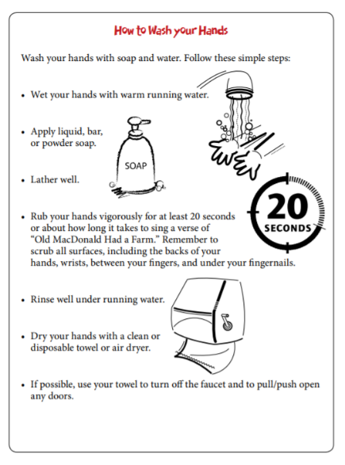
Handwashing and Cleaning Resources Webpage
fns.usda.gov/tn/handwashing-and-cleaning-resources
Photographs and Illustrations
Signs and Mini-Posters
Notes:
To encourage proper handwashing and cleaning practices, Team Nutrition’s Handwashing and Cleaning Resources webpage allows Child Nutrition Program operators to access free handwashing photos and illustrations, download handwashing signs and mini-posters, and more!

Slide 40
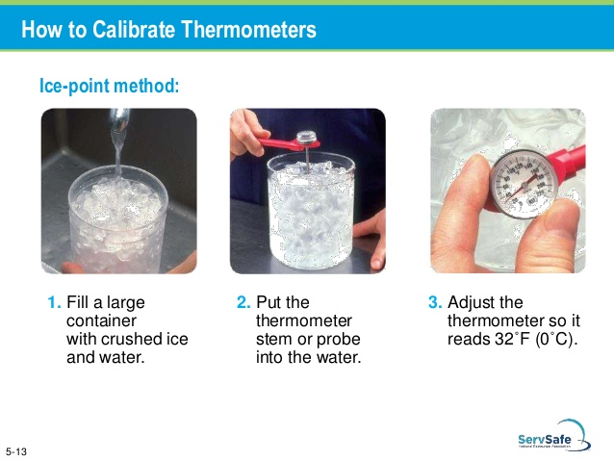
Notes:
Explain calibration. Possibly calibrate weekly. Log temps.

Slide 41
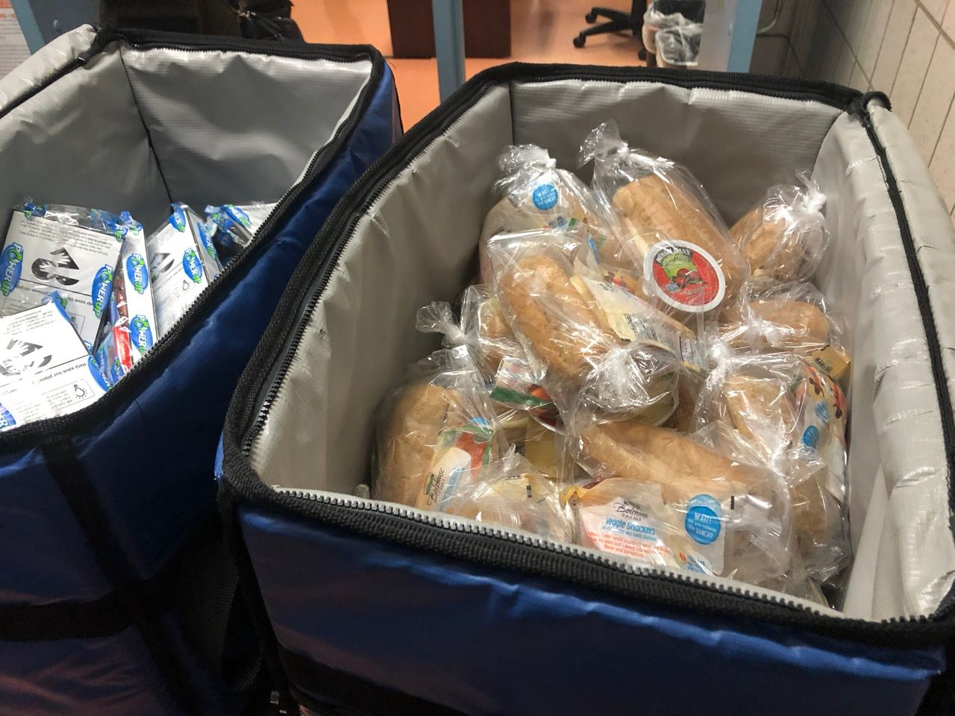
Food Safety
Packaging & Temperatures
Packaging
  Meal modifications for allergies
    Prevent cross-contamination
    Safe storage + Labeling + Specific meal site
Meal Temperatures
  Option to serve or distribute cold, shelf-stable, or hot
    Cold meals –
      Maintain at or below 41 degrees
    Hot meals
      Best for on-site meals
      Maintain at 165 degrees
    Shelf-stable meals (room temperature)
  Ice blankets/insulated coolers and cardboard boxes
  Calibrate thermometers

Slide 42
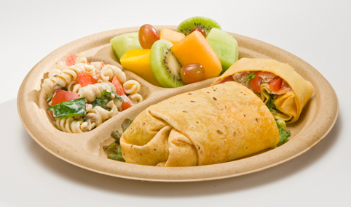

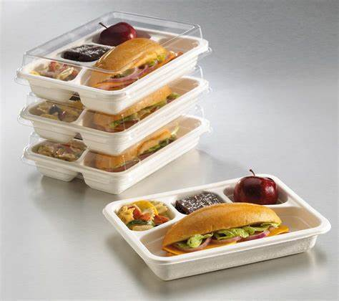
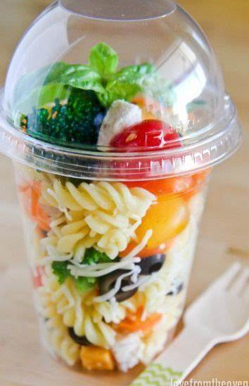
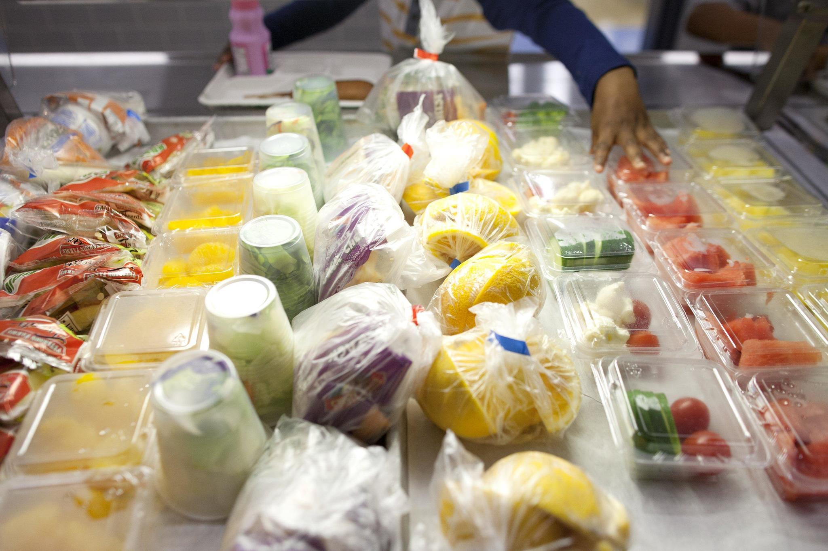
Packaging

Slide 43
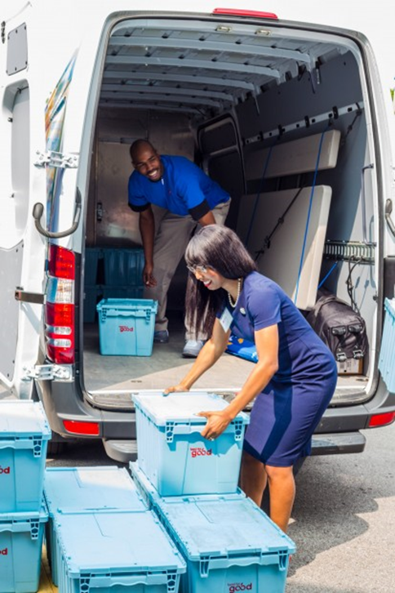
Transporting Food Safely
Hot at 135 °F or above or
Cold at 41 °F or below
  Maintain these temperatures when transporting food to another site
  Milk
  Sandwiches
Log temperatures on delivery form
  Leaving the kitchen
  Arriving at the meal site

Slide 44
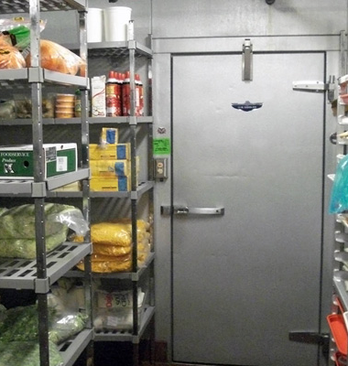
Storing Food Safely
Store in original/new containers
  Label and date
Store at proper temperatures
First in First Out (FIFO)

Slide 45

Nutrition Education Resources
Notes:
Team Nutrition also provides a wide selection of nutrition education resources for children ages 6 through 18 years participating at different summer meal sites. This collection of resources are part of the Summer Food, Summer Moves kit found at Team Nutrition website (fns.usda.gov/tn/summer-food-summer-moves).

Slide 46

Activity Placemat
fns.usda.gov/tn/summer-food-summer-moves
Notes:
The Summer Food, Summer Moves Activity Placemat was created to reinforce MyPlate messages. Kids can color, decode nutrition messages, and laugh at a few funny food jokes with this Summer Food Summer Moves placemat. It is available online and can be ordered in print as part of the kit or individually from the Team Nutrition website. It is provided with one side in English, and the other side in Spanish.

Slide 47








Spanish Materials Available from Team Nutrition

Slide 48

Nutrition Education and Training (NET) Team
Questions about
Menus
CN Labels
Creditable Foods
Contact
Pam Mitchell, NET Manager
505-699-2632
Laura Spencer, Nutritionist
505-946-8558

Slide 49

Thank You for Feeding the Children of New Mexico

