Slide 1
Early Childhood Education and Care Department
Cabinet Secretary Elizabeth Groginsky
Milk Requirements
Notes:
Acknowledge: Governor, Dr. Scrase, Sec. Stewart
Thank you, Secretary Stewart – and thank you, Governor, for the chance to share an update on child care and other early childhood programs in New Mexico.
NEXT SLIDE

Slide 2
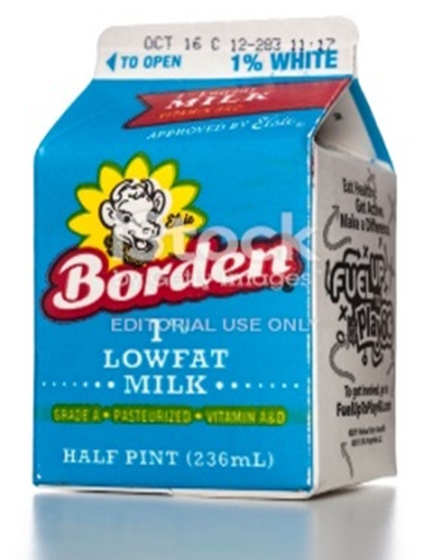
Availability of Milk and Verification of Purchases

Slide 3
FLUID MILK IS REQUIRED: 7 CFR, Part 225.16(d)
Milk is a requirement for
Breakfast
Lunch
Supper
Must provide 1 cup milk (1/2 pint, 8 fluid ounces)
Juice is not a substitute
Cheese is not a substitute
Yogurt is not a substitute
Not a participant choice to be served a milk
Notes:
If purchasing a gallon of milk utilize a 10 oz cup.

Slide 4
VALIDATION PROCESS
Review of milk invoices and receipts
100% of milk being purchased
We will verify and sum all purchases and compare against meals claimed
Maintain inventory of milk that is recycled back into the program using SFSP Form 4.4
Track milk purchases using SFSP Form 4.13 (excel workbook)
Both can be downloaded at: https://summerfoodnm.org/sponsors
Sponsor must compare milk purchases against meals claimed
Notes:
OIG and the federal agents consider not purchasing enough milk to be fraud. Validation also includes non program meals. USDA had findings that resulted in disallowance for not purchasing enough milk. During COVID milk is required for all meals served.

Slide 5
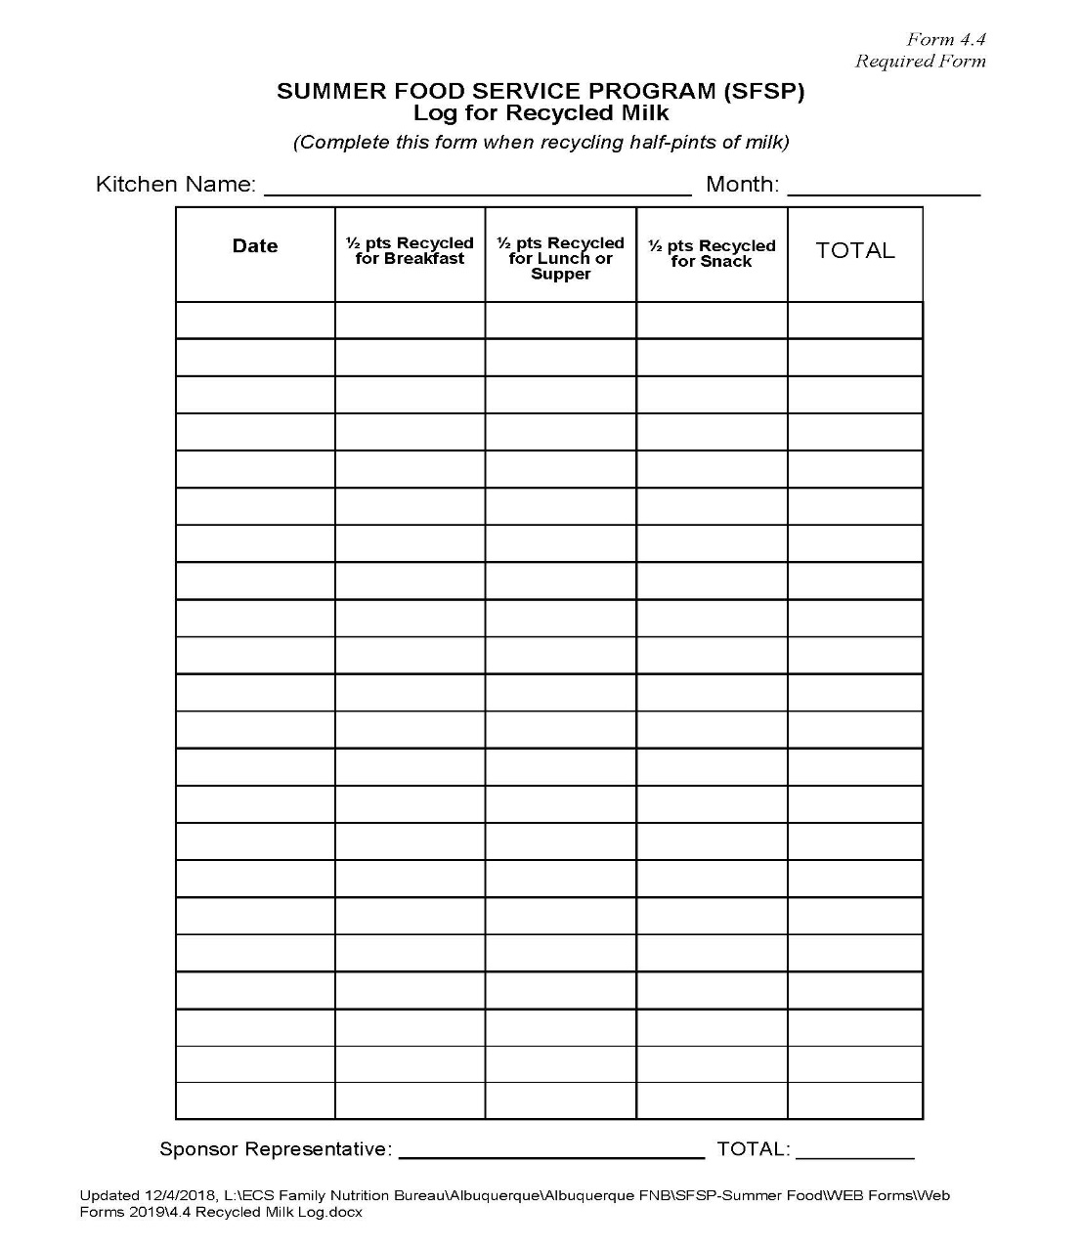
Summer Food Service Program Log for Recycled Milk Form 4.4

Slide 6
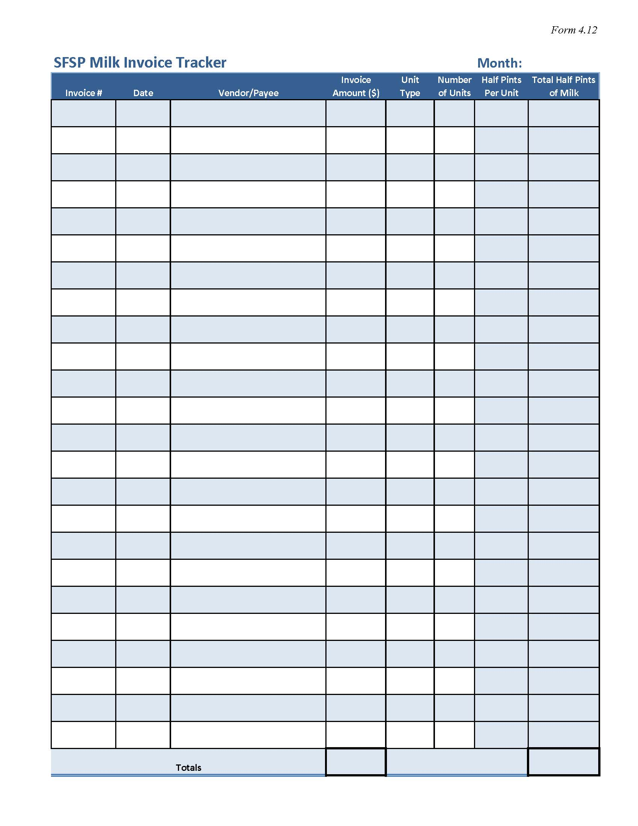
Summer Food Service Program Milk Invoice Tracker Form 4.12
(Excel Spreadsheet)

Slide 7
MEAL DISALLOWANCE
Insufficient milk purchases result in meal disallowance
Disallowance for these meals may be at the lunch rate of $4.5625 per meal
½ pint of milk averages 0.48 – white milk

Slide 8
PREVIOUS SPONSOR DISALLOWANCE
Sponsors that did not purchase enough milk and did not utilize their SFSP Form #4.4 for recycled milk
Total: $ disallowance paid back to the State Agency:
3195 - $ 6,320.82
RECAP- Meal disallowance can be avoided by purchasing adequate milk and utilizing SFSP forms that are available to all Sponsors to aid in tracking purchases

Slide 9
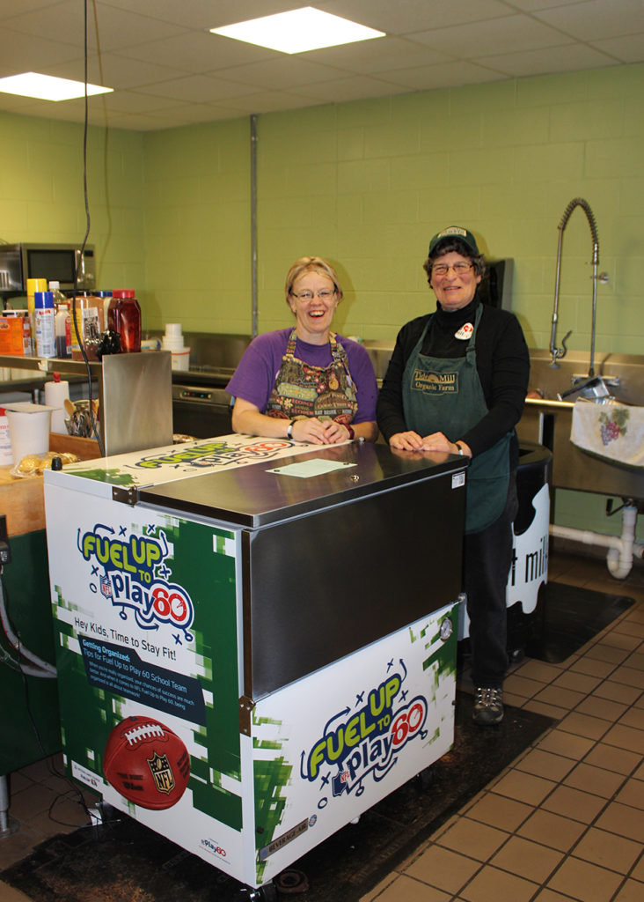
MILK SERVICE REQUIREMENTS
Best practices at the point of service
Train site staff heavily on the requirement for milk
Include milk as part of every breakfast, lunch and supper
Don’t struggle with children that do not want milk. Encourage use of sharing box instead
Food service staff in school settings must serve milk to children
Sponsor Monitor must ensure Site Supervisors are compliant with the requirement to serve milk

Slide 10
More information about the New Mexico Early Childhood Education and Care Department— Programs for Parents and Professionals: nmececd.org
Program Resources for SFSP Sponsors–
summerfoodnm.org/sponsors/program-resources

