Slide 1


Early Childhood Education and Care Department
Cabinet Secretary Elizabeth Groginsky
Meal Site Operations
Notes:
Acknowledge: Governor, Dr. Scrase, Sec. Stewart
Thank you, Secretary Stewart – and thank you, Governor, for the chance to share an update on child care and other early childhood programs in New Mexico.
NEXT SLIDE

Slide 2

Meal Site Operations

Slide 3
Site Supervisor Definition:​
The individual on site for the duration of the meal service, who has been trained by the sponsor, and is responsible for all administrative and management activities of the site including, but not limited to:​
Maintaining documentation of meal deliveries,​
Ensuring that all meals served are safe, and​
Maintaining accurate Point of Service meal counts​

Slide 4
Site Supervisor Responsibilities
Maintains control of the meal site
Ensures all meals served are in compliance with Federal regulations
Records accurate meal counts at the Point of Service
Ensures food safety and sanitation before, during, and immediately after meal service
Primarily responsible for determining the number of meals for the next day
Represents the organization and the Program

Slide 5
Site Supervisor’s Supply List
Daily meal count forms
Clipboard
Calculator
Pens/Pencils
Complaint Forms
Thermometer
Cleaning Supplies
List of Contacts
“…And Justice for all” Poster
Meal Site Rules
Notice of meals sold to adults
Cash Report Form (if meals are sold)

Slide 6
Mandatory Postings
What and where to post?
Other places to post
“And Justice For All”
  Meal service area
  Eating area
Off-Site Consumption
  Meal service area
  Eating area
Notice of Meals Sold (if applicable)
  Meal service area
At the meal service line
Sandwich board or “A” frame board
Tree
Display board
Wall
Doorway to serving area

Slide 7
Cleaning Before, During and After Meal Service
Meal site must be clean before meal service
Meal site must be cleaned during meal service as needed
Children must dispose of their trash appropriately
Site Supervisors must dispose of trash according to Sponsor policy
Notes:
Site Supervisors remain responsible for children’s loose trash.
Sponsor remains responsible for trash disposal at all of its sites.

Slide 8

Meal Site Locations
Meal site
  Location approved by the State Agency where meals can be served to attending children
  Kitchens can serve as a meal preparation facility and as a meal service location
Notes:
Children must be where the site supervisor can see them at all times

Slide 9
Approved Meal Service Times
Serve meals only during the approved meal service times
Meals served before or after the approved meal service time are not eligible for reimbursement
Meal service time can be extended or shortened if needed
  Site Supervisors can recommend meal service time change to Monitor
  Changes must be requested by sponsor and approved by State
Notes:
Any meal service time changes require prior approval from the state agency. These changes are requested in EPICS and approved by Emiliano.

Slide 10

What must children do to receive a meal?
Children must be at the site
All children must be in line
  First come, first served

Slide 11
Ordering Meals
Site Supervisors must plan, prepare, or order meals with the objective of providing one meal per child at each meal service (7 CFR Part 225.15(b)(3))
  Do NOT plan for leftovers or second meals!
Work to identify participation patterns at the site
  Who normally attends the meal site
  Find out who may be coming the next day
  Find out what may affect participation (adjustments)
Call appropriate person to place the meal order for next day

Slide 12
Organized and Supervised Meal Service:
7 CFR, Part 225.6(g)(1)(i)
Plan how and where at the site to serve the children/parents
Serve meals in an organized manner
Do not let participants serve themselves
Supervise children while they eat
If serving adults, ensure all children are serve first
Remember, the Site Supervisor is in control of the site and is not be pressured or influenced in any way
Notes:
Rushed, crowded, coerced, intimidated

Slide 13
Serve Complete and Unitized Meals
Complete—Each meal served must contain the food components and portion sizes as required by the established USDA meal pattern (7 CFR Part 225.16(d))
Unitized—All required food components must be served at the same time

Slide 14
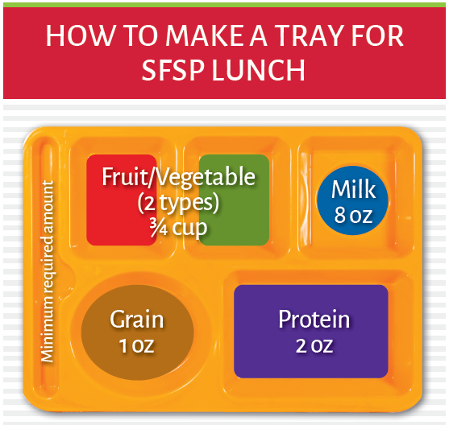
Example of a complete, unitized meal

Slide 15
Serving First Meals​
First eligible meals are defined as the first meal a participant receives
First eligible meals must be complete and unitized
Count separately on Daily Meal Count Form

Slide 16
Serving Second Meals
Ensure all in attendance have been served one meal before any second meals are served
All Second Meals served must be complete and unitized
Count separately on Daily Meal Count Form

Slide 17
Documenting Meal Counts Correctly
Each of the numbered sections of SFSP form 6.4 represents a specific category of meal
  1st eligible
  2nd meals
  Meals to non-program adults (sales)
  Meals to program adults
    Staff directly involved in the preparation and service of meals
A legible slash, circle or a tick mark must be placed through each number to indicate a meal was served

Slide 18
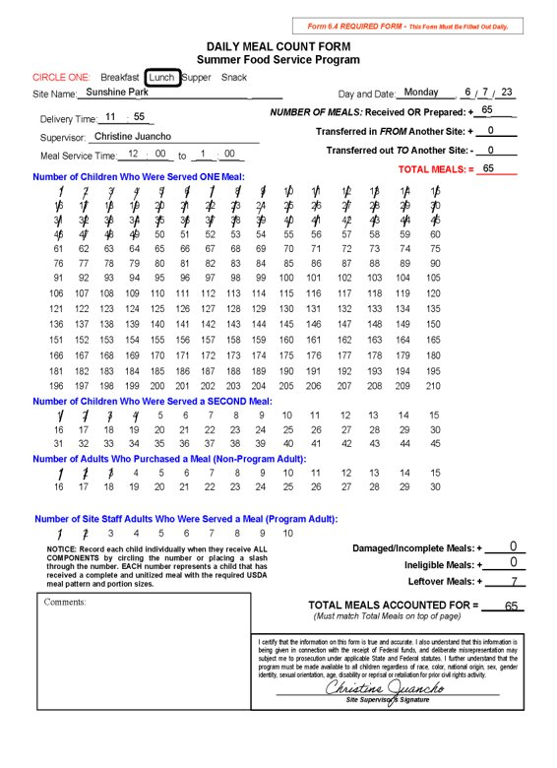

Properly Documented Meal Counts

Slide 19
Point of Service (POS) Meal Counts
Count the meals served at the POS as each participant receives a complete and unitized meal
  Federal Requirement
Each meal type served must be recorded on the SFSP Daily Meal Count Form #6.4
  Counting meals at the POS ensures accuracy

Slide 20
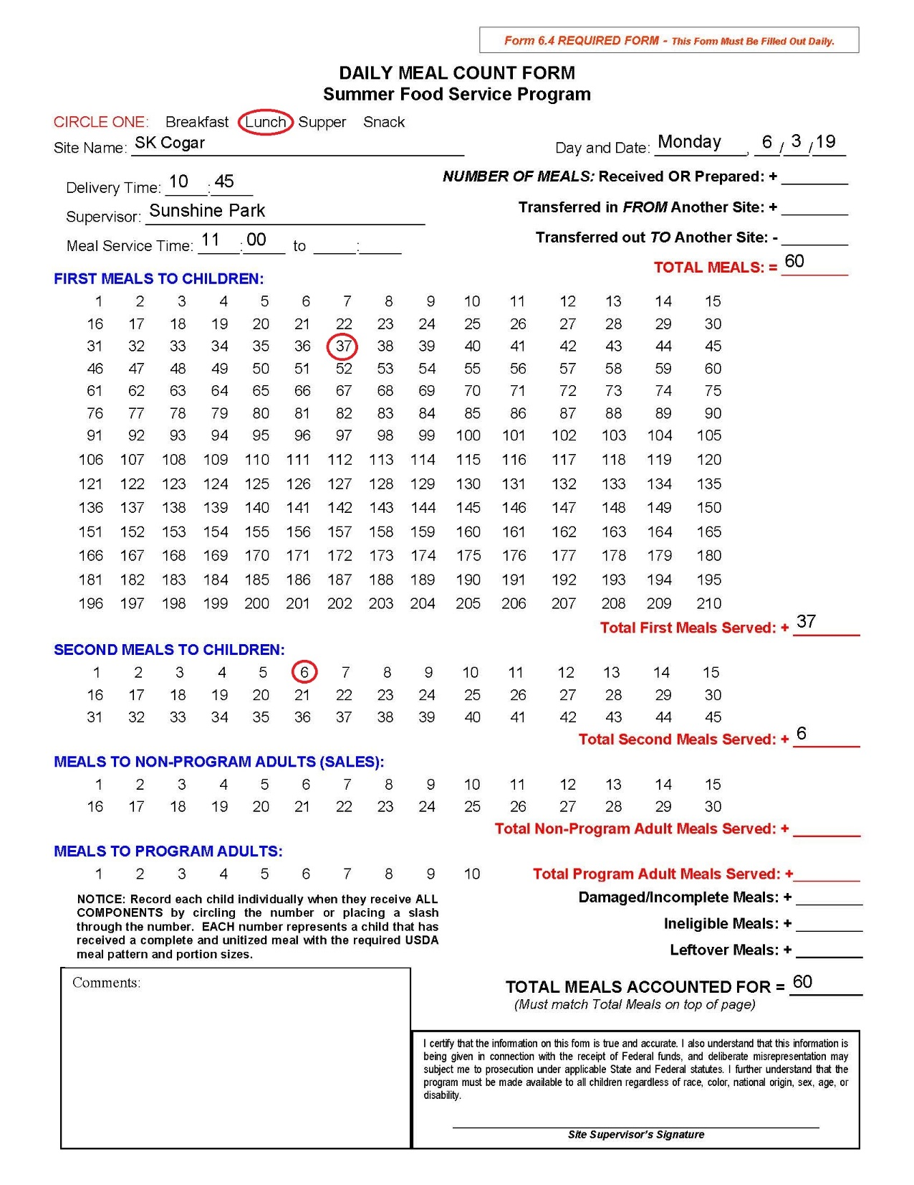

Improperly Documented Meal Counts

Slide 21
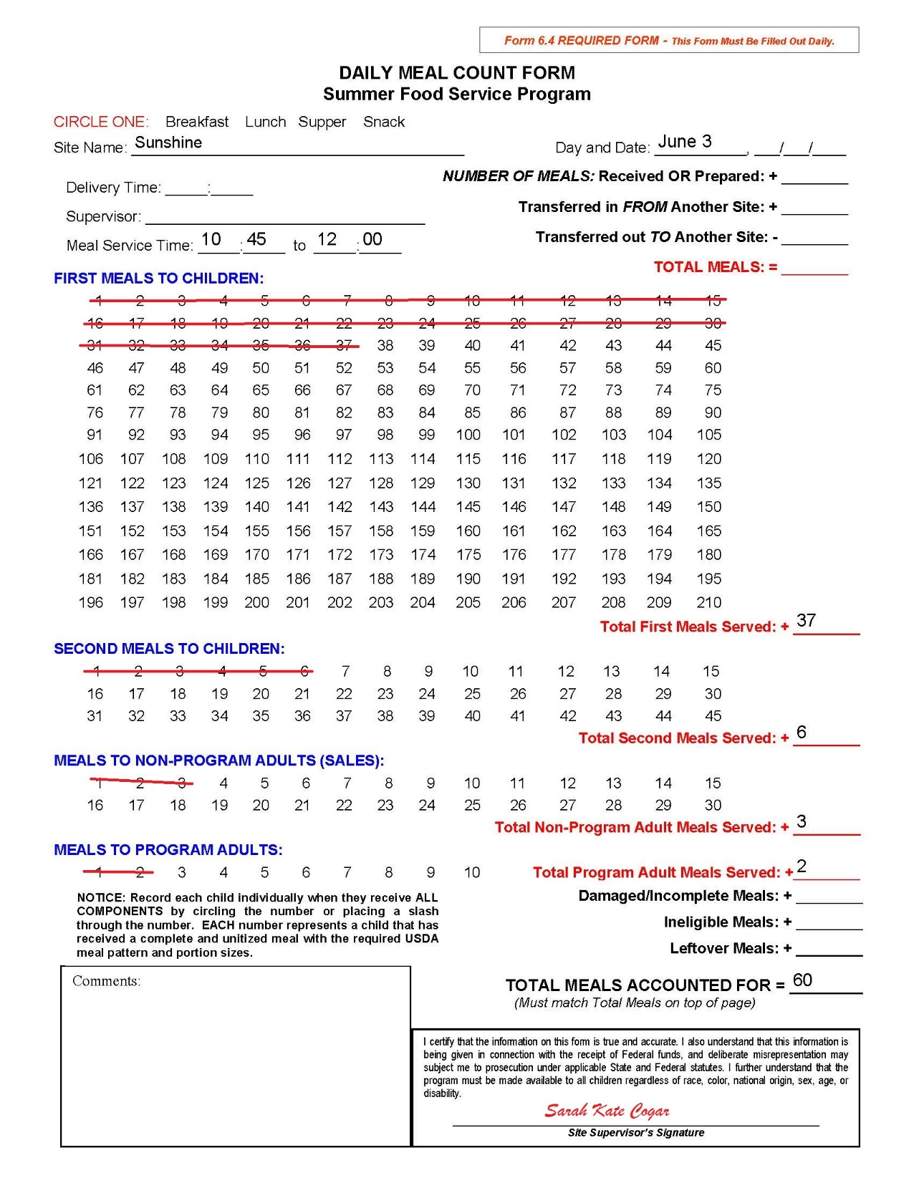

Improperly Documented Meal Counts

Slide 22
Unacceptable Meal Counting Practices
Counting number of meals prepared or received as being served
Counting 2nd meals served as 1st meals
Counting leftover meals as 1st meals or 2nd meals
Counting damaged or incomplete meals as 1st meals or 2nd meals
Counting adult meal sales or Program adult meals as 1st meals or 2nd meals
Not counting meals at the point of service

Slide 23
More information about the New Mexico
Early Childhood Education and Care Department—
Programs for Parents and Professionals:
https://nmececd.org
Program Resources for SFSP Sponsors–
https://summerfoodnm.org/sponsors/program-resources

