Slide 1
Early Childhood Education and Care Department
Cabinet Secretary Elizabeth Groginsky
Summer Food Service Program for Children - 2023
Using the FBG Calculator

Slide 2
Early Childhood Education and Care Department
Cabinet Secretary Elizabeth Groginsky
Summer Food Service Program for Children - 2023
Using the FBG Calculator

Slide 3
Using the Online Food Buying Guide Calculator and Mobile App

Slide 4
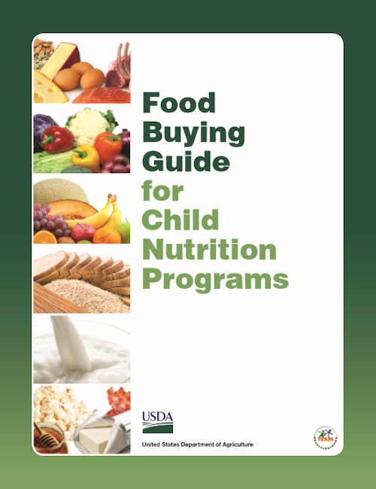
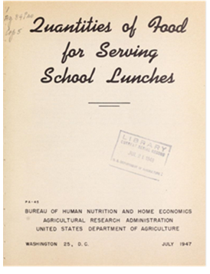
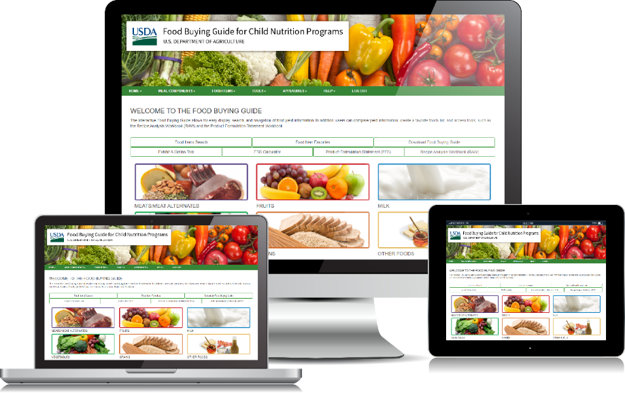
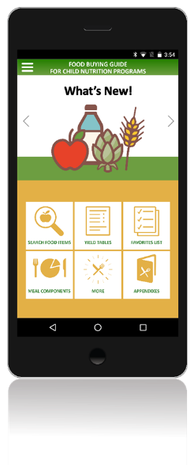
Food Buying Guide - Then & Now fns.usda.gov/tn/food-buying-guide-for-child-nutrition-programs
Then
Now
Notes:
The Food Buying Guide for Child Nutrition Programs (also known as the FBG) has been around for about 70 years and continues to be one of Child Nutrition Programs’ most popular resources.
The Food Buying Guide aims to assist Program operators in two major ways:
helps operators determine how much food to purchase for meals and snacks; and
helps operators determine how each food counts toward meal pattern requirements.
The Food Buying Guide continues to be revised with new yield data. Currently, the Guide contains yield data for more than 2,100 foods.
The Food Buying Guide has been transformed from a printed publication an Interactive Web-based Tool and Mobile App for smartphones and tablets.

Slide 5
The Old Reliable –
NM Food Purchasing and Production Guide
Small quantity food production
5-100 servings
Meat/Meat Alternate Section
2 ounce serving size
1 ½ ounce serving size
Grains Section
“Exhibit A” grain chart
Fruit and Vegetable Sections
½ cup serving size

Slide 6
Food Buying Guide Digital Resources
Easy search & navigation
Compare
Favorite list
Select serving size
Notes:
Both the Food Buying Guide Web Tool and Mobile App include the following features that are available to both guest users and registered users.
These features include:
the ability to search for food items by food groups and further narrow the search by food categories;
the capability for side-by-side comparisons of food items within a food category (such as comparing diced, canned carrots to diced, fresh carrots);
the ability to create a Favorite Foods list; and
the capability to select the desired Serving Size per Meal Contribution for fruits and vegetables using a drop-down menu.
Registered users have access to additional features and capabilities such as saving Favorite Foods lists that can be accessed in future sessions. Guest users can also create a Favorite Foods list, but the list can only be accessed during that session. Registered users will use the same login for both the Interactive Web Tool and Mobile App, allowing access to saved information on both tools.

Slide 7
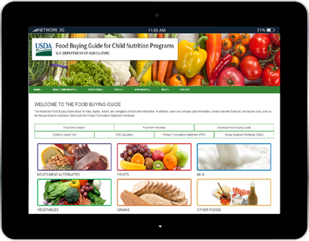
Food Buying Guide Features
Recipe Analysis Workbook
Product Formulation Statement Workbook
Food Buying Guide Calculator
Exhibit A Grains Tool
Notes:
Four other built-in features of the interactive Food Buying Guide include:
the Recipe Analysis Workbook, otherwise known as the RAW, which is available to registered users;
the Product Formulation Statement Workbook, which is available to food vendors with registered accounts;
the Food Buying Guide Calculator, which creates a shopping list to assist Program operators in ordering and purchasing food for their programs; and
the Exhibit A Grains Tool, which helps operators determine the amount of grains ounce equivalents in a product. This tool also helps operators determine how much of an item to serve to meet meal pattern requirements for grains at meals and snacks.
Let’s take a closer look at each of these tools now.

Slide 8
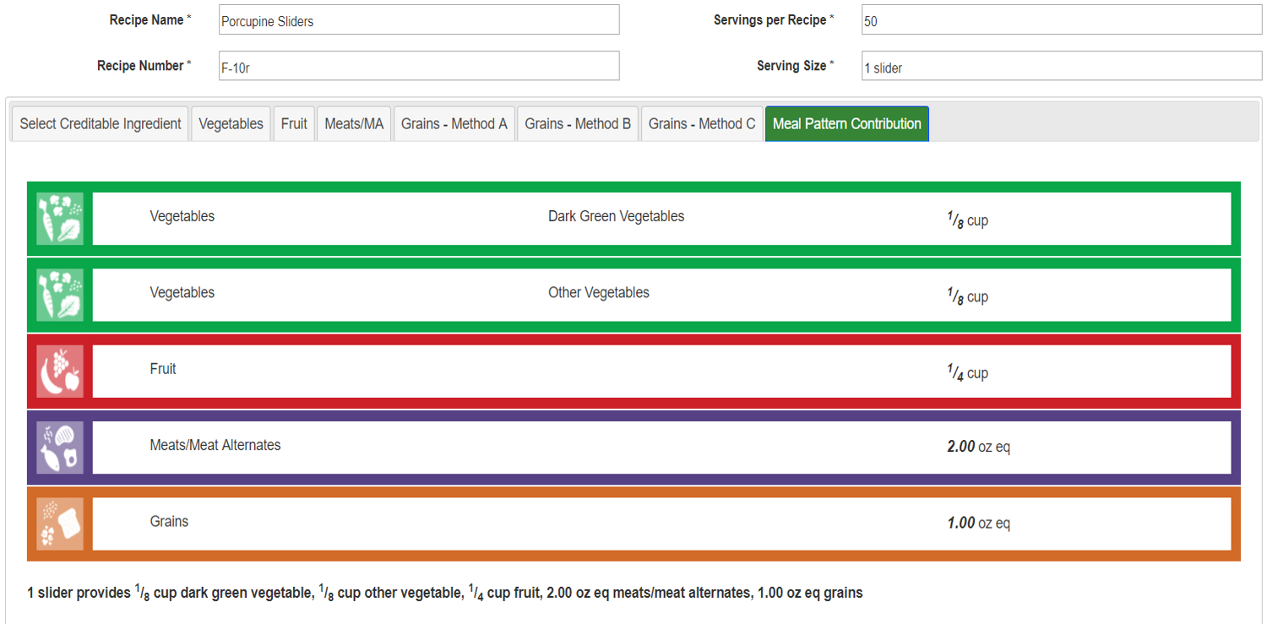
Recipe Analysis Workbook (RAW)
Notes:
The Recipe Analysis Workbook, also known as the RAW, allows operators to easily search the Food Buying Guide for creditable ingredients that are listed in a recipe. The selected food items will auto-populate into the RAW and calculate the items’ crediting information (based on the amounts entered by the operator). The meal pattern contribution is calculated and the meal pattern contribution statement for the recipe can be saved, printed, and emailed.
The RAW also allows operators to:
recreate RAWs for multiple yield quantities;
add recipe notes;
determine the meal component contribution for creditable ingredients, to include total vegetables and vegetable subgroups; and
create folders to organize RAWs.
Registered users can create and save a RAW on the Web Tool and then access and view it as a PDF file on the Mobile App.

Slide 9
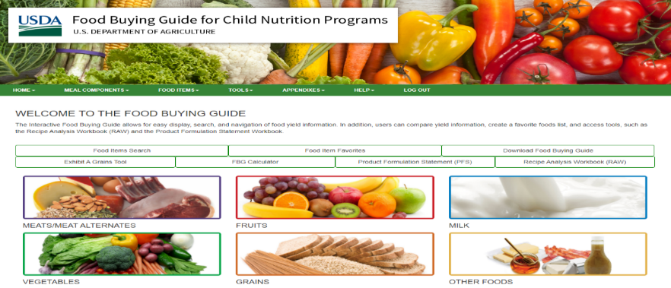
Exhibit A Grains Tool
Notes:
To help Program operators determine the amount of grains to serve as part of a reimbursable meal, Team Nutrition developed the Exhibit A Grains Tool. This tool is included in the Web Tool as well as the Mobile App. Registered users can save their product results within the tool for future use.
Program operators can look at the Serving Size information on an item’s Nutrition Facts label and enter that information into the tool. The tool will then calculate:
how many ounce equivalents of grains, or grains/bread servings are in one portion of that item;
the amount to serve of a grain product based on a desired grains contribution; and,
how much of a grain item is needed in order to meet minimum required amounts of grains at meals and snacks. ​

Slide 10
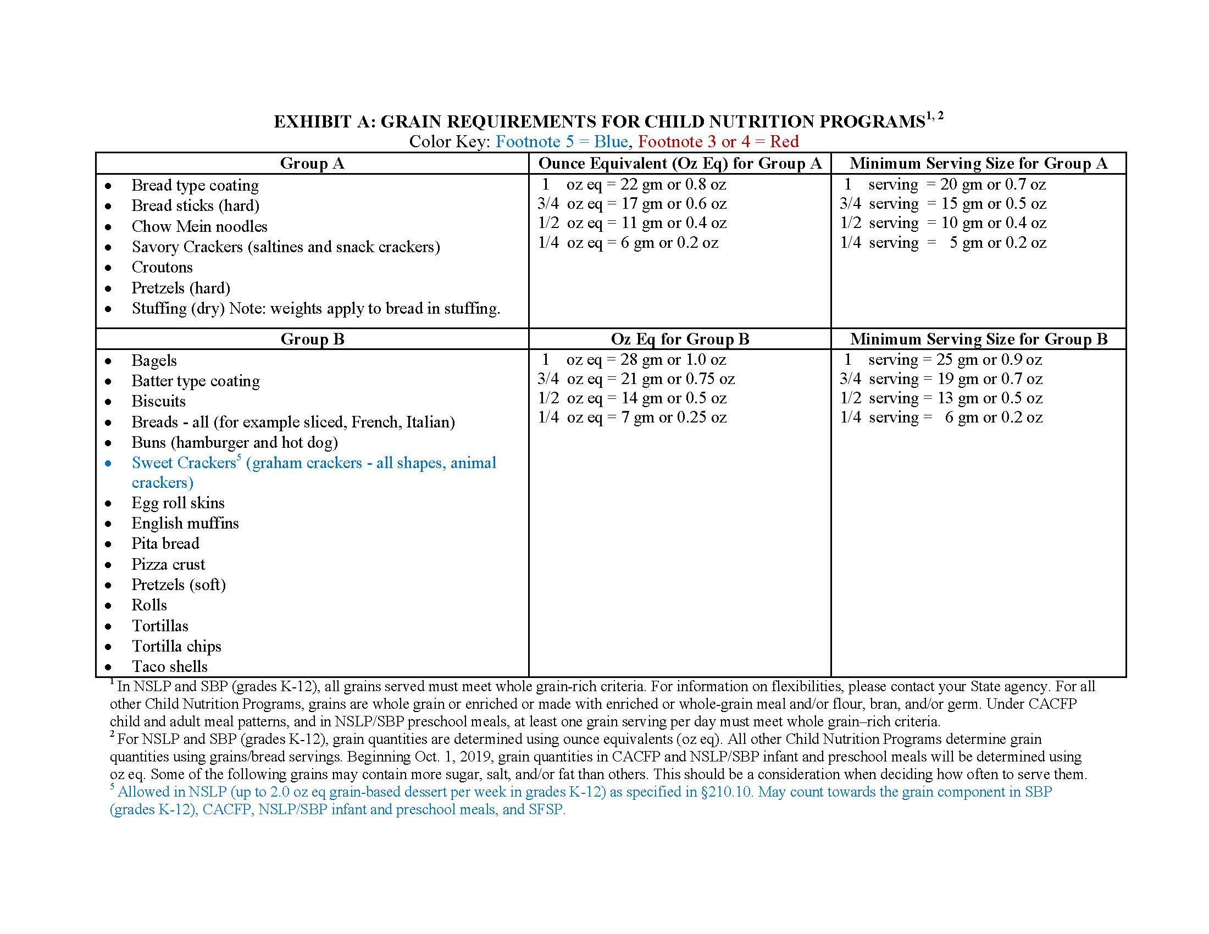

Slide 11
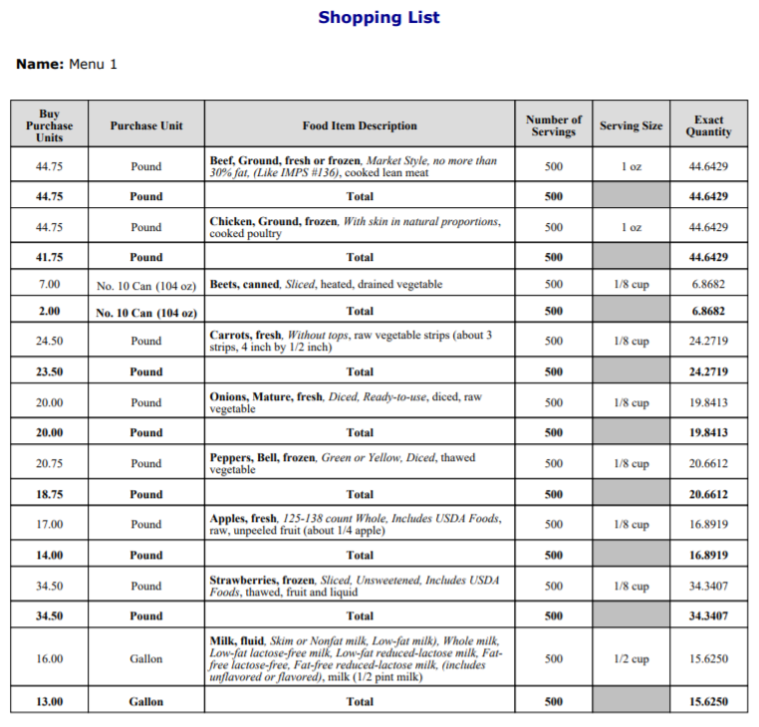
Food Buying Guide Calculator fns.usda.gov/tn/food-buying-guide-for-child-nutrition-programs
Notes:
The Food Buying Guide Calculator allows operators to create a shopping list to assist in ordering and purchasing food for their programs. This calculator is available on both the Web Tool and the Mobile App. When using the calculator, users have the option to view the minimum requirements per meal component for the various grade groups of the National School Lunch Program, School Breakfast Program, Afterschool Snacks, and Preschool while creating a shopping list.
Registered users can create and save a shopping list on the Web Tool and access it on the Mobile App and vice versa.

Slide 12
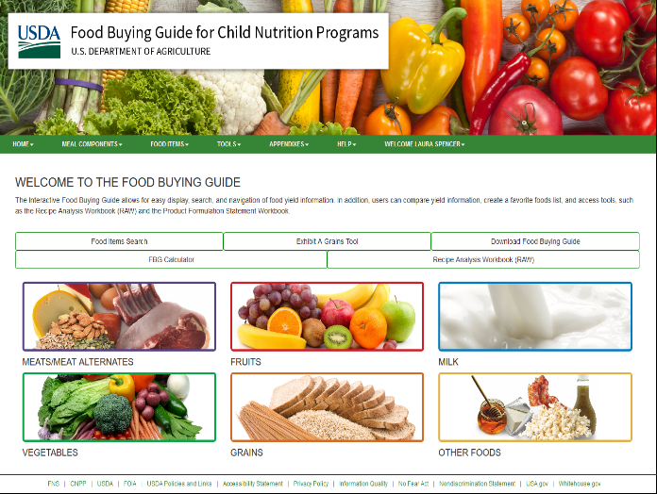
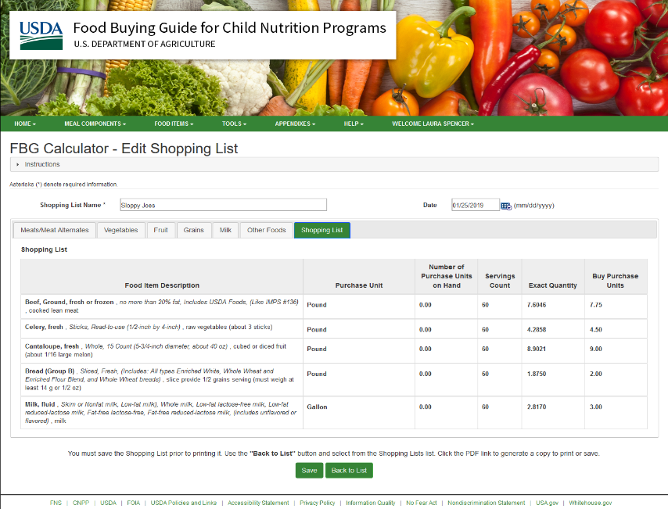
Food Buying Guide (FBG) Calculator: Instructions
Register as a user
FBG Calculator → Create Shopping List
Type Shopping List Name/Date
Optional: Select Program (SFSP) & Meal
Refer to Cycle Menu → Click component
Type food name → Enter or search
Select food item & portion size → Add
Enter # Purchase Units on hand (if any)
Notes:
This interactive and simple to use calculator allows child nutrition professionals to build shopping lists of foods from the FBG and determine how much of each item to purchase to provide enough servings for the children in their program.
We will show you how to use this great tool a little later when we talk about documentation.

Slide 13
FBG Calculator Instructions, continued
Click on “Add Serving Size”
Select correct serving size
Type number of servings → Enter
Click Save → Repeat with remaining components
“Back to List” when done
“Edit” to review Shopping List
“PDF” to save / “Email” to send Shopping List
Rename PDF with menu name and # servings
Ex: “SFSP Chicken Fajita Lunch Menu – 150 servings”
Notes:
This interactive and simple to use calculator allows child nutrition professionals to build shopping lists of foods from the FBG and determine how much of each item to purchase to provide enough servings for the children in their program.
We will show you how to use this great tool a little later when we talk about documentation.

Slide 14
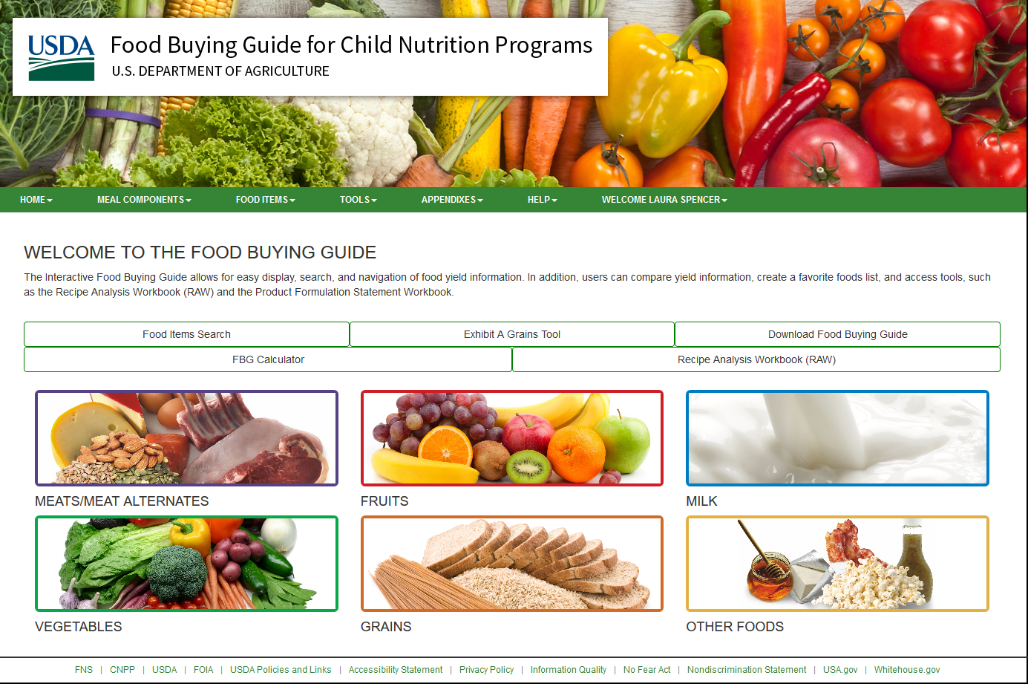

Slide 15
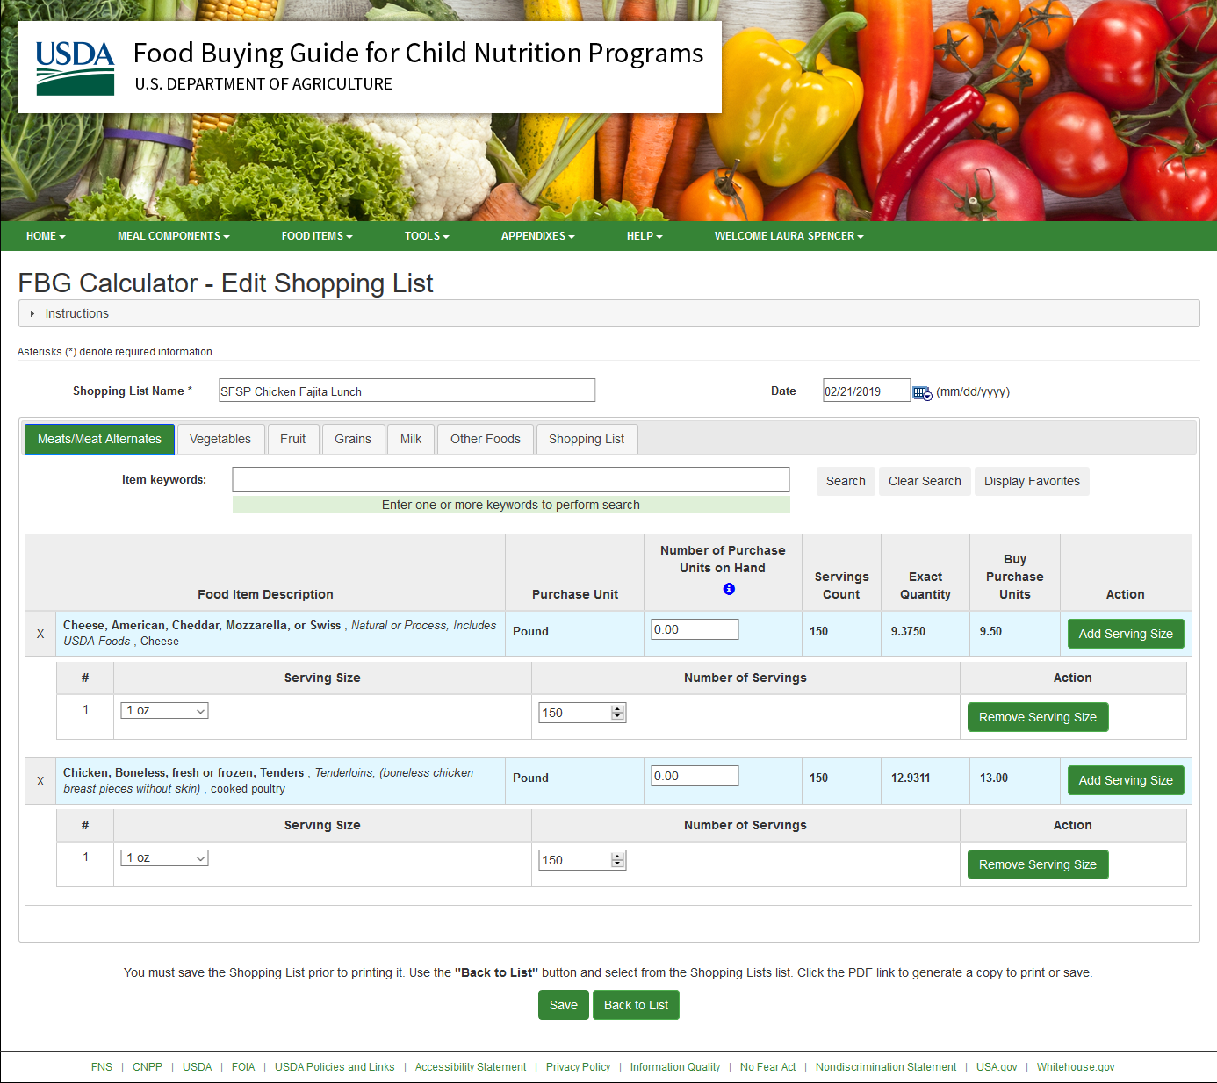
- 150 servings

Slide 16
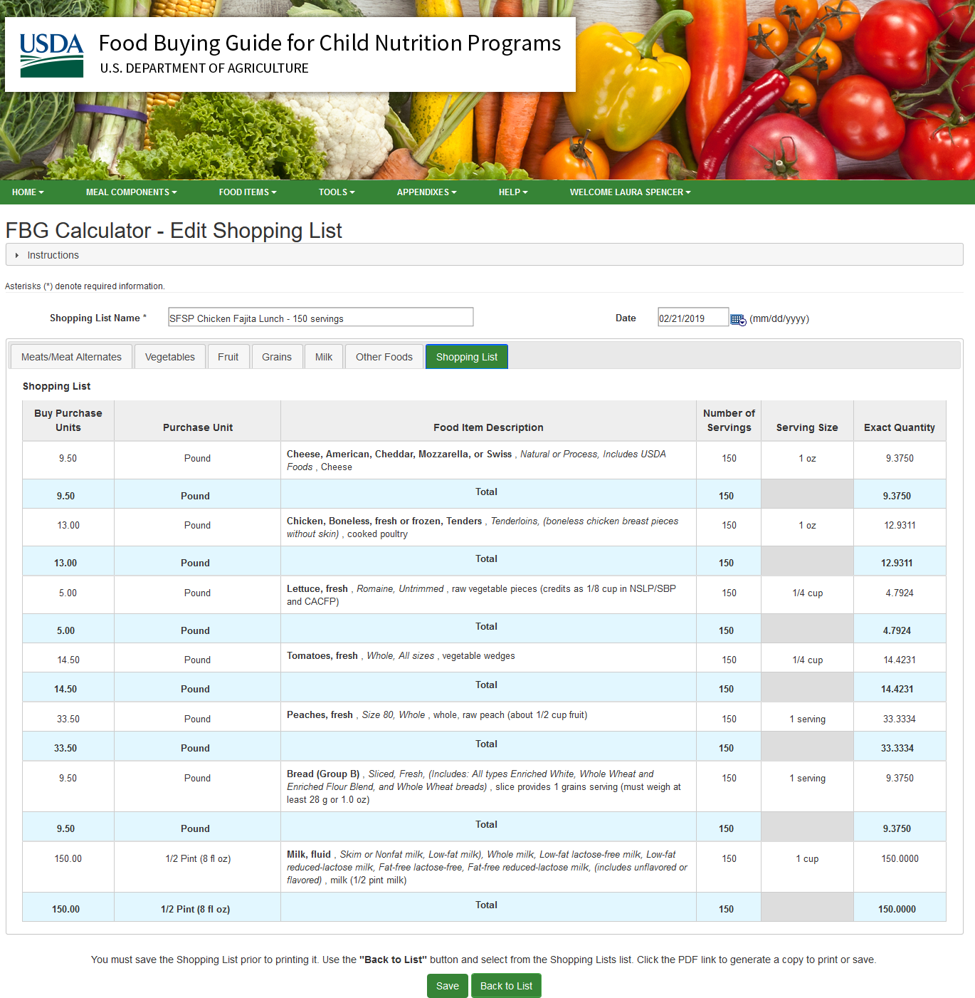
- 150 servings

Slide 17
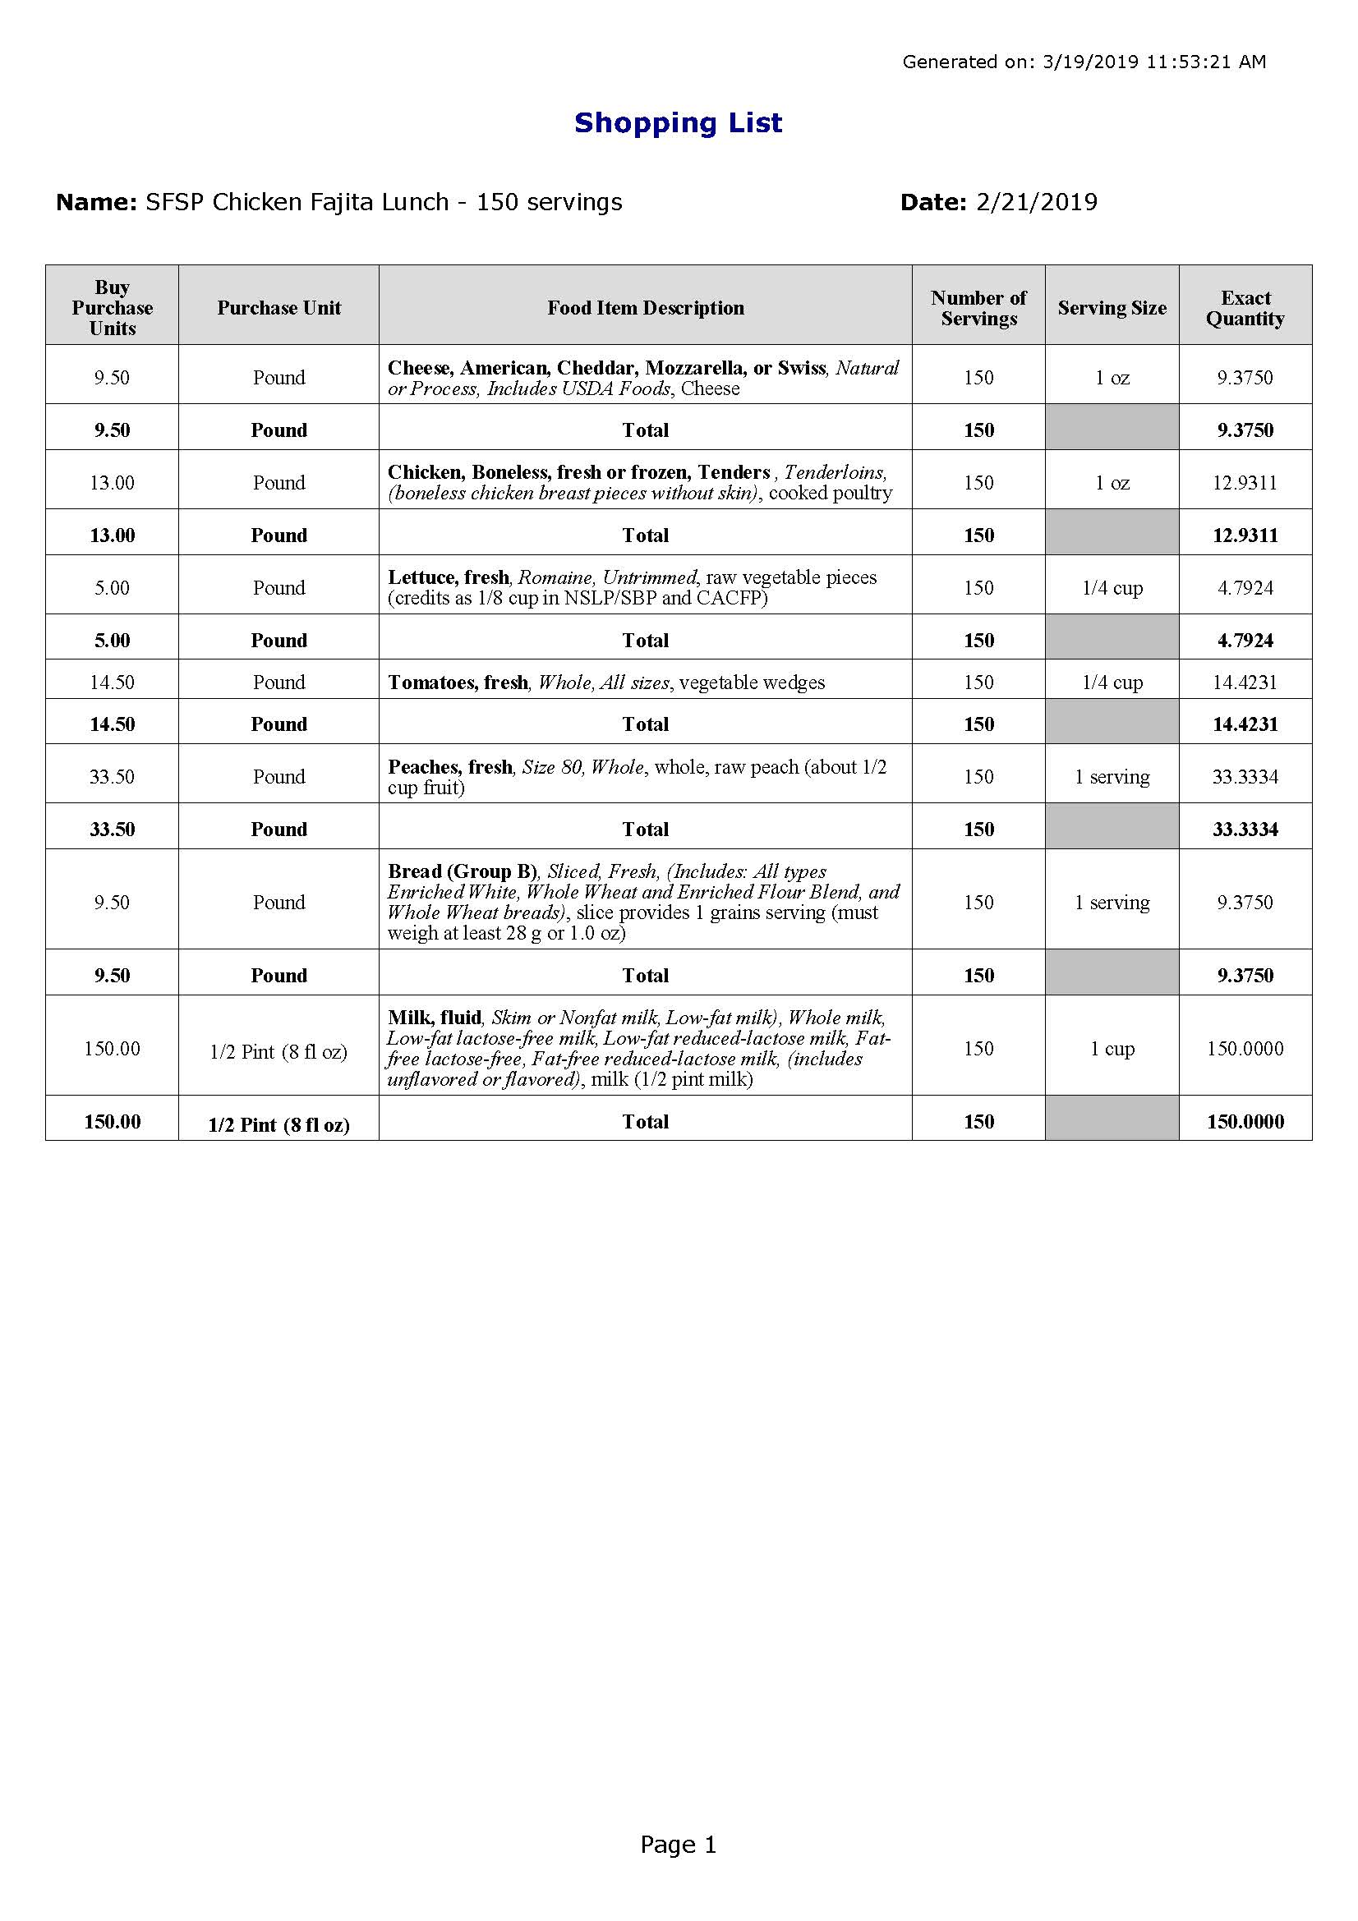

Slide 18
“Buy Purchase Units” REDUCED by the entered “Number of Purchase Units on Hand”

Slide 19
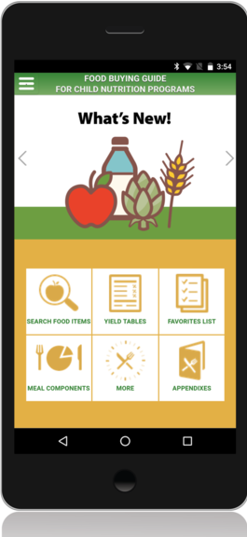
Download the Food Buying Guide Mobile App!
Production information for foods typically served in Child Nutrition programs
Available for iOs & Android
https://www.fns.usda.gov/tn/food-buying-guide-mobile-app
Notes:
As of January 2022, the FBG Mobile App has been downloaded over 37,000 times. Give it a try for “on-the-go” access.

Slide 20
Mobile App Demo / Recorded Webinar
Webinar: Food Buying Guide Goes Digital! Food and Nutrition Service (usda.gov)

Slide 21
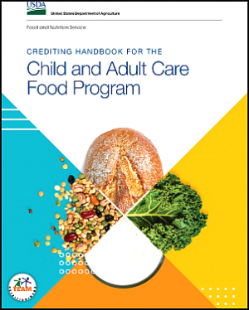
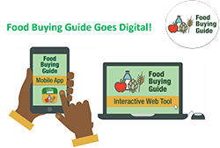
Additional Resource
FBG Training Resources
https://www.fns.usda.gov/tn/food-buying-guide-training-resources
Webinar: Food Buying Guide Goes Digital! | Food and Nutrition Service (usda.gov)
Crediting Handbook for Child Nutrition Programs (2019)
https://www.fns.usda.gov/tn/crediting-handbook-child-and-adult-care-food-program
Notes:
This interactive and simple to use calculator allows child nutrition professionals to build shopping lists of foods from the FBG and determine how much of each item to purchase to provide enough servings for the children in their program.
We will show you how to use this great tool a little later when we talk about documentation.

Slide 22
Questions?

Slide 23
Nutrition Education & Training Staff
Contact
Pam Mitchell, NET Manager
pam.mitchell@ececd.nm.gov
505-699-2632
Michelle Gallarza RD, Nutritionist
Michelle.gallarza@ececd.nm.gov
505-XXX-XXXX
Laura Spencer, Nutritionist
laura.spencer2@ececd.nm.gov
505-946-8558
Questions about
FBG
Menus
CN Labels
Creditable Foods

Slide 24
More information about the New Mexico Early Childhood Education and Care Department— Programs for Parents and Professionals: nmececd.org
More information about Summer Food Service Program for Children— For families and sponsors: summerfoodnm.org

