Slide 1
Early Childhood Education and Care Department
Cabinet Secretary Elizabeth Groginsky
SFSP Meals Counts and Claims

Slide 2
MEAL COUNTS AND CLAIMS

Slide 3
ORGANIZATION OF MEAL COUNT RECORDS
Meal count forms must be completed for every meal service at every site and maintained for review.
Use updated forms from the summerfoodnm.org website
Keep meal count records organized
By the meal type
By the day, from newest to oldest
By the month
Notes:
Meal count forms are very important to your program. Always make it in good habit to download all forms from website as they are updated annually. Using the incorrect, outdated form could account for errors and a lower reimbursement as we have seen overtime. When form are turned in, monitors , coordinator and directors should review these forms to ensure they are completed correctly, no abbreviations, times and days are legible but most importantly, tick marks.

Slide 4
MEAL COUNT BASICS
Meal count form 6.4
The official record of meals served – serves as an invoice for payment
When serving multiple types of meals keep separate meal counts for breakfast, lunch and supper
Closely review daily meal count forms before they are entered in EPICS
Most discrepancies result from 6.4 forms not being properly reviewed prior to inputting to EPICS
Notes:
Incorrectly entering meal counts into Epics can account from improperly completing the form or using an outdated form. Please use all forms from website.

Slide 5
MEAL COUNT BASICS
Prior to input into EPICS look for:
Incomplete forms
No day or date indicated
Meal type not indicated
No Site Supervisor signature
Evidence of meals not being counted at the point of service (POS) – examples given
Questionable claiming patterns – example given
Evidence of block claiming – definition and example given
Use the slash or tick marks as your guide for the correct number of meals to input into EPICS
The presence or absence of a slash or tick marks on form 6.4 determines the number of meals allowed for reimbursement
Notes:
The meal count form will give state reviewers a good picture how your program is running. If we see a lot of information missing when reviewing the forms during a review, this will show that there is training that is needed for both site supervisors and monitors. This could account for a disallowance of meals due to incorrect entry into Epics and a low reimbursement for your program. We can also tell if site supervisors are following the federal requirement of Point of Service.

Slide 6
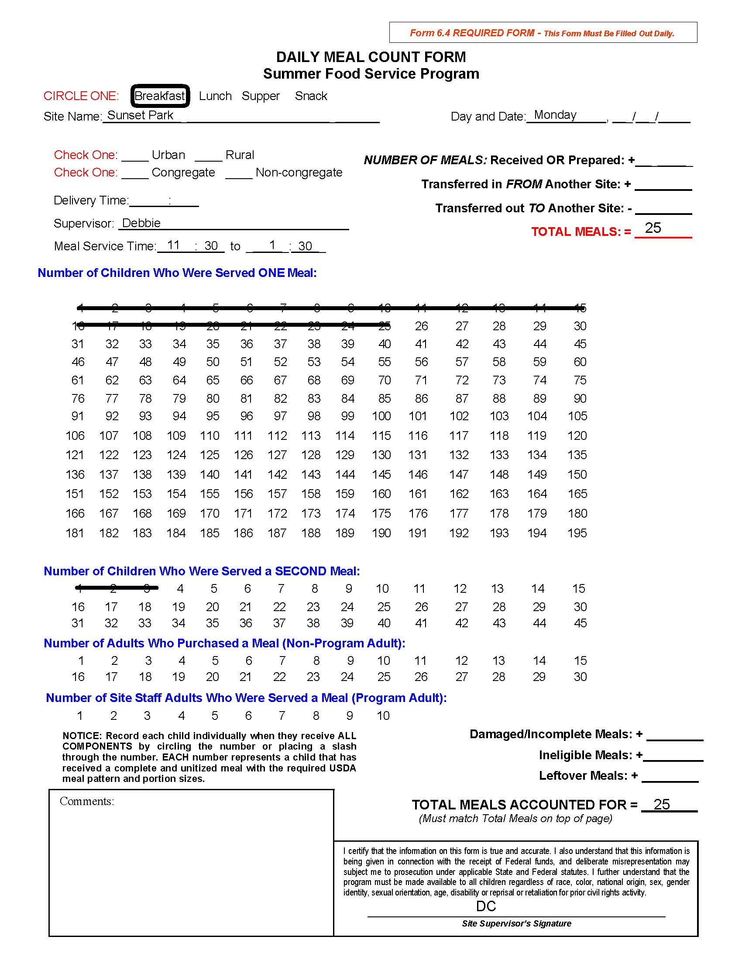
Notes:
On this form, we see information is missing. There is a day but no date. This meal site is at a park. It would be very important for monitors to the time the meals arrived at the park, especially if it is hot outside or if a delivery delay delayed the start of the meal service. Do adjustments need to be made? Again, no abbreviations or initials. The form should have full names of sites as well as staff and required signatures. But more importantly, meal counts are incorrect. This shows state reviewers that POS was not used but rather all meals delivered were counted instead of actual true meal counts.

Slide 7
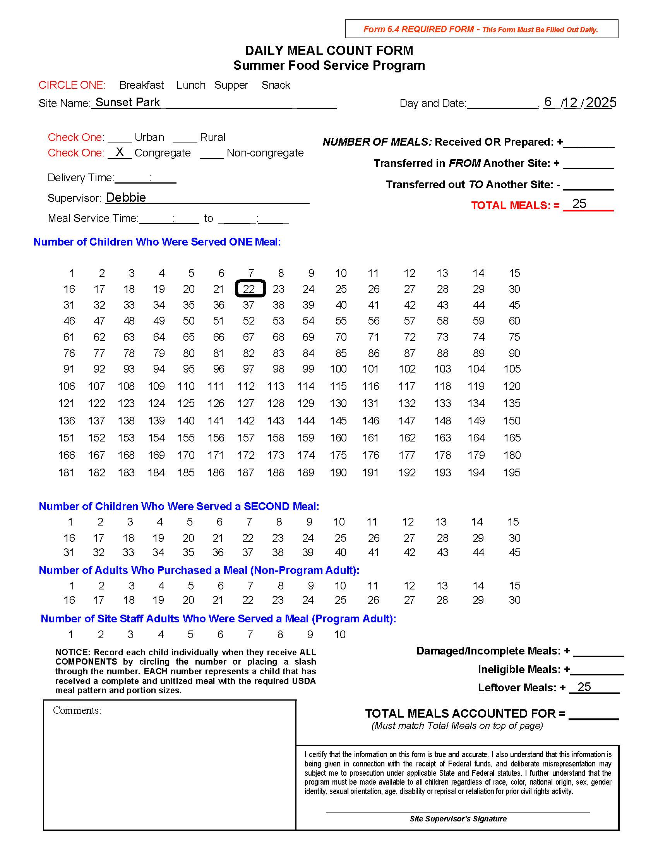
Notes:
This is another example of an incomplete meal count form. Meal Service Time is missing, there is a date but no day and the is also no meal type. Is this breakfast or lunch? POS was not used at this meal service. Site Supervisor may state that 22 meals were given out but as a state reviewer, I only see a total of one meal. All together with the information missing, we could not approve a reimbursement for this day due to no knowledge of meal type of correct number of meals handed out. Again, loss of reimbursement which in turn is dollars for your program.

Slide 8
QUESTIONABLE CLAIMING PATTERNS
Meal counts for each day end in a “5”
Meal counts for each day end in a “0”
Notes:
As we are out on review, we see some sites are very popular and all meals are handed out. Normally we see these ending in 5 or zeros. We will ask the sponsor for the cause of this occurrence; it can sometimes be explained reasonably. Then there are the times when compliance officers go out for a meal site review and the site has 25 entered every single day in Epics but when we are on site and see 4 participants come by, this becomes questionable. This may not be a true picture of meal counts captured. Please adjust meals accordingly to what site supervisors are reporting and make necessary adjustments.

Slide 9
BLOCK REPORTING/CLAIMING
Block reporting or claiming is defined as reporting the same number of meals served each day
Example listed on the next page

Slide 10
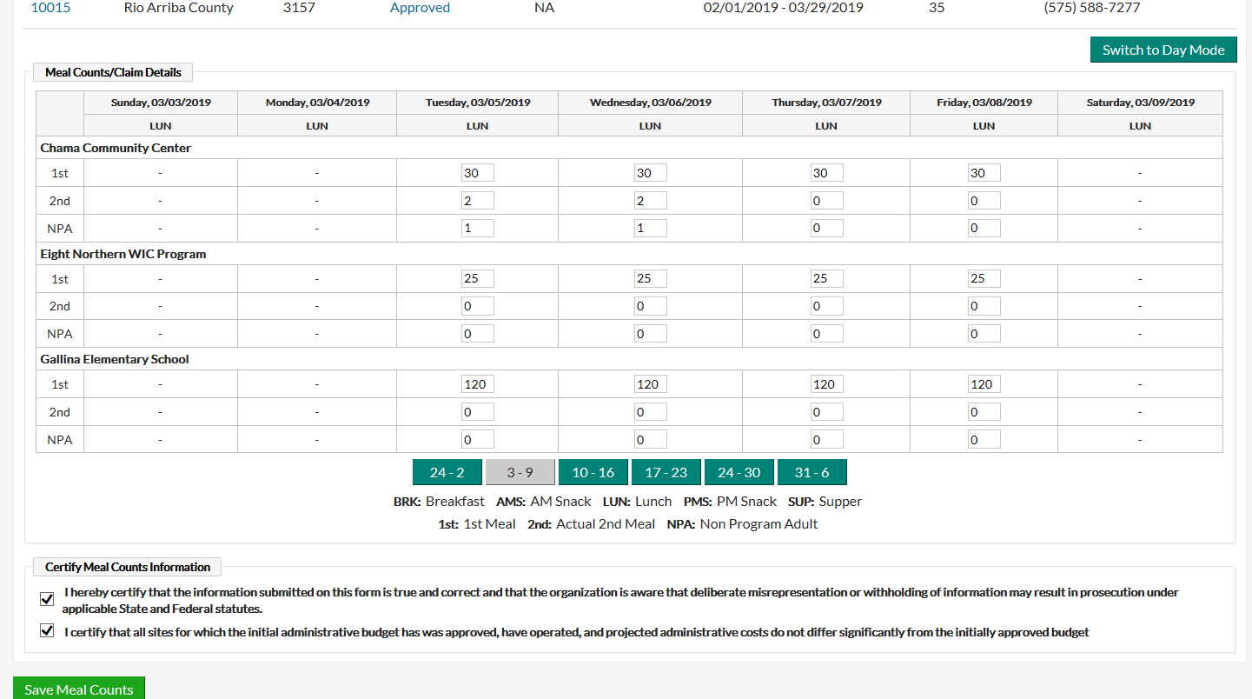
Notes:
Again, this could be possible but highly questionable. Participants may not show due to going on vacation or home sick. So please, make sure meal counts are correctly entered. This could lead to a finding in an administrative review.

Slide 11
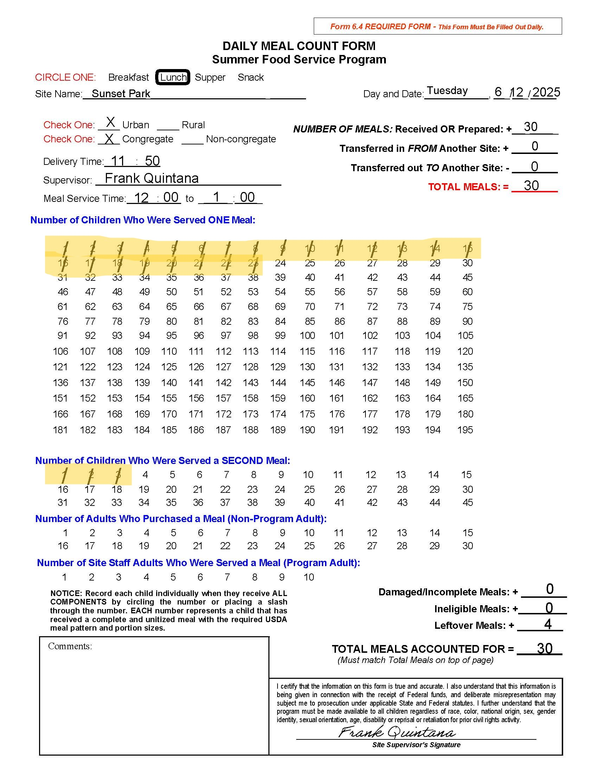
TICK MARKS TELL THE STORY, NOT THE NUMBERS!
The number of meals that were entered into Epics was 30, BUT according to the tick marks on this meal count form, only 23-1st meals were served on this day AND 3- 2nds. The actual number of meals served that should have been entered into Epics should have been 23-1st meals and 3-2nds meals.
Notes:
Training your site supervisors is key to a successful meal site and program. Monitors should be reviewing all meal count forms when turned in. Re-train staff if necessary. Do they understand the form and what needs to be completed? Remember, this form serves as an invoice for reimbursement. Also, non congregate meal sites can not give out 2nds. Also, there should not be a high number of seconds recorded. If this is the case, adjustments need to be made to meals prepared for the following day. Sponsors will only receive 2% of total number of meals claimed, not all 2nd meals are reimbursable, so your organization will be losing dollars.

Slide 12
SITE CAPACITY ADJUSTMENTS
Each meal site has an approved capacity that reflects the approved level of meal service
Insufficient site capacities will prevent you from entering correct meal counts
CAPs cannot be adjusted upward, once claim is submitted
Notes:
Your site supervisors will inform the monitors or coordinators if capacity changes are needed. Contact your assigned compliance officer if adjustments need to be made. Don’t wait, make those as soon as possible.

Slide 13
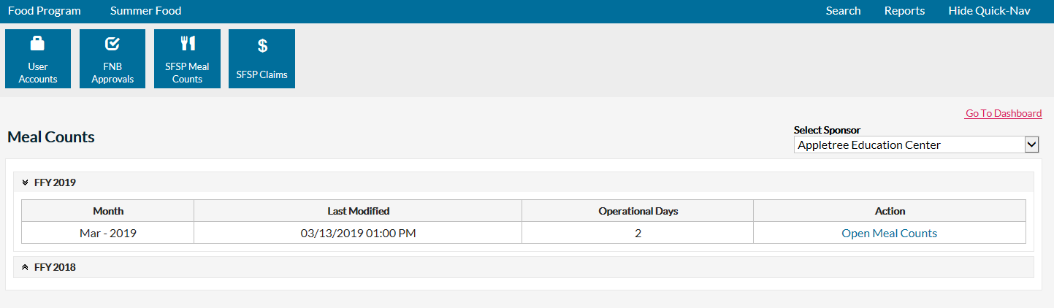
ADJUSTING MEAL COUNTS IN EPICS
Example: After claim submission
75 1st eligible breakfast meals was entered in EPICS
The correct number of 1st eligible breakfast served was 78
The correct adjustment is a positive 3
Notes:
Meal counts can be adjusted in Epics but there is a process. You will need to go in and make theses adjustments. If you need assistance, contact your compliance officer. You will start by clicking on SFSP meal counts in Epics, then open Meal counts on right hand side for that particular month.

Slide 14
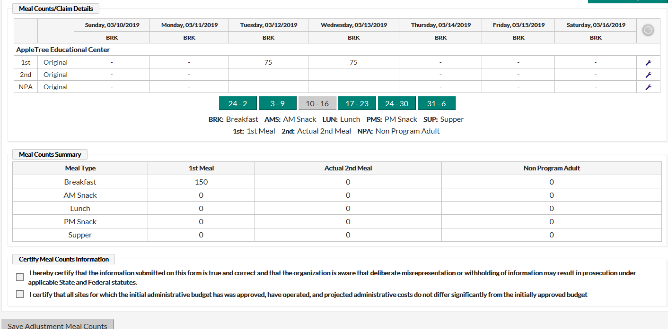
Notes:
Once the page opens on the correct day, you will click wrench on right hand side

Slide 15
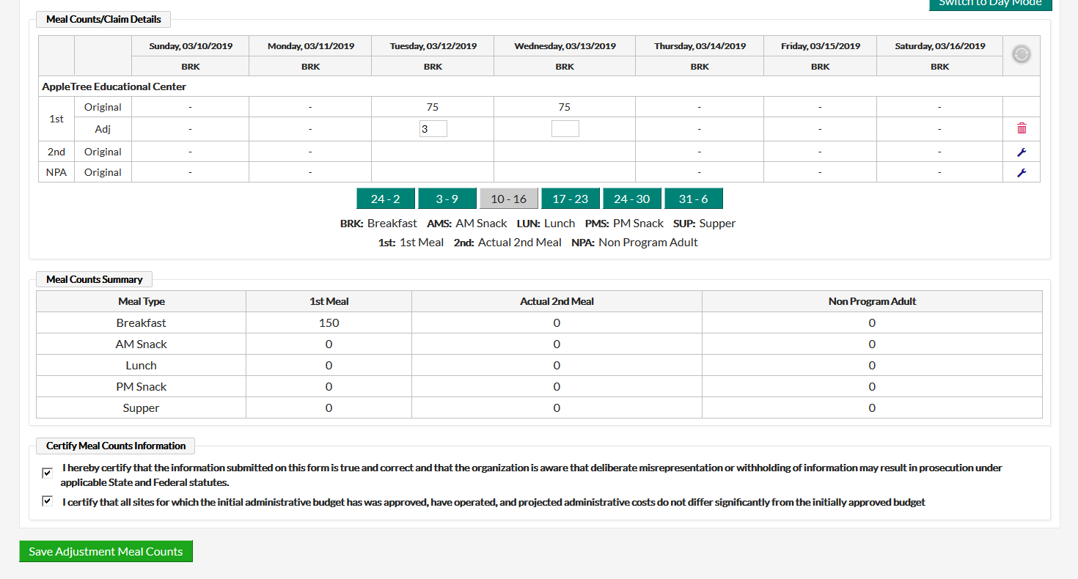
Notes:
And it will open up to allow you to make that adjustment. If it is a positive number, you will just enter that number but if a negative number needs to be entered, you will add a minus sign in front of the number. Then certify and save. This will capture your adjustment.

Slide 16
CLAIMS IN EPICS
Reminders
Claims are being completed as meal counts are being entered
Claim submission is a separate process
Notes:
Meal counts should be entered daily, especially with programs that have a large number of sites. Waiting can account for incorrect entry. Once you enter meal counts, then at end of the month you have to submit your claim. You also have a deadline for that claim submission.

Slide 17
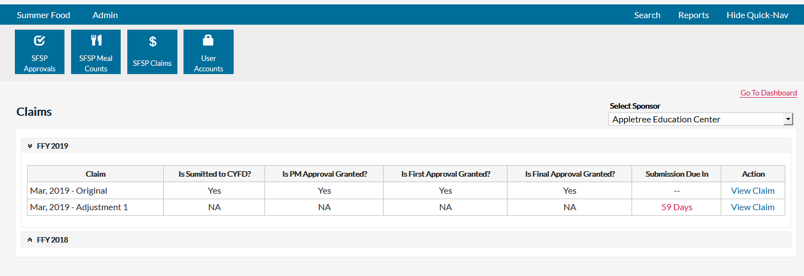
Notes:
In Epics in your claims page, you will have a count down on the number of days you have to submit your claim. But don’t wait. You also have a button where you can view claim. This will give you a picture of that particular month of participation.

Slide 18
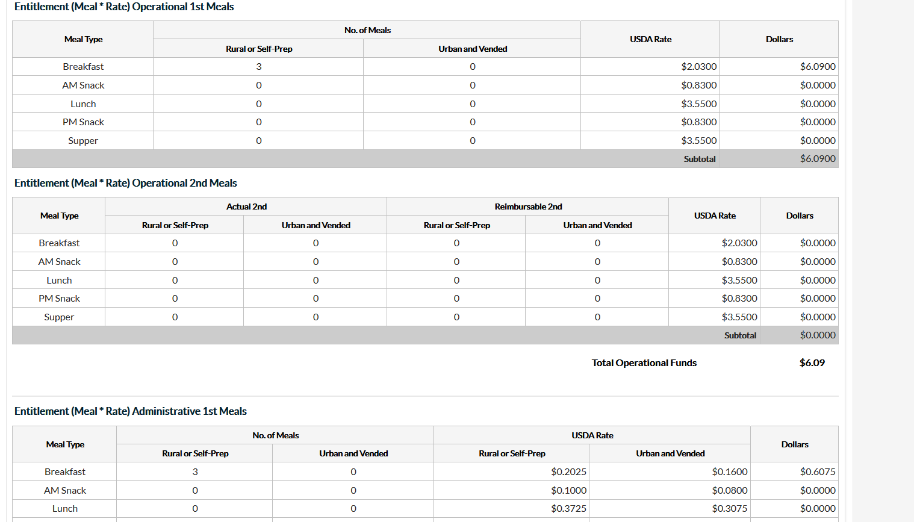
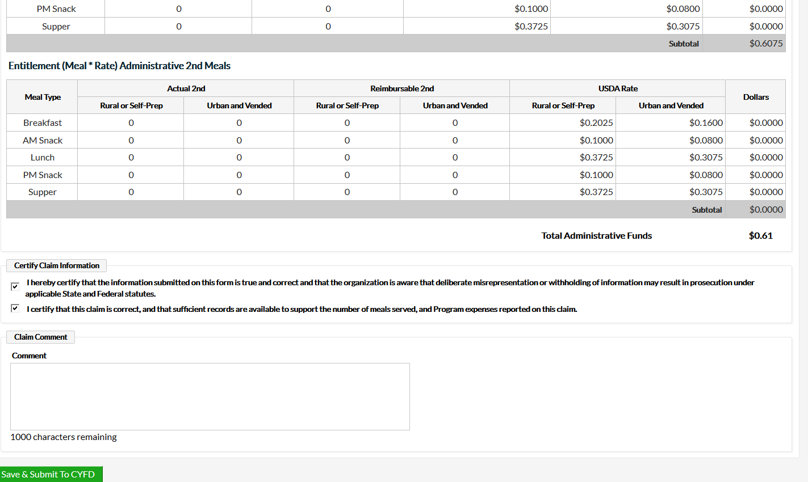
Notes:
You will also see any adjustments that were made.

Slide 19
Notes:
When you submit your claim, you will know if it was submitted correctly as you will see all steps of approval stating YES. Remember, if you are in need of assistance, don’t hesitate to contact our office.

