Slide 1
Early Childhood Education and Care Department
Cabinet Secretary Elizabeth Groginsky
SFSP Monitoring Requirements

Slide 2
SFSP Monitoring Requirements Understanding your Responsibilities

Slide 3
WORKSHOP GOALS
Understanding monitoring requirements
Successful Review
Notes:
There are many moving parts for an organization administering the summer food program. You have your operational staff, which would be cooks and assistants, delivery drivers and site supervisors. They are working to get those nutritious meals to participants. All very important roles. Then we have your administrative staff, which are your directors and coordinators and monitors. They will do the overall oversight of the program. But one of the most important roles for a successful program will be your monitors. Let’s spend a little time talking about that role as it plays maybe the one of the most important roles for your program.

Slide 4
MONITORING
It is not just completing a form
Monitors are critical to the successful operation of the program
Organizational monitor = state reviewer
Notes:
Monitors are the eyes and ears of your program. They will see and report and changes that are needed for the program. Do times need to be adjusted at meal site, are there more participants arriving after the site ends it service time, or maybe the meal site runs out of meals before the end of the meal service time? Do they need to make an upward adjustment of meals for the next day? Maybe there is a meal site that has very few participants or none from day to day. Does the site need to close or is a better option available to bring those participants to the site? Are all meal components included in the meal or are the meals at safe temps when delivered? This is why it is important that monitors are required to conduct their site visits at crucial times in the program. The beginning of the program, within the first 14 days and when the program is running at its full potential, within the first 28 days. The information that the monitor receives from the site supervisor and overall operation will make your program a success.

Slide 5
WHAT ARE THE REQUIREMENTS FOR THE SITE VISIT?
7 CFR 225.15(d)(2) Site visits must be conducted within the first fourteen calendar days of meal service only if the site is new or had operational problems in the prior year. Otherwise, site visits are not required.
NEW- Required if the site was previously congregate and now a non-congregate meal site
Brief visit to the site
Use updated SFSP form #7.2
Ensure the Program operates in accordance with the regulations
Identify problems or potential problems early
Implement corrective action for problems encountered
Conduct on-site training as necessary
Follow up when problems are found
7 CFR 225.15(d)(3) CAN DO BOTH AT THE SAME TIME. Sponsor may conduct food service reviews to occur at the same time as the site visit.
.
Notes:
The site visits that the monitors need to complete have deadlines that MUST absolutely be met. Please keep in mind that the days for theses deadlines are calendar days, which means weekends and holidays are included. Write them down on a calendar as a reminder. Remember that the Site visit can be brief but long enough to ensure that your meal site is running as it should with no issues. If the monitor should have any concerns or issues, it should be reported immediately to coordinators or their directors to correct. Time is valuable.

Slide 6
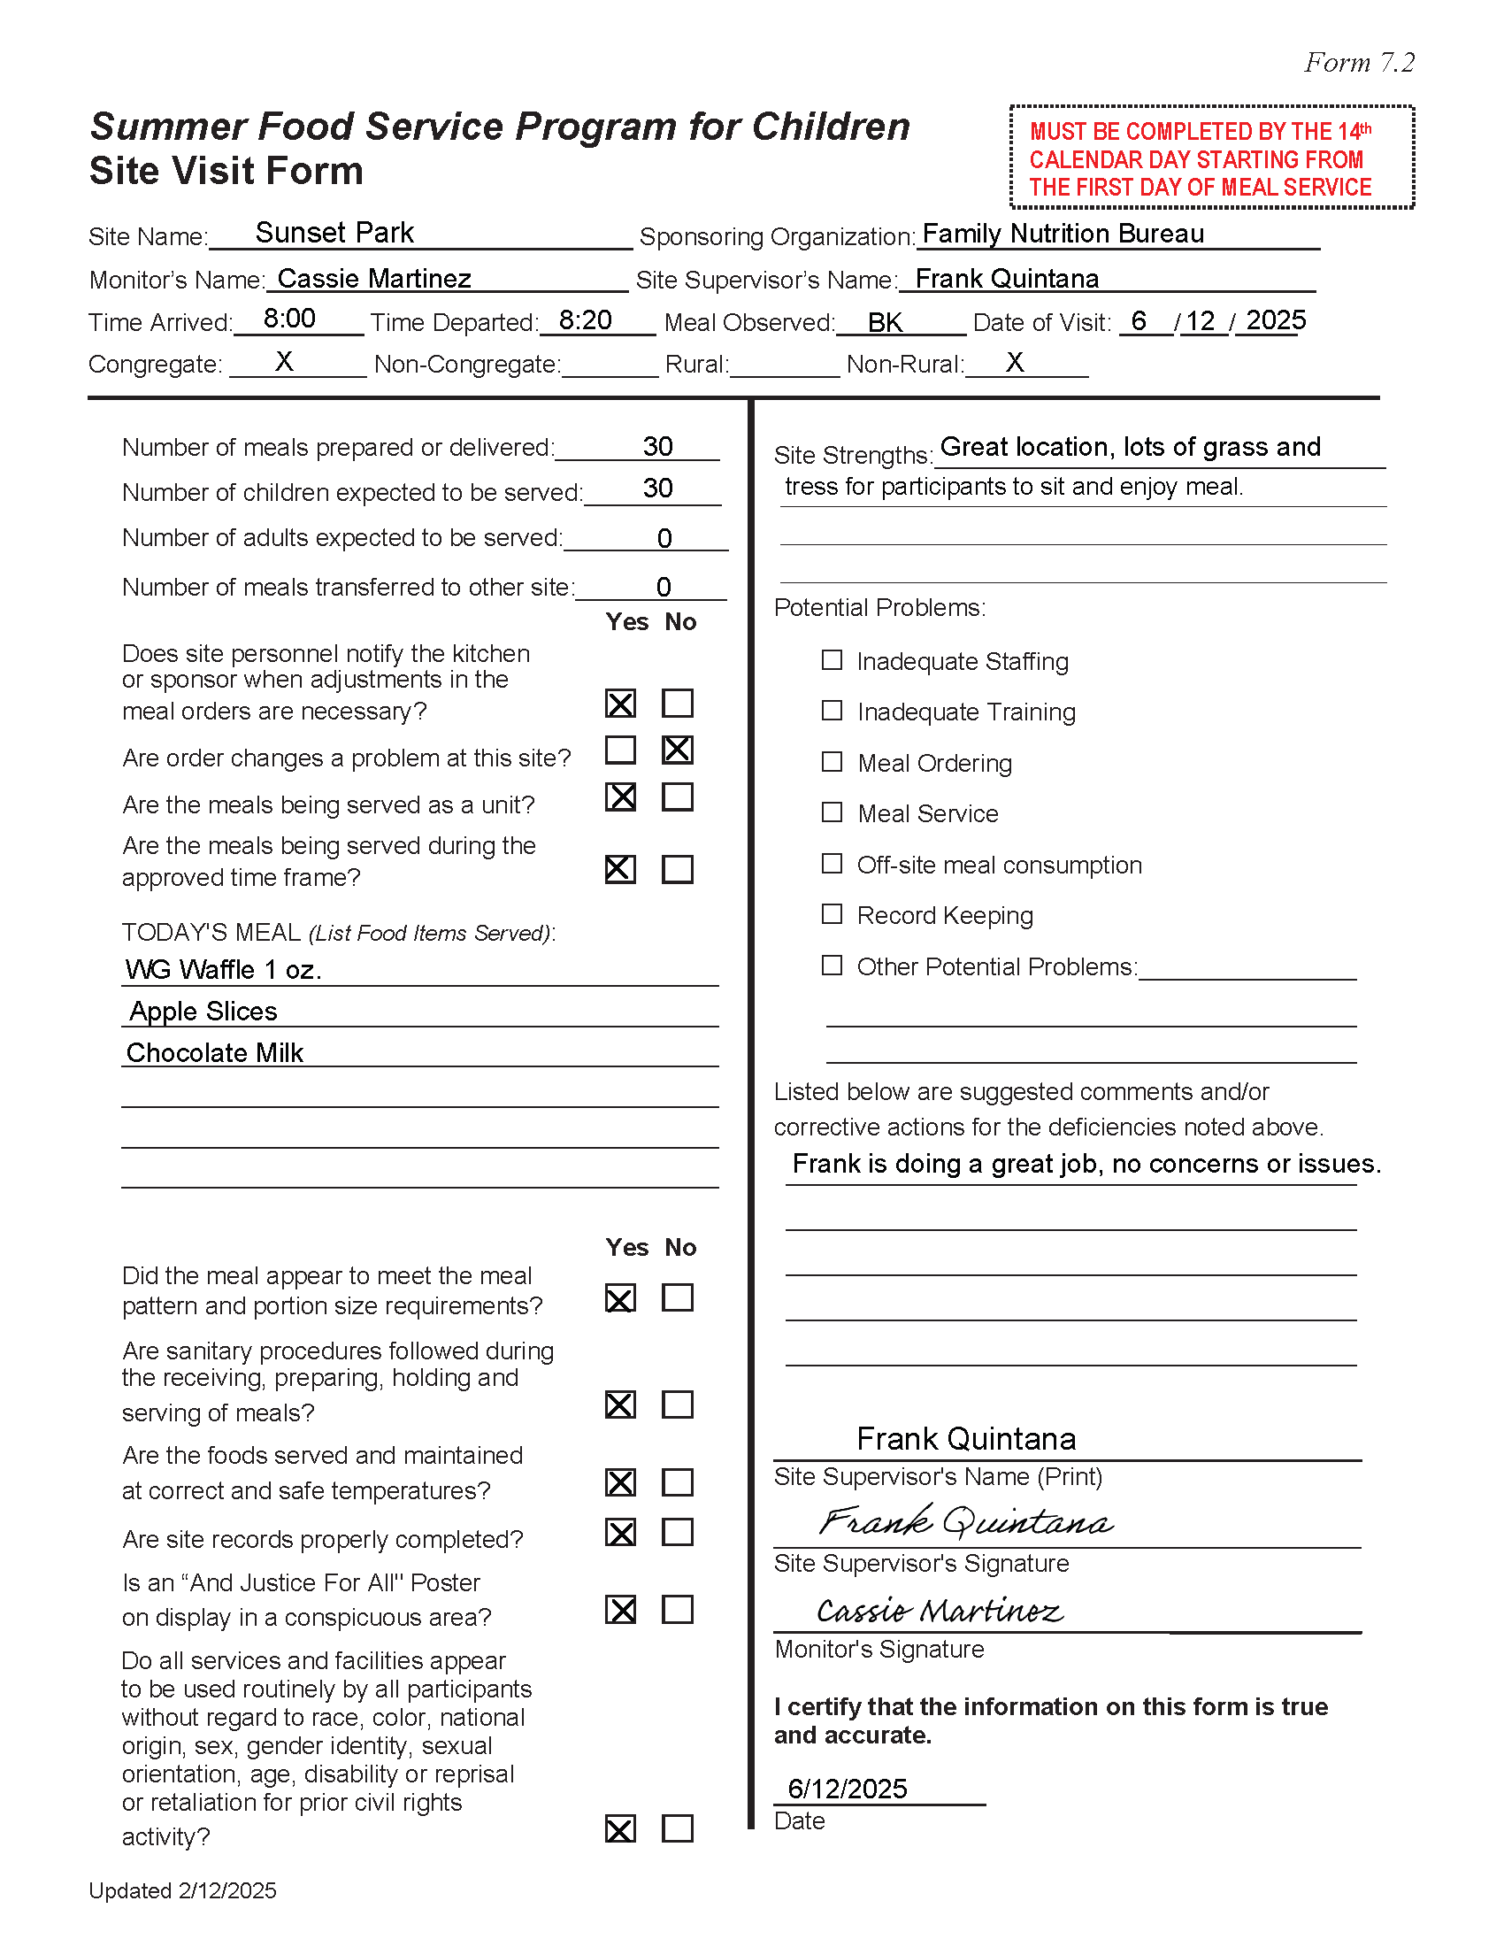
SITE VISIT FORM
Notes:
The 7.2 form is a one-page form that will gather information of the meal site. But as all forms, has important information and should always be completed entirely. No abbreviations, list times and meal types, names of site supervisors and site names. And of course, sign and date all forms. If there are concerns, monitors can list them on the form. This will let us know that there may have been an issue but was quickly addressed. This is what makes a great monitor and successful program. This information will be gathered during your programs administrative review. If needed, it is always a great idea to have that second pair of eyes to ensure forms are completed correctly.

Slide 7
WHAT ARE THE REQUIREMENTS FOR A FOOD SERVICE REVIEW
Conduct a food service review within first 28 calendar days of meal service
Must stay the entire approved meal service time
Use SFSP form #7.4
New information- Congregate, Non-Congregate, Rural, Non-Rural
Ensure the program operates in accordance with the regulations
Correct any problems not previously identified
Implement corrective action for problems encountered
Conduct on-site training as necessary
Follow up when problems are found
Notes:
The food service review, as stated, the monitor will need to stay the full duration of the meal service. Getting a full view of the meal service will let you know that your site supervisors are following POS requirements and that meal counts are being captured correctly. This comes down to dollars for your program. If the monitor feels that another visit maybe needed to any meal site that may have had issues, this can also be done. The overall goal is to capture any issues or concerns and get them addressed immediately.

Slide 8
FOOD SERVICE REVIEW FORM
Notes:
The 7.4 Foos Service Review form is 2 pages. Again, no abbreviations and please make sure that all information is completed, and forms are signed and dated. Deadline reminders are on the upper right-hand side of the form….don’t forget to write them down so you get your visits done.

Slide 9
ACTIVITY
Explore!
Discover!
Grow!
Enrich!
Notes:
Now a little example for you.

Slide 10
Notes:
The program started on the 2nd day of June. You will count the very first day of the start of the program as part of the 14 days. The site visit on this example was conducted on June 12th which is the 11 day from the start of the program, therefore meeting the 14-day deadline which would fall on the 15th of June and a weekend.

Slide 11
Notes:
This example shows that the 1- day visit was conducted on the June 16th which exceeded the deadline by 1 day. Which now, Program is out of compliance with this site visit.

Slide 12
Notes:
This is an example of the 28-day food service review. Again, the program started on the 2nd of June and the review was conducted on the 26th. The food service review was conducted within the 28-day deadline which fell on the 29th. Remember, count weekend days as part of that deadline.

Slide 13
Notes:
This calendar shows that the review was conducted on July 3rd, definitely out of compliance. In Epics, when you are completing the application, you will be instructed to pick the day these visits will be conducted…perfect time to pull out that calendar and write them down.

Slide 14
PROBLEMS IDENTIFIED DURING ADMINISTRATIVE REVIEW
Conducted the visit and /or review past the deadline
Conducting Site visit prior to start of meal service
Not staying for the entire approved time during the Food Service Review
Food component missing during visit/review
Forms are incomplete/signatures
Monitor improperly trained
Notes:
If you have questions about monitoring or any other concern for the program, please reach out to us for assistance.

Slide 15
REMINDERS
When are site visits required?
When sites are new
When sites had operational problems in the prior year
Includes sites that run 1 week or less
Includes sites that only run one day
If site was previously congregate and now non-congregate
Regardless of how long the site operates each site needs a food service review
Includes sites that run 1 week or less
Includes sites that run 1 day
Site name must match what was approved in EPICS
No abbreviations
Notes:
If you know a site is going to close early, ask yourself if you did the visit and review? If not, complete immediately. And remember, both visits can be conducted at the same time but must stay the entire duration of the meal service time.

Slide 16
MORE REMINDERS
...and did you know?
Must count weekends and holidays toward deadline
First day of meal service counts as day one
All sites require both a site visit and site review regardless of how many days the site is scheduled to operate
And remember, sites that were congregate previously and are now non-congregate, MUST receive a Site Visit
Notes:
We are here to assist and always here for questions..please call us.

