Slide 1
Early Childhood Education and Care Department
Cabinet Secretary Elizabeth Groginsky
SFSP NMED Requirements
Notes:
Acknowledge: Governor, Dr. Scrase, Sec. Stewart
Thank you, Secretary Stewart – and thank you, Governor, for the chance to share an update on child care and other early childhood programs in New Mexico.
NEXT SLIDE

Slide 2
NM Environment Department Requirements

Slide 3
NMED Food Code
New Food Code is effective January 1, 2019; adopted from the most recent FDA Food Code—2017
Applies to all organizations permitted under NMED jurisdiction (Districts I, II, and III)
Includes new mandate for Food Handler Cards (FHC) and Certified Food Protection Manager (CFPM) certifications, effective April 1, 2019

Slide 4
Food Handler Card (FHC) Mandate
Effective April 1, 2019, FHCs are required for ALL employees who:
Handle unpackaged food (prep, cook, serve);
Handle utensils; or
Utilize food contact surfaces (cutting boards, prep tables, serving lines, etc.)
Food Handler
Handles Food (prep/cook/serve)
Handles utensils
Utilizes food contact surfaces

Slide 5
FHC Continued
May be obtained upon successful completion from one of the 22 ANSI-Accredited training programs
Cost: $10-30
Valid for 3 years; stays with the individual to whom it was issued (useful and portable)
REQUIRED for cooks/prep; STRONGLY recommended for anyone who may serve food in the SFSP Program!

Slide 6
Exemptions
Sponsor employees that do not handle, prepare, cook or serve bulk food items
Site Supervisors that handle packaged meals
Site Assistants that handle packaged meals
Volunteer Food Employees
Employees or volunteers who occasionally function as Food Employees are not required to obtain a FHC (e.g. administrative staff)

Slide 7
CFPM Mandate
Certified Food Protection Manager – a person who has demonstrated by means of a food safety certification examination that he/she has the knowledge, skills and abilities required to protect the public from foodborne illness
Effective April 1, 2019: At least one employee at each permitted food establishment that has supervisory and management responsibility and has authority to direct and control food preparation and service must be a Certified Food Protection Manager

Slide 8
Sponsor’s Responsibility
It is the responsibility of both the Sponsor’s SFSP Program Coordinator and CFPM to ensure that staff are appropriately trained and certified in food safety!
SFSP encourages all Program staff to complete an ANSI-Accredited FHC training program

Slide 9
CFPM Continued
May be obtained upon successful completion from one of the 7 ANSI-Accredited programs
Cost: $100-150
Valid up to 5 years; again, stays with the individual to whom it was issued
A CFPM is permitted to be responsible for more than a single food establishment with an approved variance

Slide 10
A Note for Vended Sponsors
Food Service Management Companies (FSMC) and School Food Authorities (SFA) will have their own CFPMs within their organizations—so it may not be necessary for vended sponsors to have a CFPM on staff
However, this does not mean sponsors who received vended meals from a FSMC or SFA are automatically exempt from having FHC holders on staff. If you are serving food, it is better to be safe than sorry!
If you are unsure of your requirements, please contact your NMED District Field Office or other Regulatory Agency

Slide 11
Temporary Food Establishments (NMED Chapter 10)
All sponsors who plan to operate an offsite food establishment (i.e. grill sites) must contact their respective Environmental Health Agency office for exact requirements and permitting
General Requirements:
Must provide a handwashing sink or station for foodservice employees with adequate liquid soap and paper towels
Maintain adequate supply of potable water for handwashing, food preparation, etc.
Person-in-charge at all times during operation of site must be a CFPM or have a Food Handlers Card
Notes:
If you are interested in operating a portable food service operation during your Program, please contact your EHA for exact requirements. These types of sites have their own unique and separate regulations from your day-to-day food service operation.

Slide 12
For more information on FHC/CFPM requirements and Temporary Food Establishments, contact the NMED District Field Office nearest you.
https://www.env.nm.gov/district-field-offices/

Slide 13
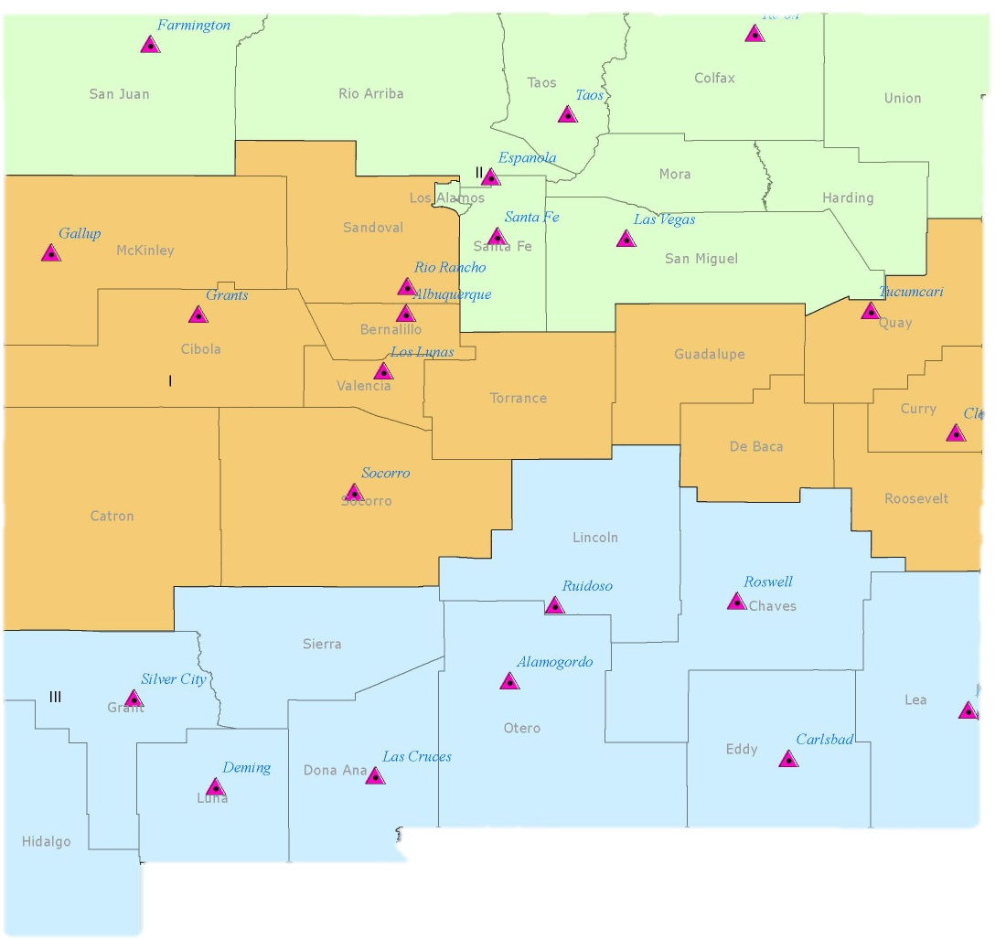
District II
District I
District III
District Field Offices

Slide 14
Regulatory Agencies Not Under NMED
Bernalillo County Consumer Health Protection;
City of Albuquerque Environmental Health Dept.;
Indian Health Service (IHS);
Navajo Office of Environmental Health; and
US Military base health and environment officials
**These Agencies have their own requirements based on FDA Food Codes. It is every Sponsor’s responsibility to know their regulatory agency and their requirements.**

Slide 15
Questions?

