Slide 1
Early Childhood Education and Care Department
Cabinet Secretary Elizabeth Groginsky
Procuring Goods and Services in the SFSP

Slide 2
Procuring Goods and Services in the SFSP

Slide 3
State Procurement Procedures
Why?
To achieve fair and open competition for Federal dollars
To obtain products efficiently and economically
To prevent fraud, waste and abuse
To comply with Federal, State and local requirements
State
Requirements for various purchase thresholds in New Mexico Administrative Code (NMAC) are stricter than those of the Federal government
Federal
2CFR, Part 200.318(a) – The non-federal entity must use its own procurement procedures which reflect applicable State, local and tribal laws and regulations, provided that the procurements conform to applicable Federal law and the standards identified

Slide 4
First Tier Small Purchases Up to $10K
Single purchases up to $20,000.00 for:
General services – (not professional)
Construction – most types not allowable in SFSP
Tangible property
food service equipment, food, non-food, supplies, computer, furniture
Must award based on “Best obtainable price” (1.4.1.50 NMAC)
2 quotes is good.
3 quotes is better!
Quotes must be documented
Written – Company letterhead
Verbal – Develop written record to vendor acknowledging his/her quote
Internet – Print web page

Slide 5
Second Tier Small Purchases 10K and up to $250K
Single purchases from $10,000.01 - $250,000.00
General services – (not professional)
Construction – most types not allowable in SFSP
Tangible property
Must award to lowest, acceptable quotation – (1.4.1.51, C)
Quotes solicited from no fewer than 3 businesses – (1.4.1.51, A)
Develop written request for solicitation of quotes. Include product/service specifications - (1.4.1.51, A)
Quotes must be documented and recorded - (1.4.1.51, D)
Must also comply with 1.4.1.51, B of the New Mexico Administrative Code (NMAC) – Disclosure restrictions
Cannot break up single purchase into smaller purchases to avoid obtaining 3 quotes

Slide 6
Competitive Sealed Bid Procurement
Purchases that are over $250,000
Formal procurement process (competitive sealed bid) – 1.4.1.15 NMAC
Must follow requirements set forth at 1.4.1.14 – 1.4.1.28 NMAC for competitive sealed bids
For contracts more than $250,000. bid and performance bonds needed.
Bids submitted – Obtain bid bond between 5% and 10% of value of contract
Contracts entered into – Obtain performance bond between 10% and 25% of the value of contract – 7CFR, Part 225.15(m)(6)
Cannot artificially break up single purchases over $250K to avoid competitive sealed bid procedures

Slide 7
Procurement Reminder
7CFR, Part 225.17(e)
Geographic Preference Option when procuring locally raised or grown, unprocessed foods

Slide 8
Definition of Unprocessed
Unprocessed agricultural products retain their inherent character
The term “unprocessed” precludes the use of Geographic preference in procuring agricultural products that have significant value added components
Accepted “unprocessed” agricultural products may have been minimally handled or prepared such as may be necessary to use in the CN programs such as:
Cooling, refrigerating, and freezing
Peeling, slicing, dicing, cutting, chopping, shucking, and grinding
Forming ground products into patties
Washing, packaging, vacuum packing, and bagging
Adding preservatives to prevent oxidation
Butchering livestock or poultry
Pasteurizing milk
Placing eggs in a carton

Slide 9
Dried Beans

Slide 10
Canned Beans

Slide 11
Geographic Preference Definition
Final Rule - Federal Register, Vol. 76, No. 78, 4/22/2011
“…Geographic preference is a tool that gives bidders in a specified geographic area a specific, defined advantage in the procurement process.”
“…Procurements may be accomplished through informal or formal procurement procedures, as required by respective Child Nutrition Program regulations.”.

Slide 12
Stipulations
Final Rule - Federal Register, Vol. 76, No. 78, 4/22/2011
“…geographic preference is not a procurement set- aside for bidders located in the specified geographic area, guaranteeing them a certain level or percentage of business.”
“…Does not preclude bidder from outside GP area from submitting a competing bid, or possibly being awarded the contract…”

Slide 13
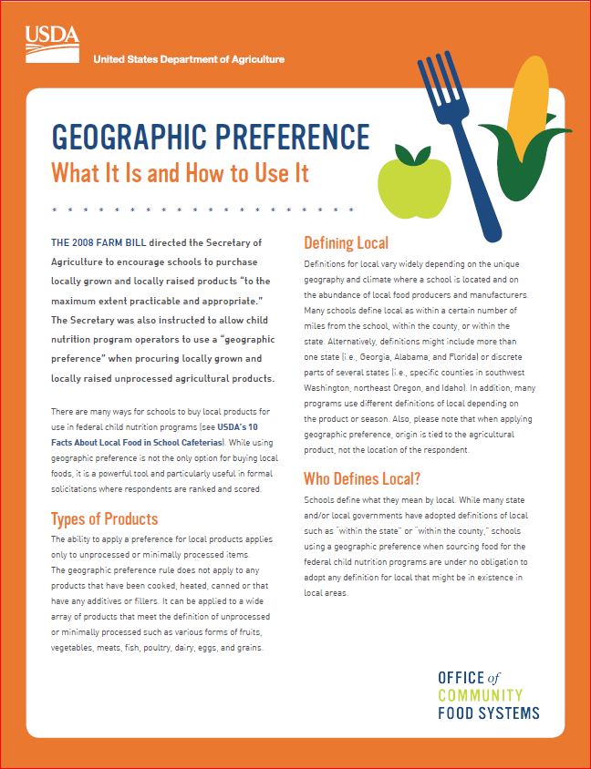
Applying Geographic Preference
“…the Sponsor making the purchase has the discretion to determine the local area to which the geographic preference option will be applied.”
7CFR, Part 225.17(e)(1)
The purchasing institution must not define local in a manner that unnecessarily restricts free and open competition
SP Memo 18-2011
https://summerfoodnm.org/sponsors/program-resources

Slide 14
Government-wide Debarment and Suspension (Non-procurement)
Debarment – To bar from having or doing something
Synonymous with – “Preclude”
To exclude
To bar
To prevent
To make impossible
In other words – Can’t do it!

Slide 15
Non-procurement
Prior to contracting, Sponsor must ensure contracting entity or person is not debarred or suspended from Federal assistance programs or activities
Food Service Management Company
Unitized SFSP meals
Meal delivery service
Individual providing service on contract
Consultants
Temporary employment service
Site Supervisors

Slide 16
Determine non-procurement status for contractors
Sponsor responsibility to search the System for Award Management (SAM) website.
https://sam.gov/content/home

Slide 17
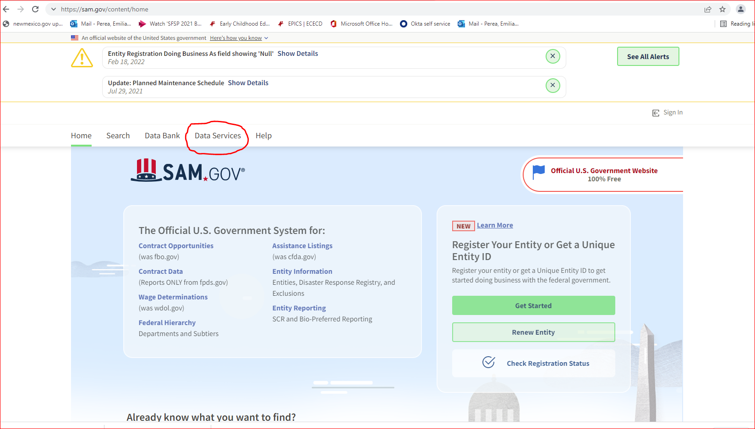

Slide 18
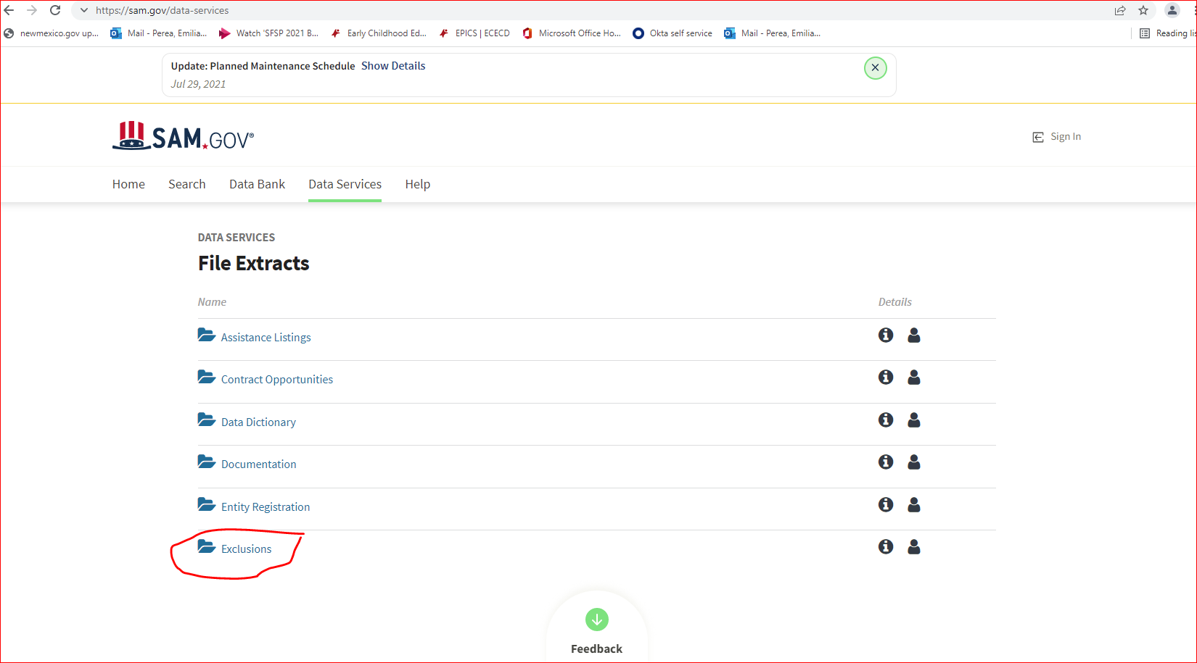

Slide 19
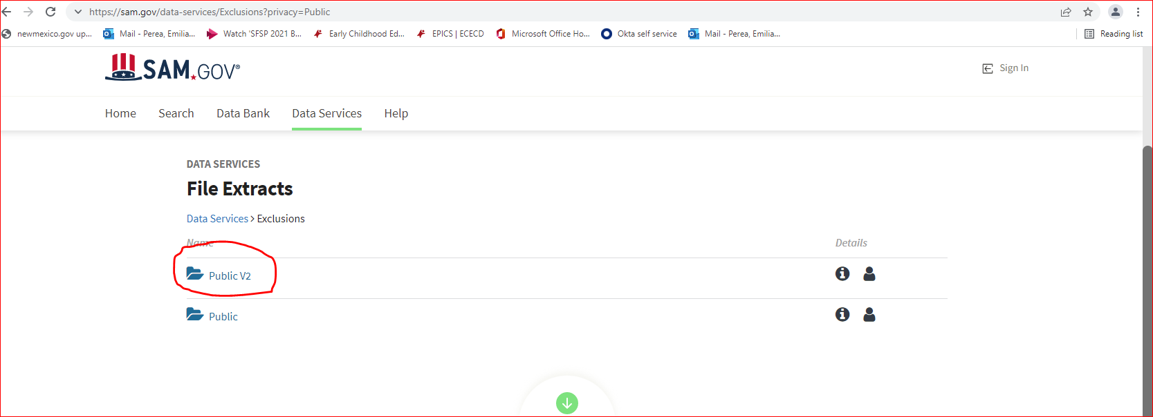

Slide 20
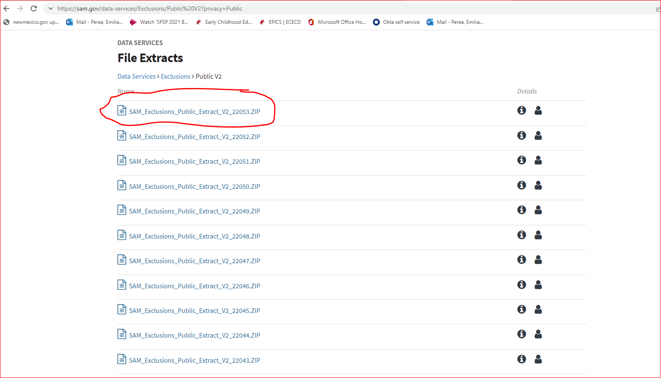

Slide 21
Procurement Reminder
7CFR, Part 225.17(c)
Small and minority business
Women’s business enterprises and
Labor surplus area firms

Slide 22
Contracting with small & minority business, women’s business enterprises, and labor surplus area firms
The sponsor must be aware of the following practices:
Placing qualified small and minority business and women’s business enterprises on solicitation lists;
Assuring that small and minority businesses, and women’s business enterprises are solicited whenever they are potential sources;
Dividing total requirements, when economically feasible, into smaller tasks or quantities to permit maximum participation by small and minority business, and women’s business enterprises;

Slide 23
Contracting with small & minority business, women’s business enterprises, and labor surplus area firms (cont.)
Establishing delivery schedules, where the requirement permits, which encourage participant by small and minority business and women’s business enterprises;
Using the services and assistance, as appropriate, of such organizations as the Small Business Administration, and the Minority Business Development Agency of the Department of Commerce; and
Requiring the prime contractor, if subcontracts are to be let, to take the affirmative steps listed in paragraphs (1) through (5) of this section

