Slide 1
Early Childhood Education and Care Department
Cabinet Secretary Elizabeth Groginsky
SFSP Recordkeeping and Program Costs
Notes:
Acknowledge: Governor, Dr. Scrase, Sec. Stewart
Thank you, Secretary Stewart – and thank you, Governor, for the chance to share an update on child care and other early childhood programs in New Mexico.
NEXT SLIDE

Slide 2
RECORD KEEPING AND PROGRAM COSTS
Notes:
Keeping all program costs organized and available is important for a successful program.

Slide 3
FINANCIAL REQUIREMENTS
Administrative Cost Records
Operating Cost Records
Meal Counts
Notes:
All costs must be documented. It is important that you keep SFSP costs separate from all other programs costs that your organization has, including grants. Administrative costs are those needed to run the actual program, and operational are those costs that go directly into feeding children.

Slide 4
OPERATIONAL REIMBURSEMENT
Operational reimbursement may be used for any cost directly associated with the purchase, preparation, packaging, delivery and service of meals to children.
Notes:
Operational Costs include the invoices and receipts for food purchased for the meals, the labor that is needed to cook and prepare meals as well as the delivery of the meals to meal sites. Your invoices and receipts need to show the actual amounts of food purchased, especially milk that is required. Part of the operational cost are also any check stubs for your operation staff that includes, cooks, delivery drivers and site supervisors.

Slide 5
ALLOWABLE OPERATING COSTS
Allowable operating cost include:
Cost of obtaining food
Labor directly involved in the preparation, service and delivery of food
Cost of nonfood supplies
Rental and use allowances for equipment and space
Cost for transporting children in rural areas to meal site in rural areas
Mileage for food transport
Coolers/Food transport bags
Notes:
If there are items that are not listed , please call myself or our Program Manager Mrs. Debra Candelaria so we can determine if it is an allowable cost. If an item is purchased that is not on the list and not pre-approved, the organization will have to pay that item out of another account.

Slide 6
ADMINISTRATIVE REIMBURSEMENT
Administrative reimbursement may be used for allowable costs related to the administration of the program
Notes:
There is a list of items that we will now look. Again, if you have a question regarding items not listed, please contact our office.

Slide 7
ALLOWABLE ADMINISTRATIVE COST
Attending training provided by the State agency
Preparing and submitting application for participation
Preparing and submitting claims for reimbursement
Generally, cost incurred are:
Mileage for monitor/training
Administrative salaries, taxes and benefits
Rental costs for office, office equipment
Office supplies/copying
Cell phones/communication for sites and Monitor
Outreach/advertising
Audit
Notes:
Remember, invoices and receipts must be kept in order to claim these as part of your administrative costs. Quotes will not be accepted.

Slide 8
LABOR EXPENSES (SALARIES)
Time Sheets
Payroll reports
Time Sheets, payroll reports inclusive of employer contribution
Gross pay and minimum tax:
1.45% Medicare
6.20% Social Security
= 7.65% FICA (Federal Insurance Contributions Act)
Federal Minimum
Your organization may be higher
Other employer paid contributions for employee benefits
Notes:
Other employer paid contributions for employee benefits can also added to your administrative costs are fringe benefits or employer contributions: Common fringe benefits include health insurance, life, employee retirement.

Slide 9
OTHER ALLOWABLE COST FOR SFSP
Repairs to equipment for food service
Repairs to delivery vehicles
Kitchen Utilities
Security at the sites
SFSP advertising and awareness
Notes:
These items may need to be pre-approved by the Program Manager. Also, keep in mind there is also the Enhancement grant that can be used for some of these costs as well. Contact your state agency for more information.

Slide 10
MEAL COST FOR VENDED PROGRAMS
The amount invoiced to the sponsor by the FSMC or SFA may include cost for the following items
Kitchen labor
Food
Non-food supplies
Kitchen utilities and permitting fees
Facility use
The sponsor will not necessarily know the cost detail
Sponsor should list the total invoice amount under the “other items” on the claim
Notes:
A contract will be required during the application approval. It will outline what the FSMC will be providing to the sponsoring organization.

Slide 11
DEFINITION OF UNALLOWABLE COST
Unallowable costs are costs for which Program funds may not be used
Sponsor may pay for unallowable costs from some other fund
Notes:
Please contact the state office if you have questions before purchase.

Slide 12
EXAMPLES OF UNALLOWABLE COSTS
Vehicle purchase
Air conditioners - unless it is rented or leased
Unallowable food – i.e. deli meats with no CN label or product formulation
Unauthorized Purchases of over $5,000.00
Bonuses - changing pay scale mid-stream of the program
Prepurchase of gas cards
Under no circumstances, the cost of disallowed meals
Notes:
If you have excess funds those dollars cannot be used to off set the cost of the disallowed meals

Slide 13
CONTROL AND ACCOUNTABILITY
To ensure program funds and program assets are safeguarded
To ensure funds and assets are used solely for the authorized program purpose
Account coding
Notes:
Internal controls ensure that management has accurate, timely and complete information, including accounting records, in order to plan. Account coding keep all program separate

Slide 14
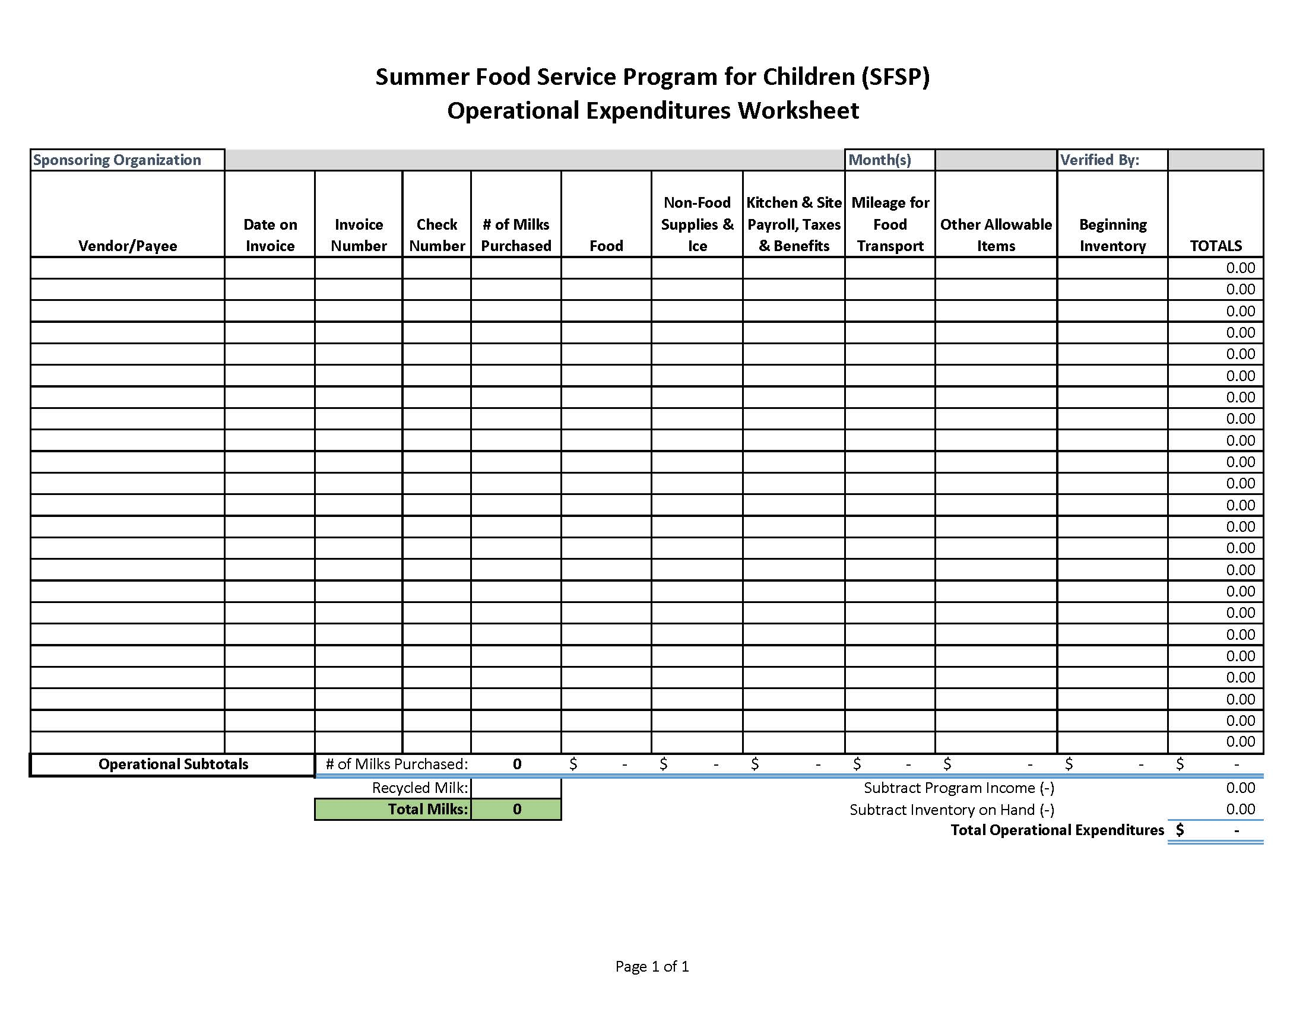
Notes:
Using the 4.12 Excel Spread sheet on our summerfoodnm.org website can help keep track of your expenses. It keeps a running total of costs as well as the amount of milk purchased. It is a great tool.

Slide 15
MAINTAINING AND SUMMARIZING RECORDS OF COST
Sponsor must be able to account for the receipt, obligation, and expenditure of all SFSP expenses
Records must be maintained that support all administrative and operating cost attributed to SFSP
Enables the state to substantiate claims for reimbursement
Track your costs
Excel spreadsheet
Existing accounting system
SFSP forms
Record Retention
Must maintain all records for three years plus current year
Notes:
Make sure and keep copies of receipt before you give to your finance office. SFSP in-house forms 4.7 for op and 4.1 admin worksheet

Slide 16
MAINTAINING RECORDS OF COST, INVENTORIES AND REQUIRED PROGRAM COST
Required
Failure to maintain records of cost is a program deficiency
Maintain records of cost in two main categories
Operational
Administrative
Maintain cost by the month or all months combined
Use internal finance system or SFSP resources
Maintain invoices and receipts to support summarized costs
Have records and summary of cost available for review
Notes:
We will need to see all receipts and invoices for administrative review. Please keep them separate from all other costs of the different programs your organization has implemented.

Slide 17
PROGRAM INCOME FROM NON-PROGRAM ADULTS
USDA recommends charging non-program adults the corresponding reimbursement rates per meal
The money received must be documented as income to the program to offset documented costs
List on claim as “Program Income”
Notes:
The is a 6.1 Cash Report for Meals Sold form that you can download to use.

Slide 18
FOOD AND NON-FOOD INVENTORY
The value of the beginning inventory is determined by taking a physical count before the food service operation begins
The value of the ending inventory is a complete physical inventory of all purchased foods, and supplies, and must be taken at the end of the reporting period.
Inventory is a key aspect of a nonprofit food service and is required of sponsors
Notes:
Arrange the items according to food groups in storage and refrigerator, freezer units. Food is dated when it is received.

Slide 19
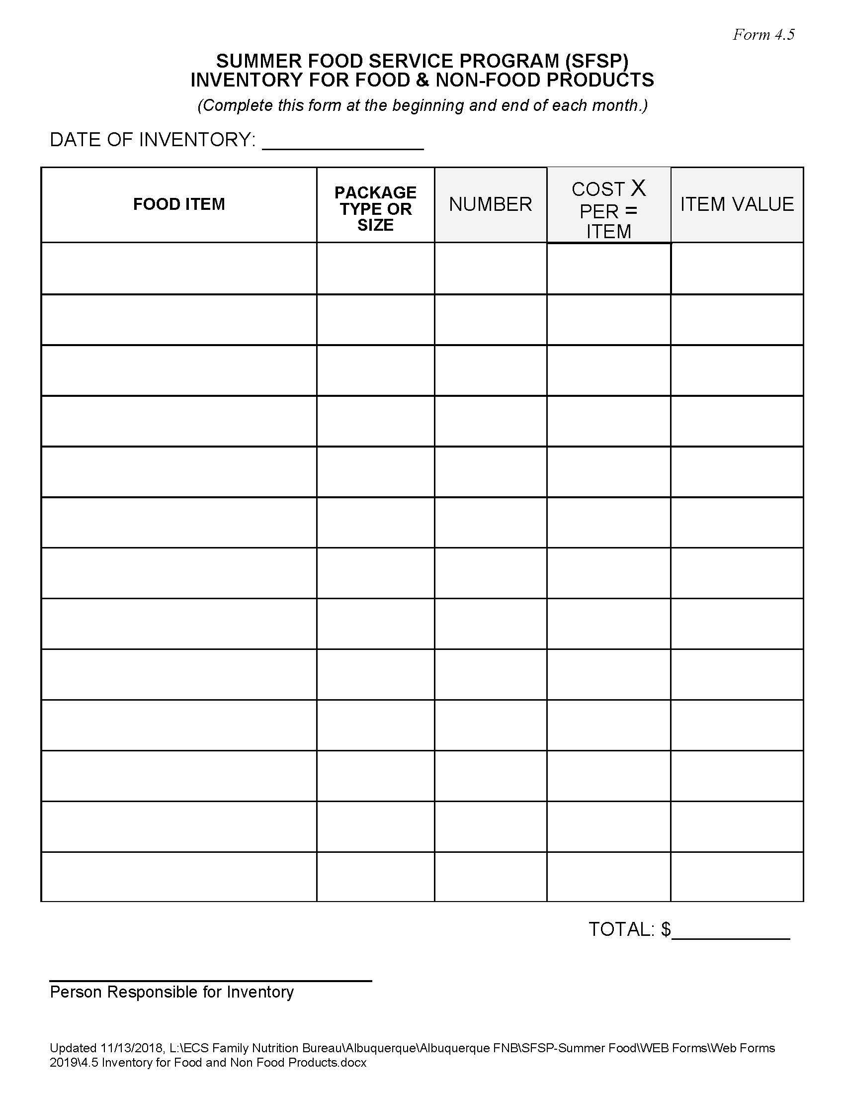
Notes:
4.5 Form

Slide 20
REPORTING COST ON THE CLAIM
Highly recommended
Failure to report cost could result in unused reimbursements
Refer to summarized records of cost
Operational
Administrative
May report cost by the month or at the end of Program
You can combine total cost onto one claim
Do not delay submission of claim due to unavailability of total cost
The reporting or non reporting of cost does not affect payment
Notes:
Focus on payment not cost

Slide 21
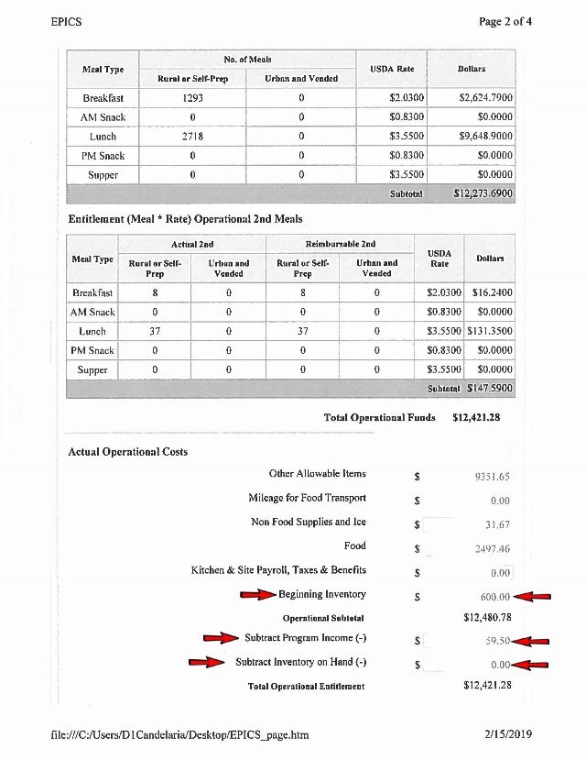
OPERATIONAL COST
Notes:
4.5 Form

Slide 22
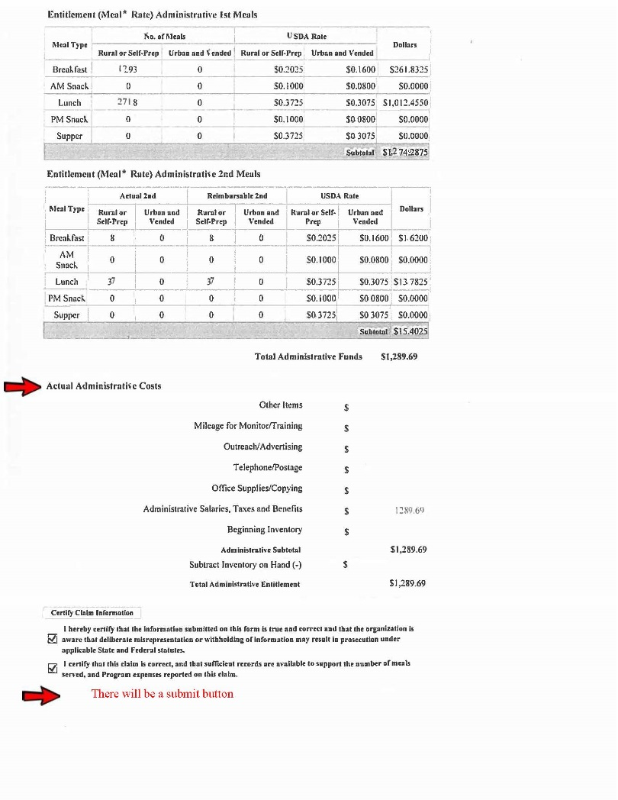
ADMINISTRATIVE COST

