Slide 1


Early Childhood Education and Care Department
Cabinet Secretary Elizabeth Groginsky
Welcome Introduction and Updates
Notes:
Thank you, Secretary Stewart – and thank you, Governor, for the chance to share an update on child care and other early childhood programs in New Mexico.
NEXT SLIDE

Slide 2

WELCOME to the
SUMMER FOOD SERVICE PROGRAM for CHILDREN (SFSP) 2025
Contact
Debra Candelaria, Program Manager
(800) 328-2665 (Toll-Free)
(505) 699-2596 (Cell)
https://summerfoodnm.org
Notes:
Introduction of self and participants
What will be covered: background on NM, 2024 data, SFSP cycle, simplified

Slide 3
Introductions
Debra Candelaria – Program Manager
Christine Juancho – Senior Compliance Officer
Frank Quintana & Cassie Martinez – Compliance Officers
Laura Spencer – Nutrition Education Training Manager
Ronna Faris & Brianna Castillo – Nutrition Staff
Lupita Perez – Financial Manager
Leticia Rodriquez – Business Analyist

Slide 4
SFSP Online
All forms are available on-line
All resources are available on-line
All training slides are available on-line
https://summerfoodnm.org/sponsors

Slide 5
New Functionality for Assurances
Sponsors will need to provide their Congressional District #
Please include the Meal Service Type

Slide 6
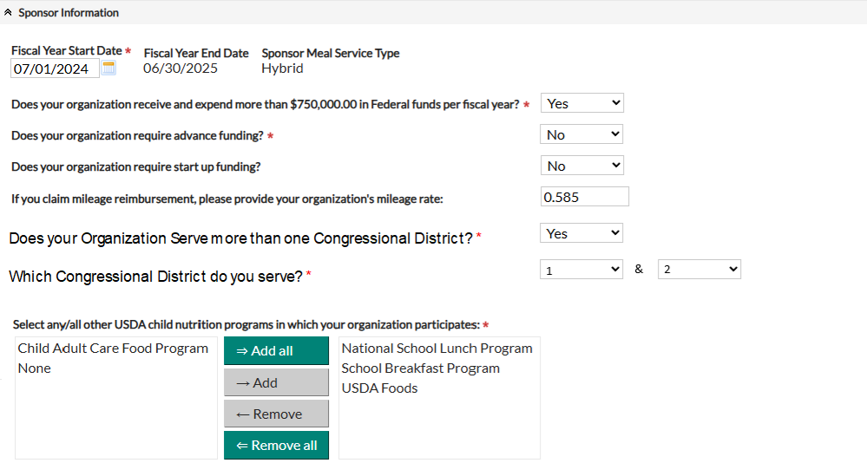


Added Assurances
Meal Service Type

Slide 7
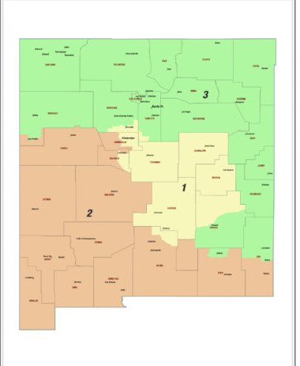
Congressional District

Slide 8
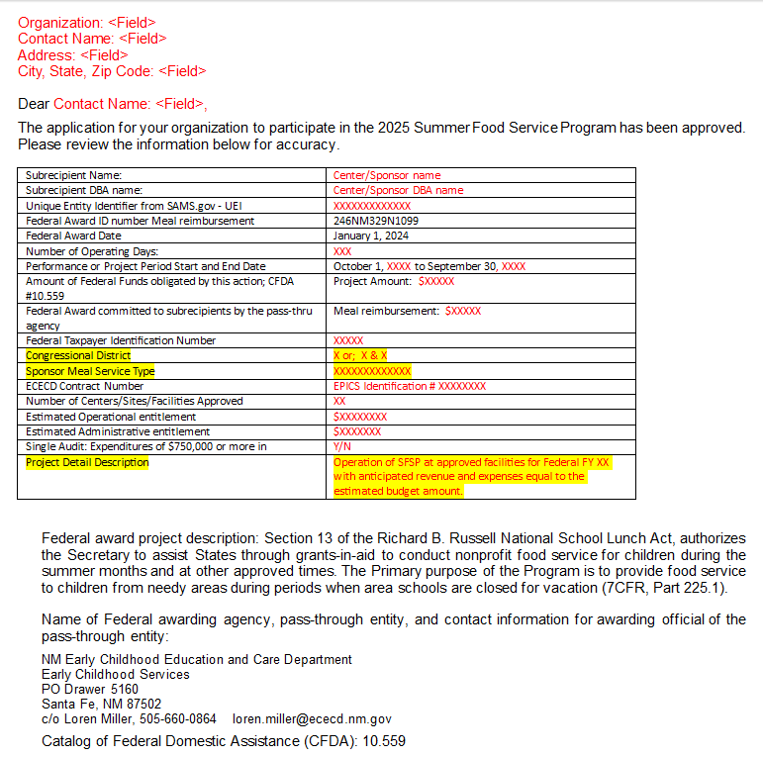
Project Detail Description will be added to the Approval Letter

Slide 9
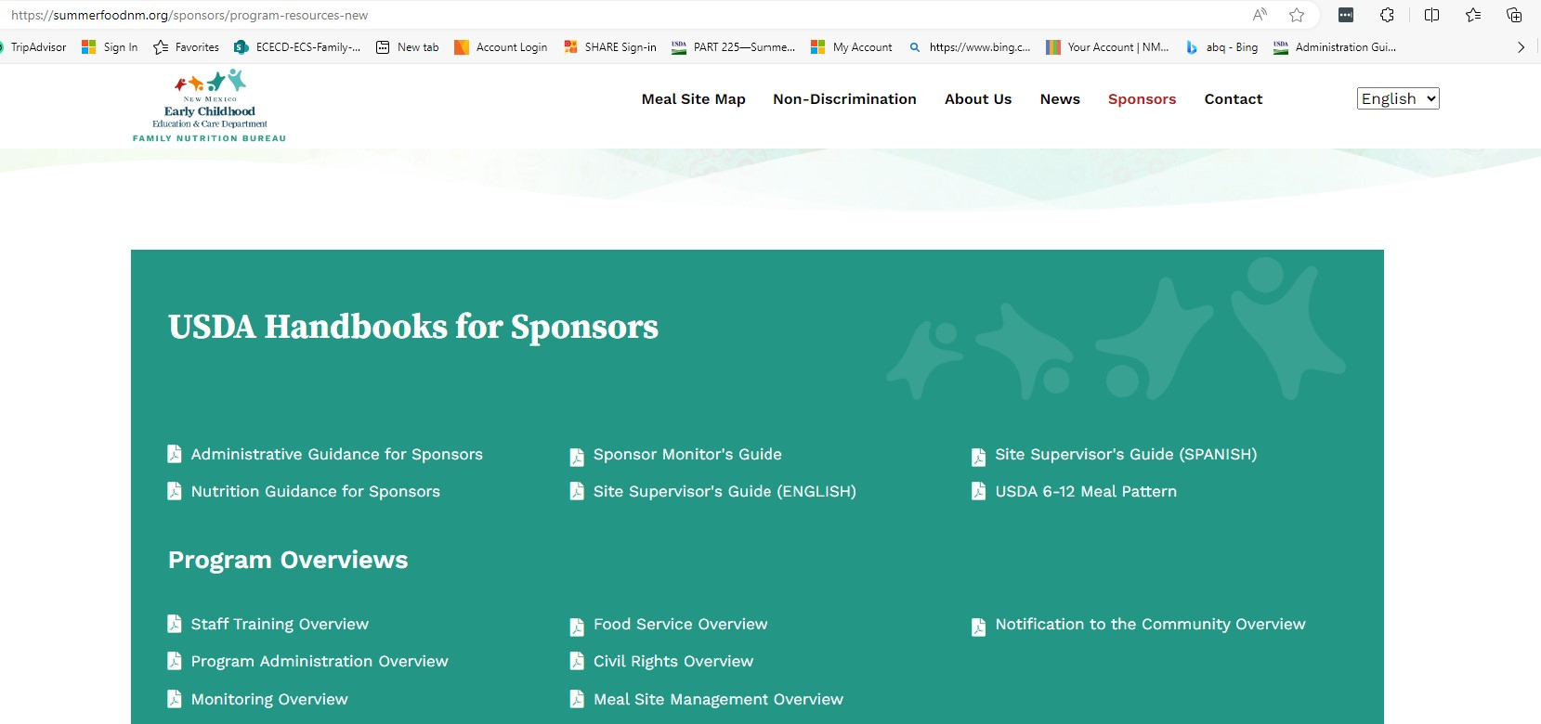
FSP Resources at
summerfoodnm.org/sponsors/program-resources

Slide 10
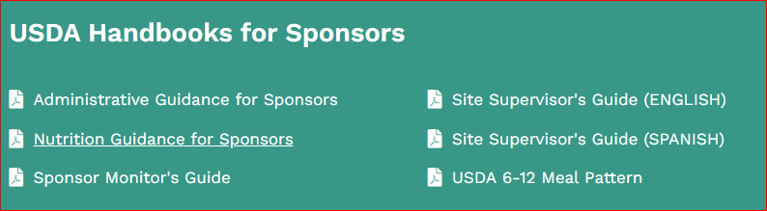
USDA Handbooks

Slide 11
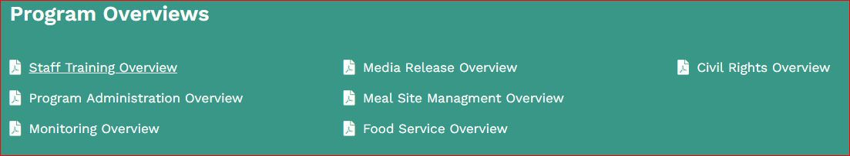
Overviews for Program Requirements

Slide 12
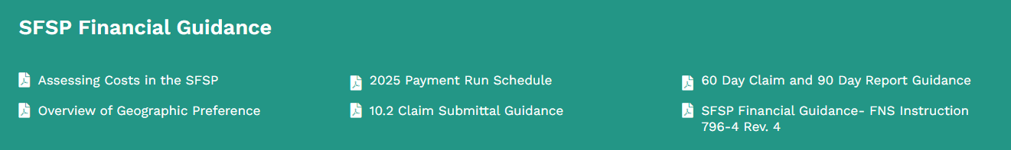
Financial Guidance

Slide 13
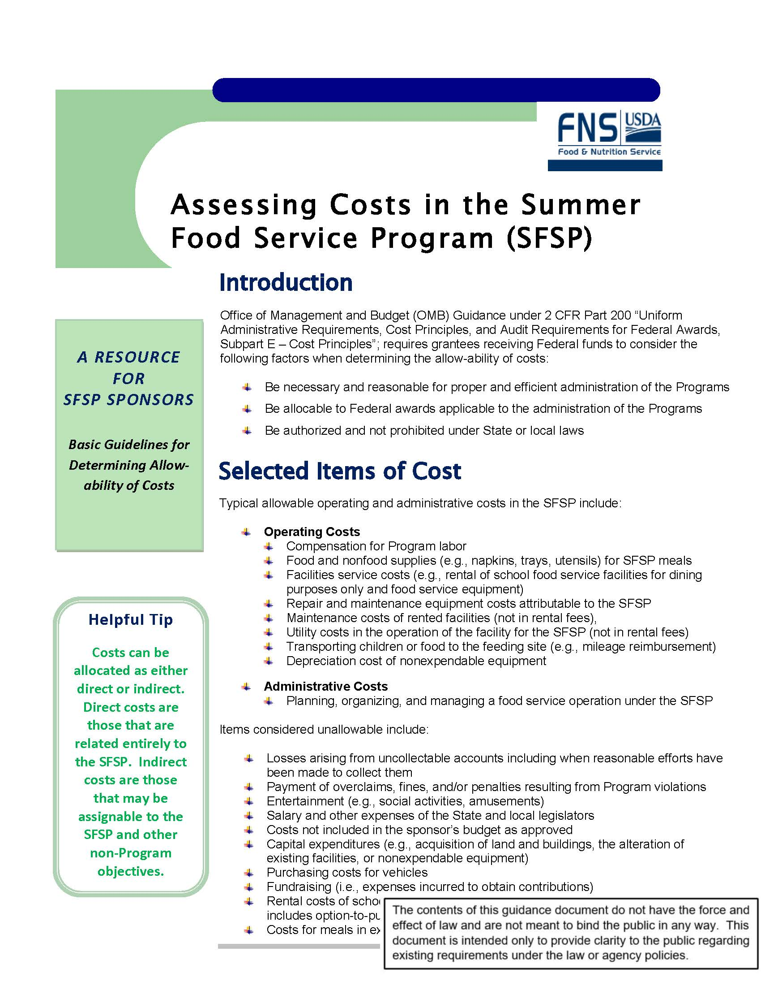
Allowable and Unallowable Costs
https://summerfoodnm.org/uploads/documents/SFSP11-2015a.pdf

Slide 14

USDA Foods

Slide 15
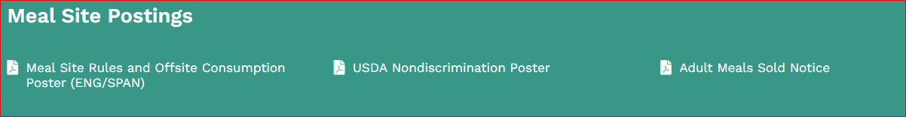
Site Posters

Slide 16
And Justice for All Poster (AJA)
Sponsors
Post at each meal site
Sponsor administrative office

Slide 17


2025 Summer Food
Service Program
Reminders

Slide 18
Permanent Agreement
Outlines SOME of the requirements for Sponsor administration the SFSP
  Train staff
  Submit claims as per regulations
  Maintain a financial system prescribed by SA
  Maintain documentation of site visits and site reviews

Slide 19
Site Capacity Adjustments (CAPS)
Site CAPs must be consistent with current participation trends at sites
  State maintains discretion to lower CAP levels
CAPs can be temporarily adjusted
  Adjust for spikes in participation
  Adjust downward once participation lowers
Meals served over the approved site CAP are not reimbursed if the claim is submitted without first requesting an upward adjustment

Slide 20

2025 Summer Food
Service Program
Updates

Slide 21
DUNS Number will no longer be used by FNB
DUNS number is used to track businesses worldwide and help suppliers and lenders learn about companies
  9-digit number
  Determine reliability and financial stability of companies
  Track Federal funding
  Included in SFSP application
Being replaced with a UEI number from SAMS.gov
  12 character alphanumeric
  Must be included in 2025 SFSP application
  Register for a number on SAM website if you don’t have one
  https://federal.famr.us/system-for-award-management/

Slide 22
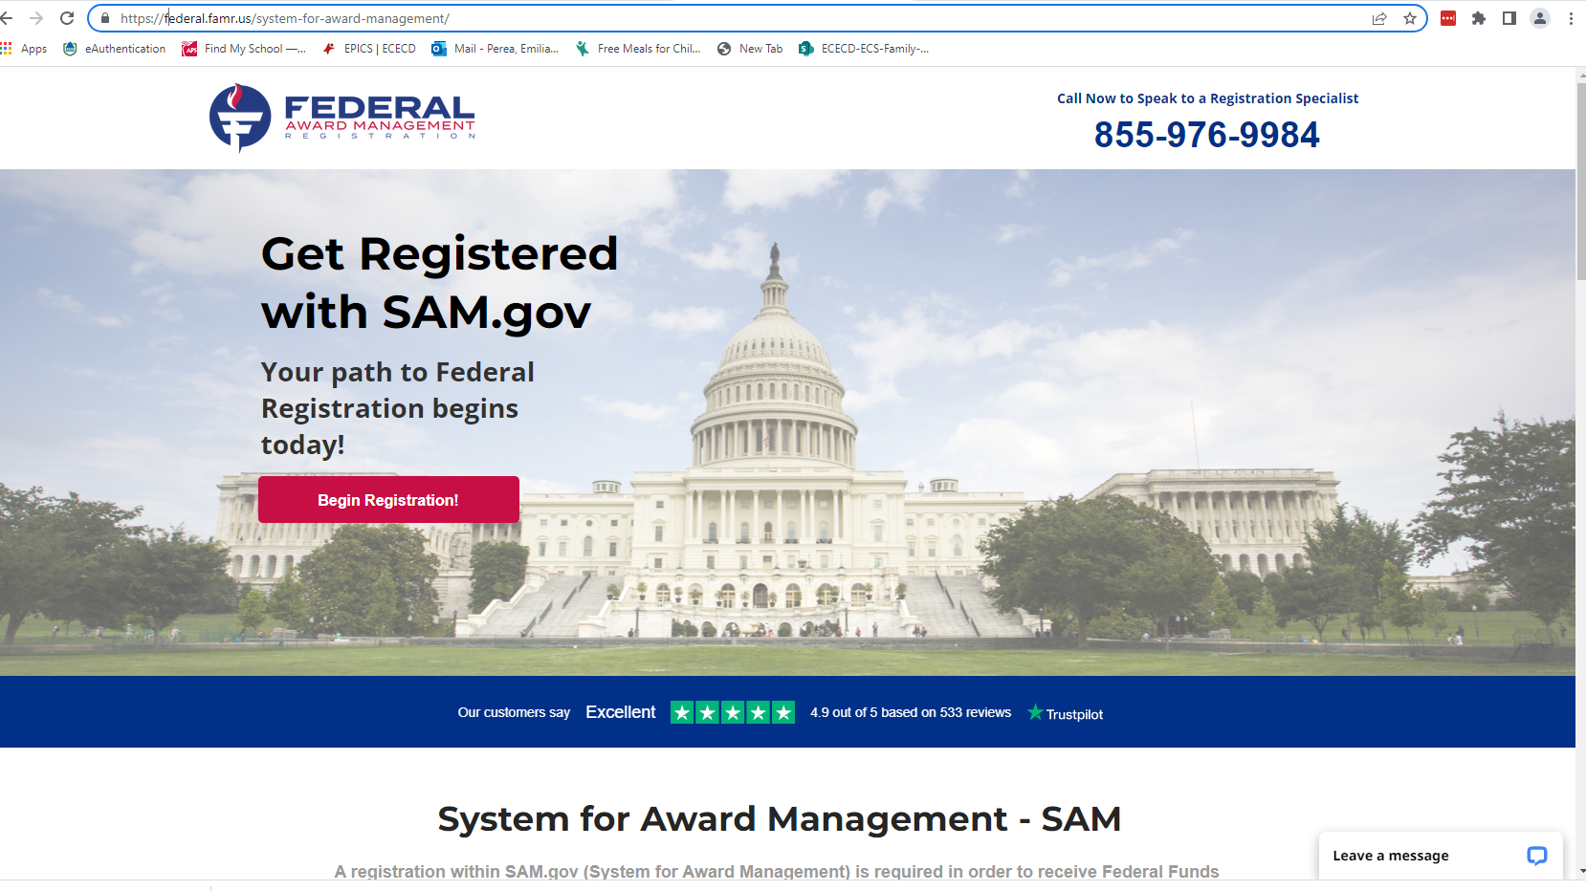

Slide 23
SFSP Non-Congregate Meal Service 2025
Non congregate meals can only be served in rural settings by organizations who are eligible and are in good standing
Sponsors must have policies for Non-congregate meal service in place prior to offering this type of meal service.
Non congregate feeding options:
  Grab & go
  Curbside pick-up
  Bus route meal drop off
  Multiple meals for multiple days
  Home delivery
Parent/Guardian Pick up of meals
Meal service time restrictions
Bulk Food Meals
  Maximum number of meals that could be provided over a 5-calendar day period

Slide 24
Streamlining Requirements and Improving Integrity in the SFSP – Final Rule
Primarily impacts State agencies
Codifies SFSP provisions into regulations previously available through policy only
  Offsite consumption of 1 item from fruit/vegetable component or grains/breads component
  Field trips
  State agency issued media release on behalf of sponsor
Changes rules on 1st monitor visits to sites that switch to non-congregate meal service for sites that are designated as “rural” and new non-congregate meal sites
Simplifies meal service time requirements
Requires sponsors to meet performance standards to participate
  Some sponsors will be required to submit management plans
Other miscellaneous provisions

Slide 25
2025 SFSP Reimbursement Rates
RURAL/SELF-PREP
Breakfast – $3.0875
  9.1% Increase
  11 cents
Lunch - $5.4025
  28.1% Increase
  19 cents
URBAN & VENDED
Breakfast - $3.0300
  8.8% Increase
  11 cents
Lunch - $5.3150
  27.2% Increase
  19 cents

Slide 26

Mileage Rates
Organizational amount recommended
State - $0.70
  4 cents higher
Federal - $0.70
  3 cents higher

Slide 27

2025 Summer Food
Service Program
General
Information

Slide 28
Translation and Interpretation Services
Sponsors are required to provide translation & interpretation services as needed
Need for clear communication with persons with limited English proficiency
Translation may be needed when handling complaints and requests for Program information
State agency resource - Masterword Services, Inc.
Contact the State agency and we can assist.

Slide 29
Health and Environment Inspections
Conducted at the kitchen and meal site levels
ECECD- FNB Contracts with Professional Health Inspectors
  Mr. James Casaus – 505-452-7600
  Mr. Richard (Rick) Abreu – 505-429-1058
They will contact you to arrange a visit and discuss any special circumstances
Part of the administrative review process
Inspectors may ask for corrective action at the time of inspection

Slide 30
EPICS: Sponsor Lessons Learned
Adjust meal service capacities when notified by EPICS – don’t put it off
Double check meal service schedules at the site level
Ensure all your sites are approved
Submit your claims timely

Slide 31


Program Participation and Promotion

Slide 32
SFSP 2025
Summer 2025 | Number/Value
Sponsors | 31
Sites | 406
Meals | 703323
Reimbursement | > $3,221.334.
Notes:
This table shows the number of sponsors, sites and highest ADA for lunch. The state experienced an increase in each of the categories.

Slide 33
Statewide Announcement
Public announcement
  https://www.nmececd.org
  https://www.newmexico.gov
  https://www.summerfoodnm.org

Slide 34


Slide 35

SFSP 04-2011:
Mandatory Outreach for All Sponsors
Schools are required to provide notice to families of the availability of summer meals in the area before the end of every school year
Non-Schools must work with their area school district to provide information to the public about their own meal site locations and times
We will ask you to provide documentation (such as a copy of an email) to show that you have provided information to your school district
Notes:
Let them know that it’s okay if service times, etc. change after telling schools. As long as they get the word to schools, they have done their part.
We will ask sponsors for correspondence with schools. PED will ask schools for mandatory outreach to families.

Slide 36
Claim-Submittal Guidance

Slide 37
2025 Payment Run Schedule
2025

Slide 38

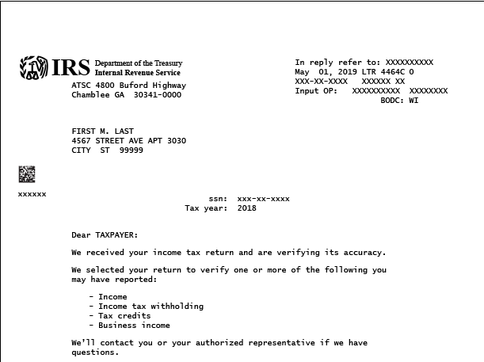
Options
  Manual Check vs. ACH Direct Deposit
  Timeframe Difference
Changes
  Past, Present, Future
  EPICS and SHARE
W9
  ALL Changes
  Be sure all items needed are provided

